Slide 1
Intro. to NoSQL Databases
Peter Mo
Summer 2017

Slide 2
Objectives
Provide an introduction and a conceptual understanding of NoSQL technologies
Understand how various types of data are represented in a NoSQL Environment

Slide 3
Agenda
What is NoSQL?
Why NoSQL?
Common NoSQL Platforms
What is a Document?
JSON
XML
Working with Documents

Slide 4
Evolution of DB Technology
Notes:
Now in 2010s, People are still primarily using Relational Technologies!

Slide 5
What is NoSQL?
A database is an organized collection of data
Many ways to organize data
Relational Technology
Based on Relational Theory (E.F. Codd 1970)
Oracle, MySQL, SQL Server, etc.
Non-Relation (NoSQL) Technologies
There are many types
Document Collections
Graph Nodes and Edges
Key-Value Pairs
Others…
Combinations of various types in a single solution
Notes:
E.F. Codd wrote the paper while working for IBM, but Oracle used it 8 years later.
We will mainly focus on Document and Graph DB, since they are more widely used.

Slide 6
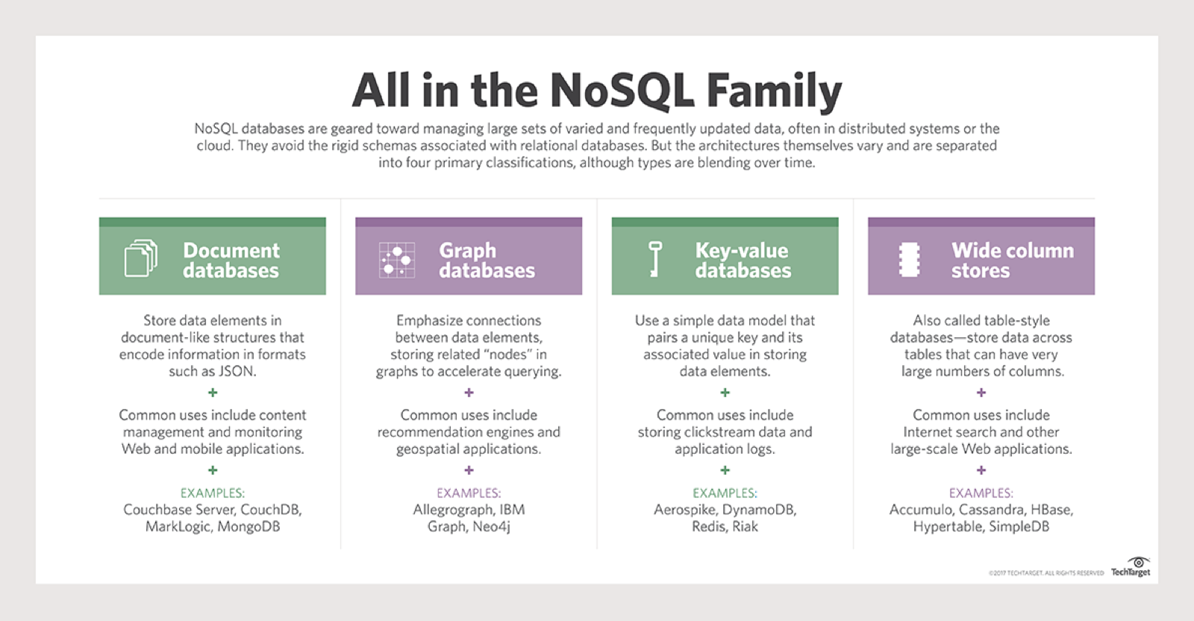
What is NoSQL?
Notes:
Read the Summery Text...
OrientDB attempts to do all of these in one product!
I think these will eventually merge into one product.

Slide 7
Why NoSQL?
Supports polymorphic data types:
Structured, Semi-Structured, Unstructured
Fits well with Agile development
Data Structures may change on-the-fly
Scalability (Big Data Compatible)
Distributed & Parallel Processing
High Performance & Availability
May take advantage of Cloud Computing
Notes:
The slide covers the reasons for using NoSQL! Any other use cases?
https://www.mongodb.com/nosql-explained
Dynamic Schemas
Auto-sharding
Replication
Integrated Caching

Slide 8
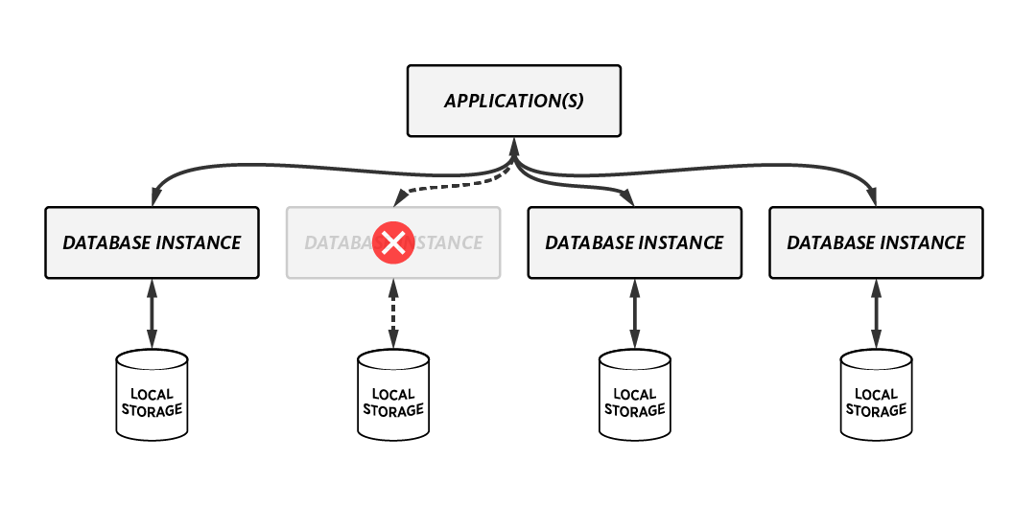
Why NoSQL?
Big Data Features:
High Availability (Auto Fail-Over)
High Performance
Commodity Hardware
May be Local, Remote, or on Cloud
Notes:
NoSQL is designed to work with Big Data Features:
Auto Fail-Over
Auto-Sharding
Replication & High Availability & High Performance Computing
Integrated Caching

Slide 9
NoSQL DB Types
Document:
Usually JSON or XML
Popular Technology/Platform:
MongoDB (BSON=Binary Form of JSON)
BaseX (XML)
Graph:
Popular Technology/Platform:
Neo4j (Cypher Query Language)
OrientDB (SQL)
Notes:
https://db-engines.com/en/ranking/document+store
BSON is a binary representation of JSON documents
http://bsonspec.org provides more data types:
https://docs.mongodb.com/manual/reference/bson-types/
https://db-engines.com/en/ranking/graph+dbms

Slide 10

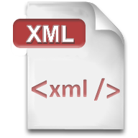
Document Data Types
Designed to Store and Transport Data
Human and Machine Readable
JSON:
JavaScript Object Notation
XML:
Extensible Markup Language
Notes:
We will go over each of these in the following slides…

Slide 11
Document Structure
Do you need document structure?
If you need to compare one document to another, then you need some structure. Otherwise, you may not need document structure.
Common practice to create a minimal set of fields, while you are free to extend to other fields at will in real-time or on-demand.
Relational Databases provide a fairly static structure, while NoSQL provides a flexible structure.
Notes:
I believe more often than not, you would want some kind of document structure.
OrientDB offers "Classes"
MongoDB offers "Schemas"

Slide 12
JSON
Data Format in key-value pairs
{"key" : "value"}
The key is always in double quotes
The value quotes depend on data type
Data Types:
String
E.g. { "stringKey" : "string value in Double quotes" }
Number
Integer or floating point, no quotes
E.g. { "age" : 30.123 }
Boolean
true or false, no quotes
E.g. { "flagField" : true }
Null
E.g. { "dummyField" : null }
Notes:
Only String Data Type Value requires Double Quotes
Date or Time Data Types are NOT supported
Everything is Case Sensitive! True <> true

Slide 13
JSON
How is JSON Data Organized?
Data Structures:
Object { }
An object is an unordered set of key-value pairs
Array [ ]
An array is an ordered collection of values (List)
Data Nesting:
A Value may be an Object or an Array
You can embed Objects inside of Array and vice versa
Notes:
Data Nesting is Supported

Slide 14
JSON Example
Simple
{
"name" : "John",
"age" : 31,
"Birth Place" : "New York"
"alive" : true
"married" : null
}
Notes:
Simple Person Object Example
Watch the Quotes and Case Sensitivity!

Slide 15
JSON Example
Nested
{
"company" : [ "University of Utah", "IHC" ],
"employees" : [ { "firstName":"John", "lastName":"Doe" }, { "firstName":"Anna", "lastName":"Smith" }, { "firstName":"Peter", "lastName":"Jones" } ],
}
Notes:
Array of Strings & Array of Objects

Slide 16
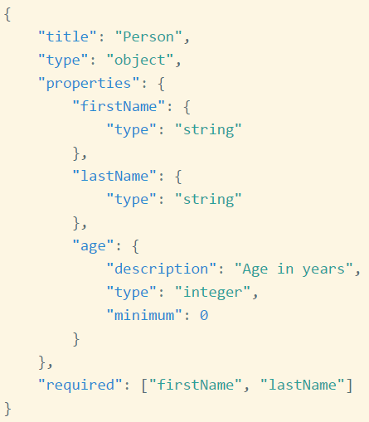
JSON Schema
Validates Structure of JSON (json-schema.org)
Notes:
http://json-schema.org/examples.html
A Developing Standard, not widely used yet.
JSON Fields start within the "properties" key:

Slide 17
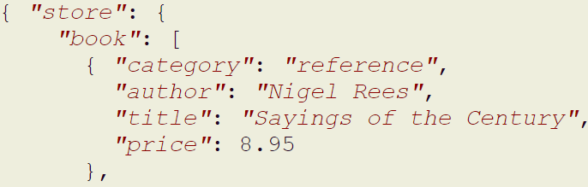
JSON Data Extraction
Extract Data from JSON
Example Books Catalog (Partial Data Shown)
JsonPath to Get Authors of All books
$.store.book[*].author
Notes:
xPath for JSON is called JsonPath
http://goessner.net/articles/JsonPath
-- online examples:
http://jsonpath.com
A Developing Standard, not widely used yet.

Slide 18
JSON Query Language
JSONiq
http://jsoniq.org
This is the equivalent of XQuery for XML, or SQL for Relational Databases
JSONiq also a developing standard (work in progress), not yet widely used.
Notes:
JSONiq leverages JsonPath
http://goessner.net/articles/JsonPath
A Developing Standard, not widely used yet.

Slide 19
Data Comments
JSON does NOT support Comments
Use the data itself to comment things
XML
<!-- XML Comments are like this.
Same as HTML Comments. -->
Notes:
XML also supports XML Attributes <node xmlAttribute="comment">Some Data</node>
XML is more mature than JSON

Slide 20
XML
eXtensible Markup Language
Uses Start and End Tags similar to <html/>
Data Format:
<nodeName>Some Data</nodeName>
Data Types:
Since Element Data does not require quotes, you may treat everything as text.
if using XML Attributes, always use quotes
<nodeName date="2017-07-24">Some Data</nodeName>
Notes:
https://www.w3schools.com/xml/
Attribute Data is best used as Metadata about the Element Data

Slide 21
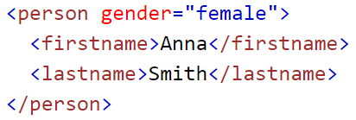
XML Example
Single Person Object
Notes:
Single Entity <person> Example
https://www.w3schools.com/xml/
Attribute Data is best used as Metadata about the Element Data
In this case, I would have used gender as another node, rather than an Attribute.

Slide 22
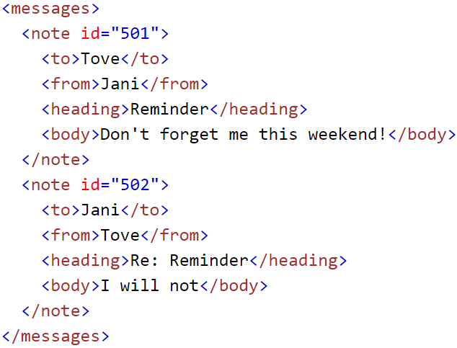
XML Example
Multiple
note
Objects
Notes:
Multiple Entity <note> Example
https://www.w3schools.com/xml/
Attribute Data is best used as Metadata about the Element Data

Slide 23
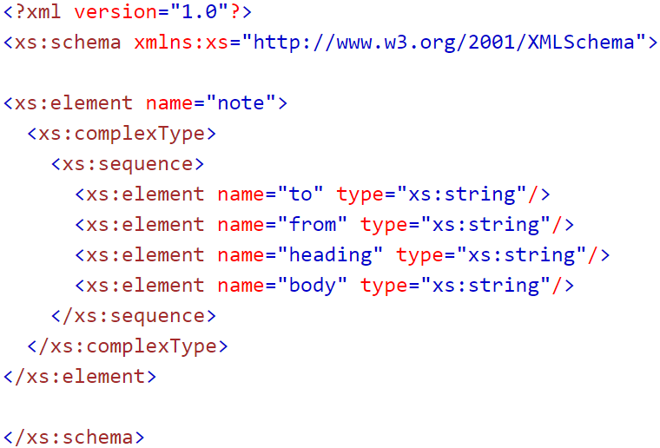
XML Schema
XML Schema Definition (XSD)
Notes:
Defines Valid Structure of the XML Document
https://www.w3schools.com/xml/schema_intro.asp
You can use Java or online tools to validate xml with xml schema.

Slide 24
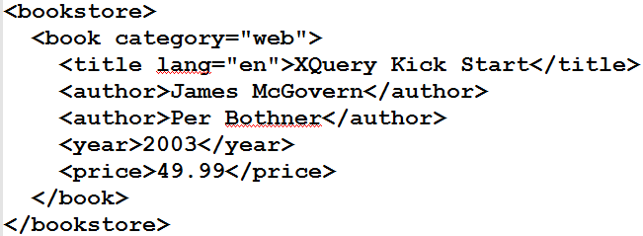
XML Data Extraction
XPath
selects all titles with a price higher than 35
/bookstore/book[price>35]/title
Returns <title lang="en">XQuery Kick Start</title>
Notes:
https://www.w3schools.com/xml/xpath_intro.asp
Returns <title lang="en">XQuery Kick Start</title>
[price>35] is referred to as the Predicate.

Slide 25
XML Query Language
XQuery is a W3C Recommendation
https://www.w3.org/XML/Query
XQuery leverages XPath to Query XML Data
Uses the FLWOR Syntax:
For - selects a sequence of nodes
Let - binds a sequence to a variable
Where - filters the nodes
Order by - sorts the nodes
Return - what to return
Notes:
https://www.w3.org/XML/Query/
https://www.w3schools.com/xml/xquery_intro.asp

Slide 26
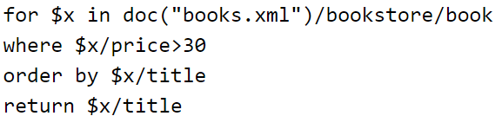
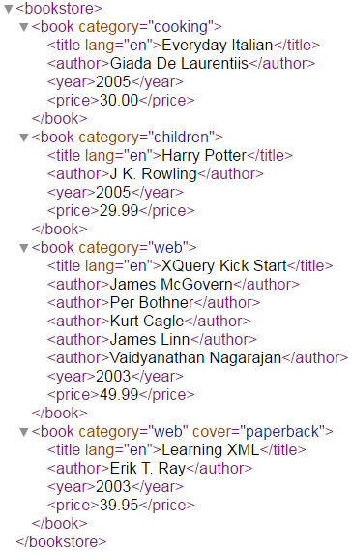
XML Query Language
XQuery Example
Return Book Titles where Price > $30
Results:
Notes:
You can execute XQuery Code in BaseX

Slide 27

Thank You!
Discussion? Questions?

