Slide 1

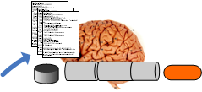
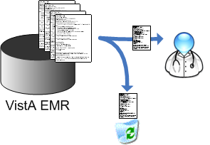
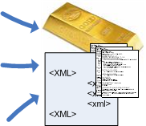

Developing / using NLP is a process
The NLP Process

Slide 2
The NLP Process
Find the right documents

Slide 3
The NLP Process
Create the “gold standard”

Slide 4
Train the system
The NLP Process

Slide 5
The NLP Process
Evaluate the system

Slide 6
Methods of NLP
A number of approaches have evolved
Simple rules-based
Symbolic, grammatical NLP
Machine learning
NLP can be considered a series of transforms
Think “PIPELINE”
6

Slide 7
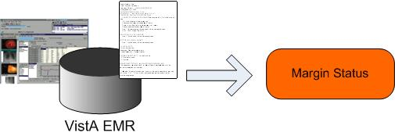
Research Scenario
Positive margins after RRP = 2 x 4 times risk of cancer recurrence
Goal: EXTRACT MARGIN STATUS
7

Slide 8
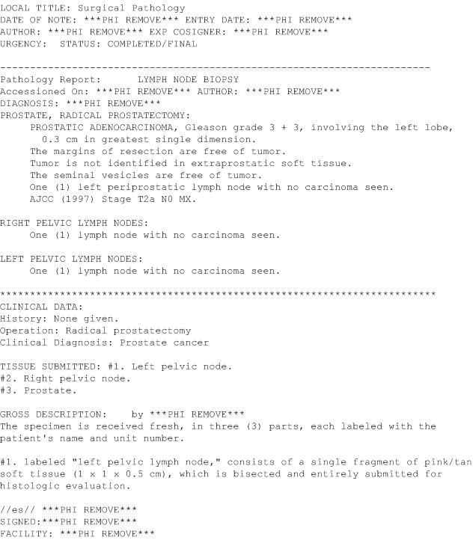
8

Slide 9
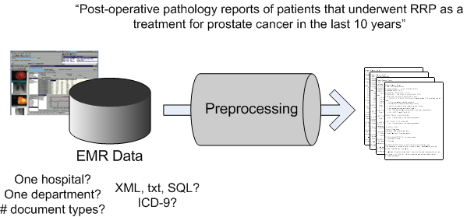
Simple Rules-Based Approach
9

Slide 10
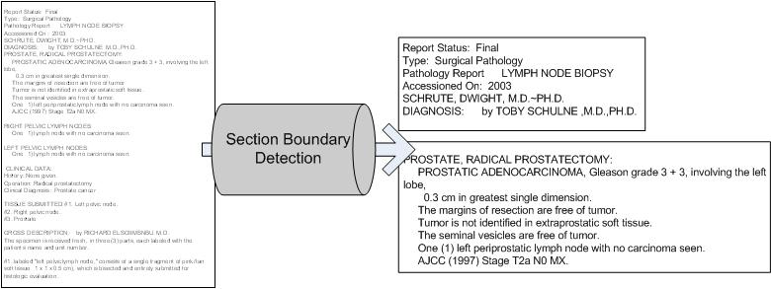
Simple Rules-Based Approach
Heuristics, Probabilities, Combination of the two
10

Slide 11
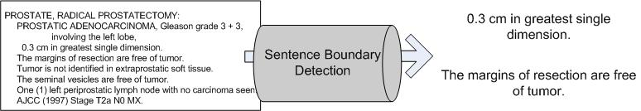
Simple Rules-Based Approach
11

Slide 12
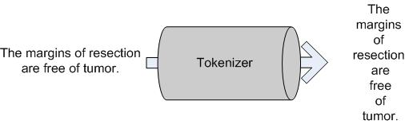
Simple Rules-Based Approach
12

Slide 13
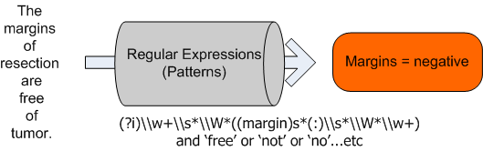
Simple Rules-Based Approach
13

Slide 14
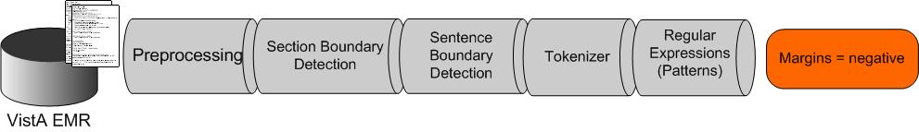
Simple Rules-Based Approach
Pros
Simple
Regular expressions included in many programming languages
Great for semi-structured (consistently formatted) targets
Cons
Patterns must consider all possible configurations.
14

Slide 15
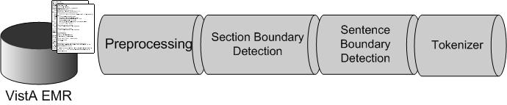
Symbolic or Grammatical NLP Approach
Many of the same components…
…plus…
15

Slide 16
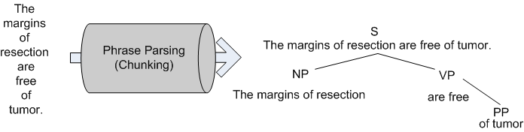
Symbolic or Grammatical NLP Approach
POS tagging & phrase chunking are active areas of research
16

Slide 17
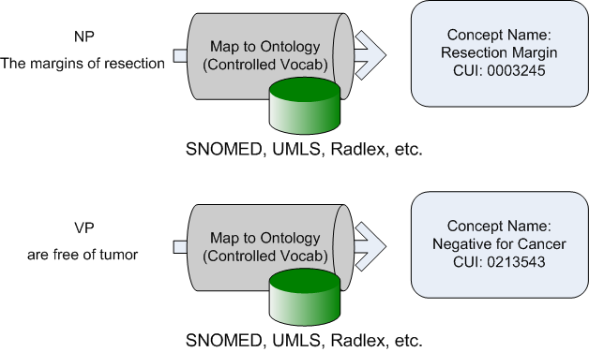
Symbolic or Grammatical NLP Approach
Sometimes called “concept mapping”
17

Slide 18
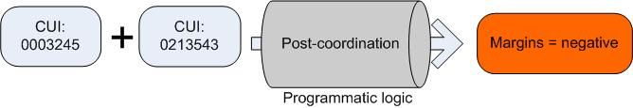
Symbolic or Grammatical NLP Approach
18

Slide 19
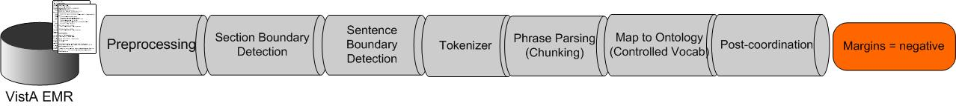
Symbolic or Grammatical NLP Approach
Pros
Robust – reduces complexity by mapping to standard terms
Great for mapping large numbers of concepts
Cons
Complex – more steps, more opportunities to introduce error
Which controlled vocabulary?
Can be slow
19

Slide 20
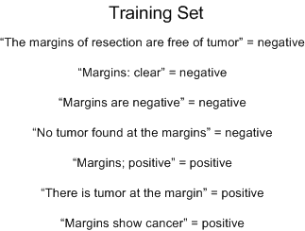
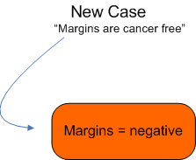
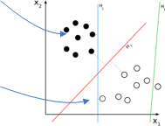
Machine Learning Approach
Classification Model
Several open source ML packages available
(decision trees, SVMs, neural nets)
20

Slide 21
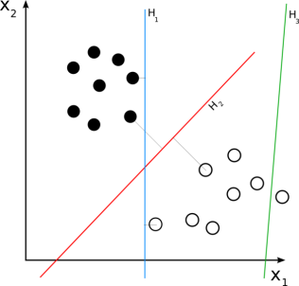
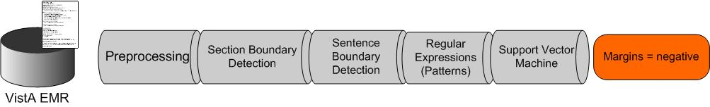
Machine Learning Approach
21

Slide 22
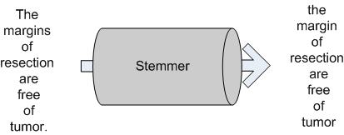
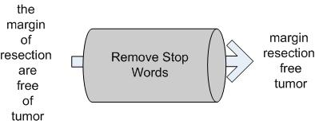
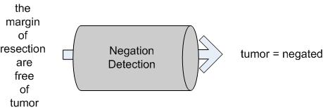
Machine Learning:
Which ‘features’ to learn from?
22

Slide 23
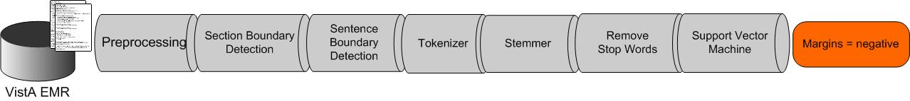
Machine Learning Approach
Pros
Targeted approach = high accuracy
Capable of learning from examples
Great for extracting few predetermined targets
Cons
Requires manual training
New target = new training effort
23

Slide 24
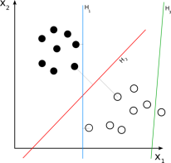
Machine Learning Approach
Not limited to a step in the pipeline
Also used increasingly in POS tagging & mapping to ontologies
24

Slide 25
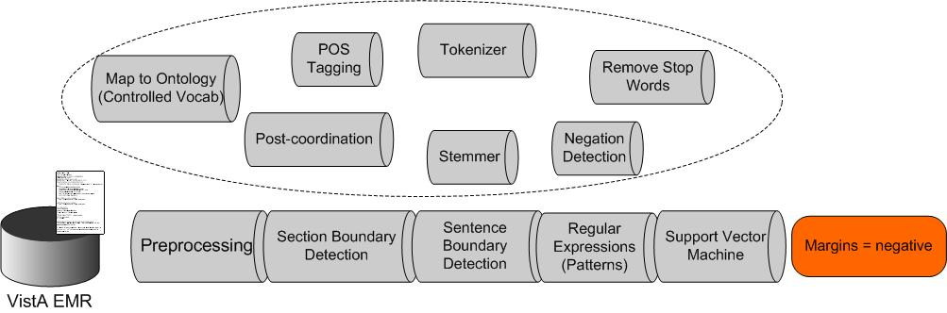

The Hybrid Approach
What if RegExs don’t cut it?
Swap them out for Grammatical NLP approach
25

Slide 26
References
Natural language processing: Manning & Schutze. Foundations of Natural Language Processing. MIT Press. 1999
Regular Expressions: Java Tutorial, http://java.sun.com/docs/books/tutorial/essential/regex/
Machine learning: Witten & Frank. Data Mining, Practical Machine Learning Tools and Techniques with Java Implementations. Academic Press. 2001

