Slide 1
Screen Sharing
OBS Plugins
Advanced Scene Switcher
Move Transition
Advanced Mask
Composite Blur
Stroke, Glow, Shadow
{Scene: “OTS”}
Notes:
Scene ExternalSlide-OTS | Slide 1 note
List 1
The birch canoe slid on the smooth planks.
Glue the sheet to the dark blue background.
It's easy to tell the depth of a well.
These days a chicken leg is a rare dish.
Rice is often served in round bowls.
The juice of lemons makes fine punch.
The box was thrown beside the parked truck.
The hogs were fed chopped corn and garbage.
Four hours of steady work faced us.
A large size in stockings is hard to sell.

Slide 2
Controls
Shapes
7
8
9
+
Zoom
4
5
6
Circle size
-
-
+
1
2
3
Rectangle size
Cursor
0
{NOTES}
{Scene: “FullScreen”}
Notes:
Scene ExternalSlide-Full | Slide 2 NOTE
List 2
[edit]
The boy was there when the sun rose.
A rod is used to catch pink salmon.
The source of the huge river is the clear spring.
Kick the ball straight and follow through.
Help the woman get back to her feet.
A pot of tea helps to pass the evening.
Smoky fires lack flame and heat.
The soft cushion broke the man's fall.
The salt breeze came across from the sea.
The girl at the booth sold fifty bonds.

Slide 3
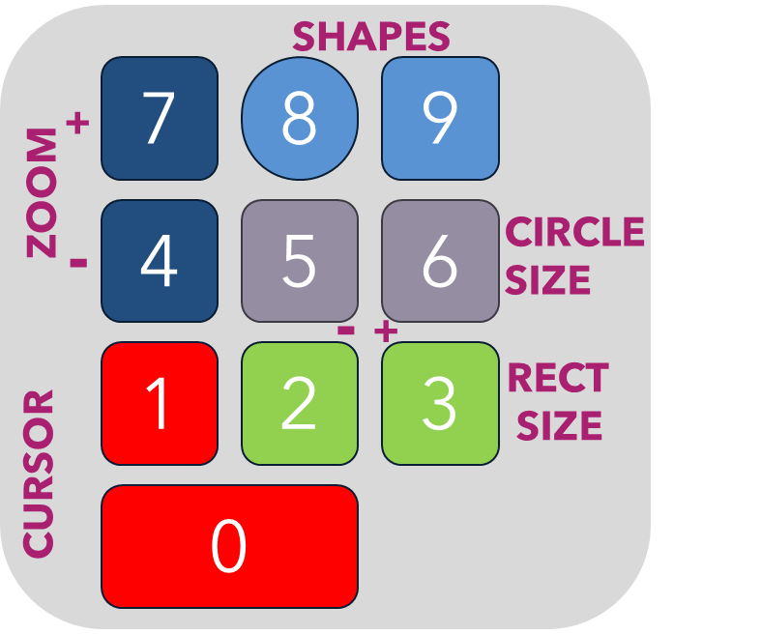
Views
Highlight Region
Region 1
Region 2
Region 3
Region 4
Region 5
Region 6
{NOTES}
{Scene: “OTS”}
Notes:
Scene ExternalSlide-OTS |
List 3
The small pup gnawed a hole in the sock.
The fish twisted and turned on the bent hook.
Press the pants and sew a button on the vest.
The swan dive was far short of perfect.
The beauty of the view stunned the young boy.
Two blue fish swam in the tank.
Her purse was full of useless trash.
The colt reared and threw the tall rider.
It snowed, rained, and hailed the same morning.
Read verse out loud for pleasure.

Slide 4
Views
Zoom In Region
Region 1
Region 3
Region 2
Region 4
Region 5
Region 6

Slide 5
Views
Follow Cursor
Cursor Position

Slide 6
PROBLEM
MARKET GAP
COSTS
Few, if any, products on the market help customers like we do
Loss of productivity costing consumers thousands of dollars
CUSTOMERS
USABILITY
66% of US consumers spend money on multiple products that only partially resolves their issue
Customers want something easy to use that helps make their life easier
FINANCIALS
Millennials account for about a quarter of the $48 billion spent on other products in 2018

Slide 7
SOLUTION
CLOSE THE GAP
COST SAVINGS
Our product makes consumer lives easier, and no other product on the market offers the same features
Reduce expenses for replacement products
TARGET AUDIENCE
EASY TO USE
Gen Z (18-25 years old)
Simple design that gives customers the targeted information they need

Slide 8
PRODUCT OVERVIEW
UNIQUE
TESTED
Only product specifically dedicated to this niche market
Conducted testing with college students in the area
FIRST TO MARKET
AUTHENTIC
First beautifully designed product that's both stylish and functional
Designed with the help and input of experts in the field

Slide 9
PRODUCT BENEFITS
Cool and stylish product
Areas for community connections
Online store and market swap

Slide 10
COMPANY OVERVIEW

Slide 11



BUSINESS MODEL
RESEARCH
ABSTRACT
DESIGN
We based our research on market trends and social media
We believe people need more products specifically dedicated to this niche market
Minimalist and easy to use

Slide 12
MARKET OVERVIEW
$3B
$2B
$1B
Opportunity to build
Fully inclusive market
Total addressable market
Freedom to invent
Selectively inclusive market
Serviceable available market
Few competitors
Specifically targeted market
Serviceable obtainable market

Slide 13
MARKET COMPARISON
$3B
Opportunity to build + addressable market
$2B
Freedom to invent + serviceable market
$1B
Few competitors + obtainable market

Slide 14
OUR COMPETITION
CONTOSO
COMPETITORS
Our product is priced below that of other companies on the market
Design is simple and easy to use, compared to the complex designs of the competitors
Affordability is the main draw for our consumers to our product
Company A
Product is more expensive
Companies B & C
Product is expensive and inconvenient to use
Companies D & E
Product is affordable, but inconvenient to use

Slide 15
OUR COMPETITION GRAPHIC
CONTOSO
A
CONVENIENT
EXPENSIVE
AFFORDABLE
D
C
E
INCONVENIENT
B

Slide 16
GROWTH STRATEGY
How we’ll scale in the future
PHASE 1: FEB 20XX
Roll out product to high profile or top-level participants to help establish the product
PHASE 2: MAY 20XX
Release of the product to the general public and monitor press release and social media accounts
PHASE 3: OCT 20XX
Gather feedback and adjust product design as necessary

Slide 17
TWO YEAR ACTION PLAN
Draft blueprints
Run focus group
Gather feedback
Feb 20XX
May 20XX
Oct 20XX
20XX
JAN
FEB
MAR
APR
MAY
JUN
JUL
AUG
SEP
OCT
NOV
DEC
20XX
JAN
FEB
MAR
APR
MAY
JUN
JUL
AUG
SEP
OCT
NOV
DEC
Test design
Launch design
Deliver to client
Feb 20XX
July 20XX
Dec 20XX

Slide 18
FINANCIALS
 | Year 1 | Year 2 | Year 3
INCOME
Users | 50,000 | 400,000 | 1,600,000
Sales | 500,000 | 4,000,000 | 16,000,000
Average price per sale | 75 | 80 | 90
Revenue @ 15% | 5,625,000 | 48,000,000 | 216,000,000
Gross profit | 5,625,000 | 48,000,000 | 216,000,000
EXPENSES
Sales & marketing | 5,062,500 | 38,400,000 | 151,200,000 | 70%
Customer service | 1,687,500 | 9,600,000 | 21,600,000 | 10%
Product development | 562,500 | 2,400,000 | 10,800,000 | 5%
Research | 281,250 | 2,400,000 | 4,320,000 | 2%
Total expenses | 7,593,750 | 52,800,000 | 187,920,000

Slide 19




MEET THE TEAM
Takuma Hayashi
Mirjam Nilsson
Flora Berggren
Rajesh Santoshi
President
Chief Executive Officer
Chief Operations Officer
VP Marketing

Slide 20








MEET THE TEAM
Takuma Hayashi
Mirjam Nilsson
Flora Berggren
Rajesh Santoshi
President
Chief Executive Officer
Chief Operations Officer
VP Marketing
Graham Barnes
Rowan Murphy
Elizabeth Moore
Robin Kline
VP Product
SEO Strategist
Product Designer
Content Developer

Slide 21
SUMMARY
At Contoso, we believe in giving 110%. By using our next-generation data architecture, we help organizations virtually manage agile workflows. We thrive because of our market knowledge and great team behind our product. As our CEO says, "Efficiencies will come from proactively transforming how we do business."

Slide 22
THANK YOU
Mirjam Nilsson
206-555-0146
mirjam@contoso.com
www.contoso.com

