Slide 1

Hoof ‘N’ Woof Horse Show Administration Program
Shannon Darroch, Lalita Mallapragada, Shivani Nathan, Gina Pappagallo, Rhea Prahlad, Tarun Saharya, Anna Wu
Notes:
Gina

Slide 2
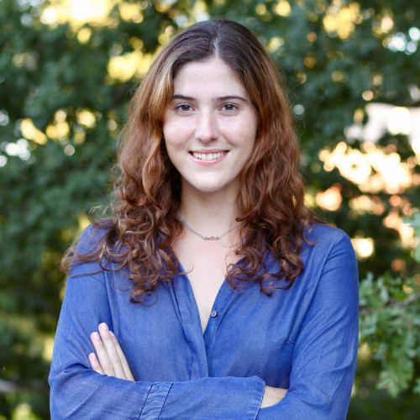
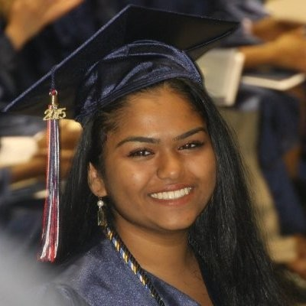
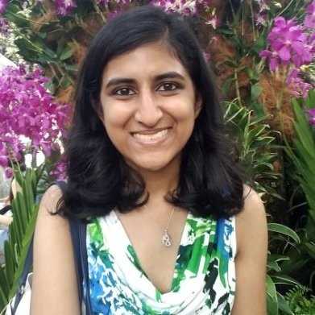
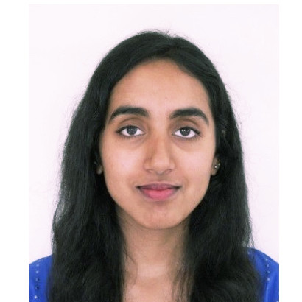
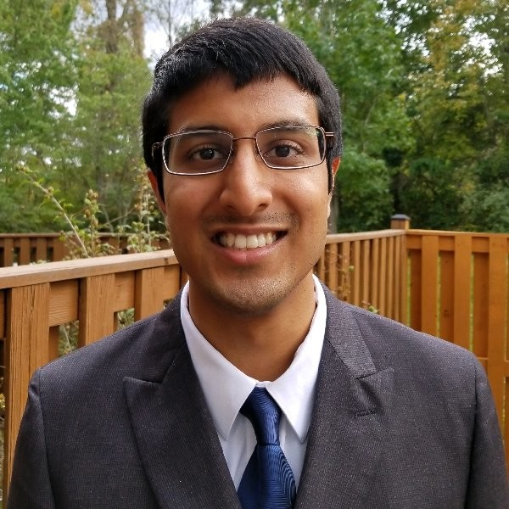

The Team
Notes:
Gina

Slide 3
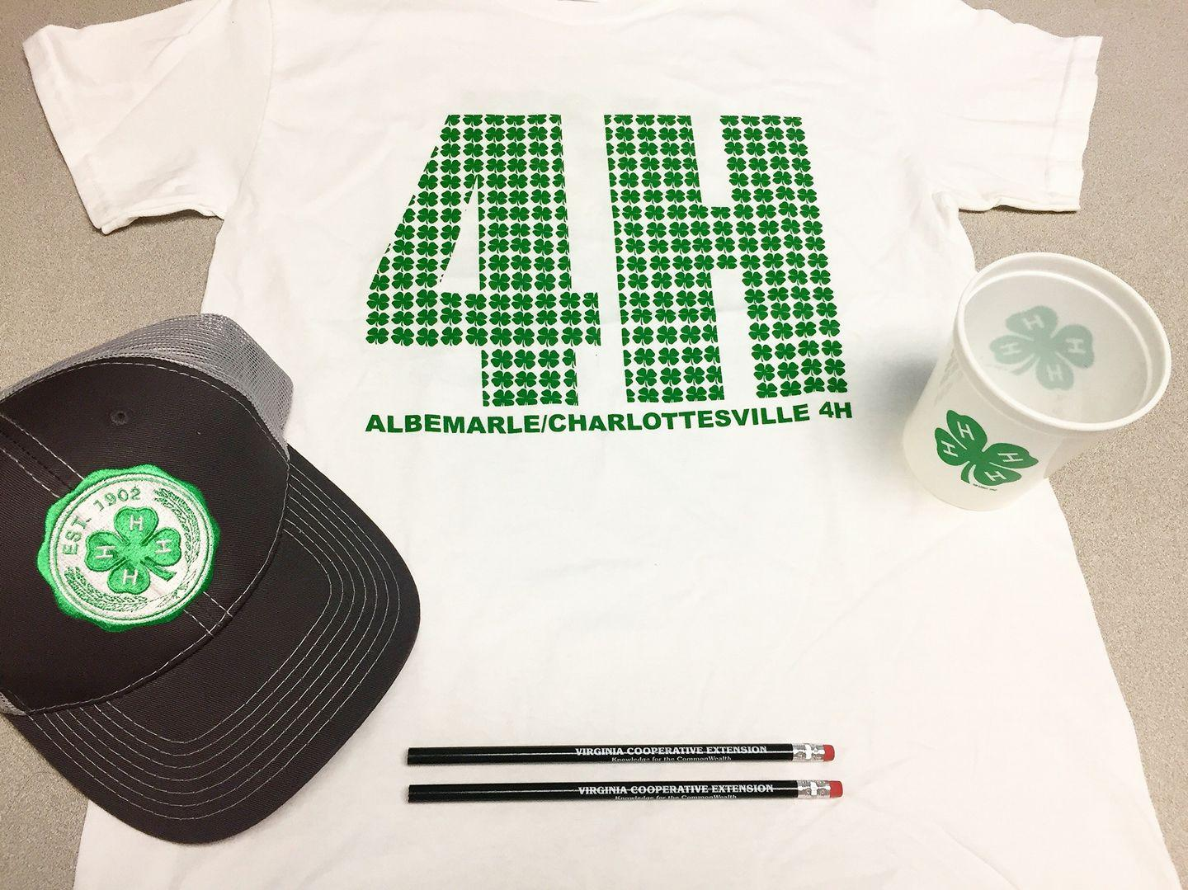
Hoof-N-Woof 4-H Club
Notes:
Gina

Slide 4
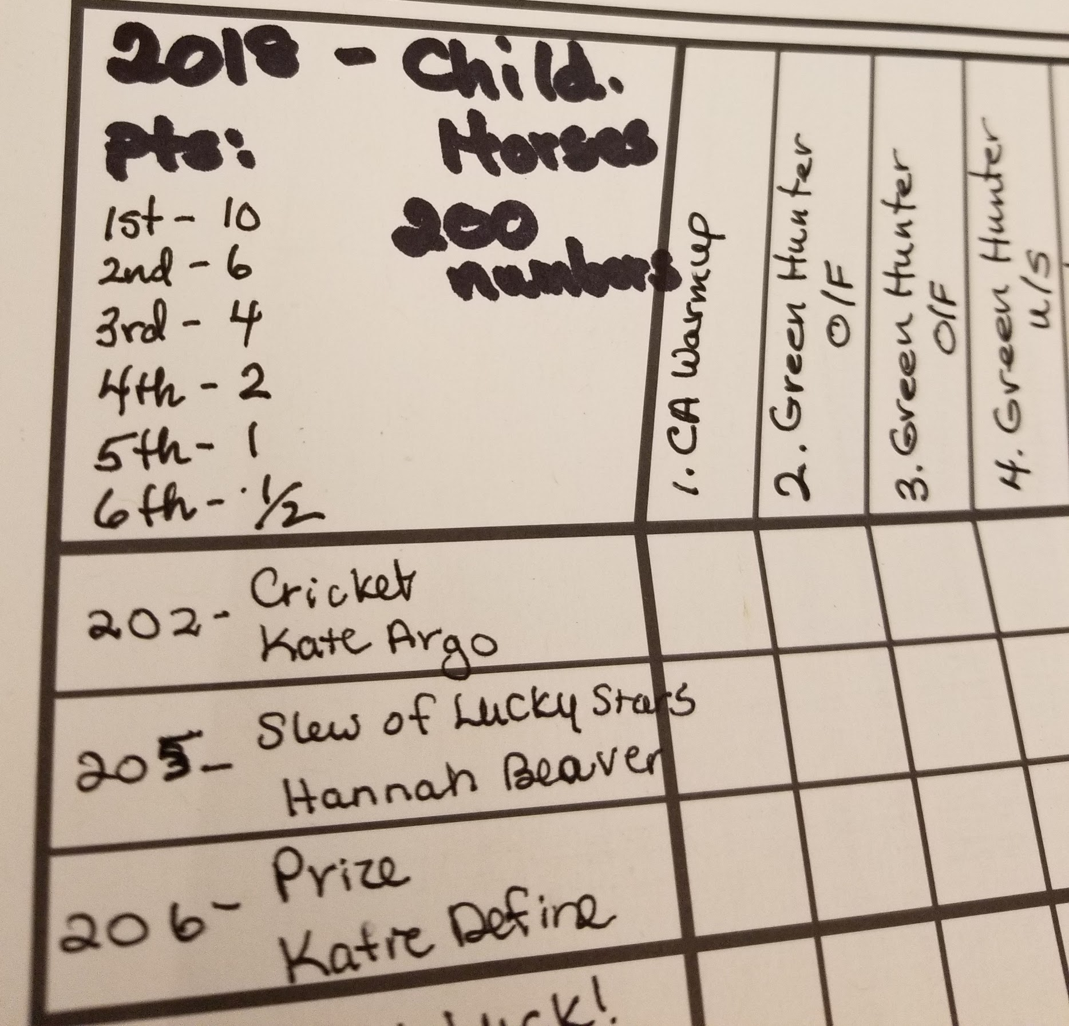
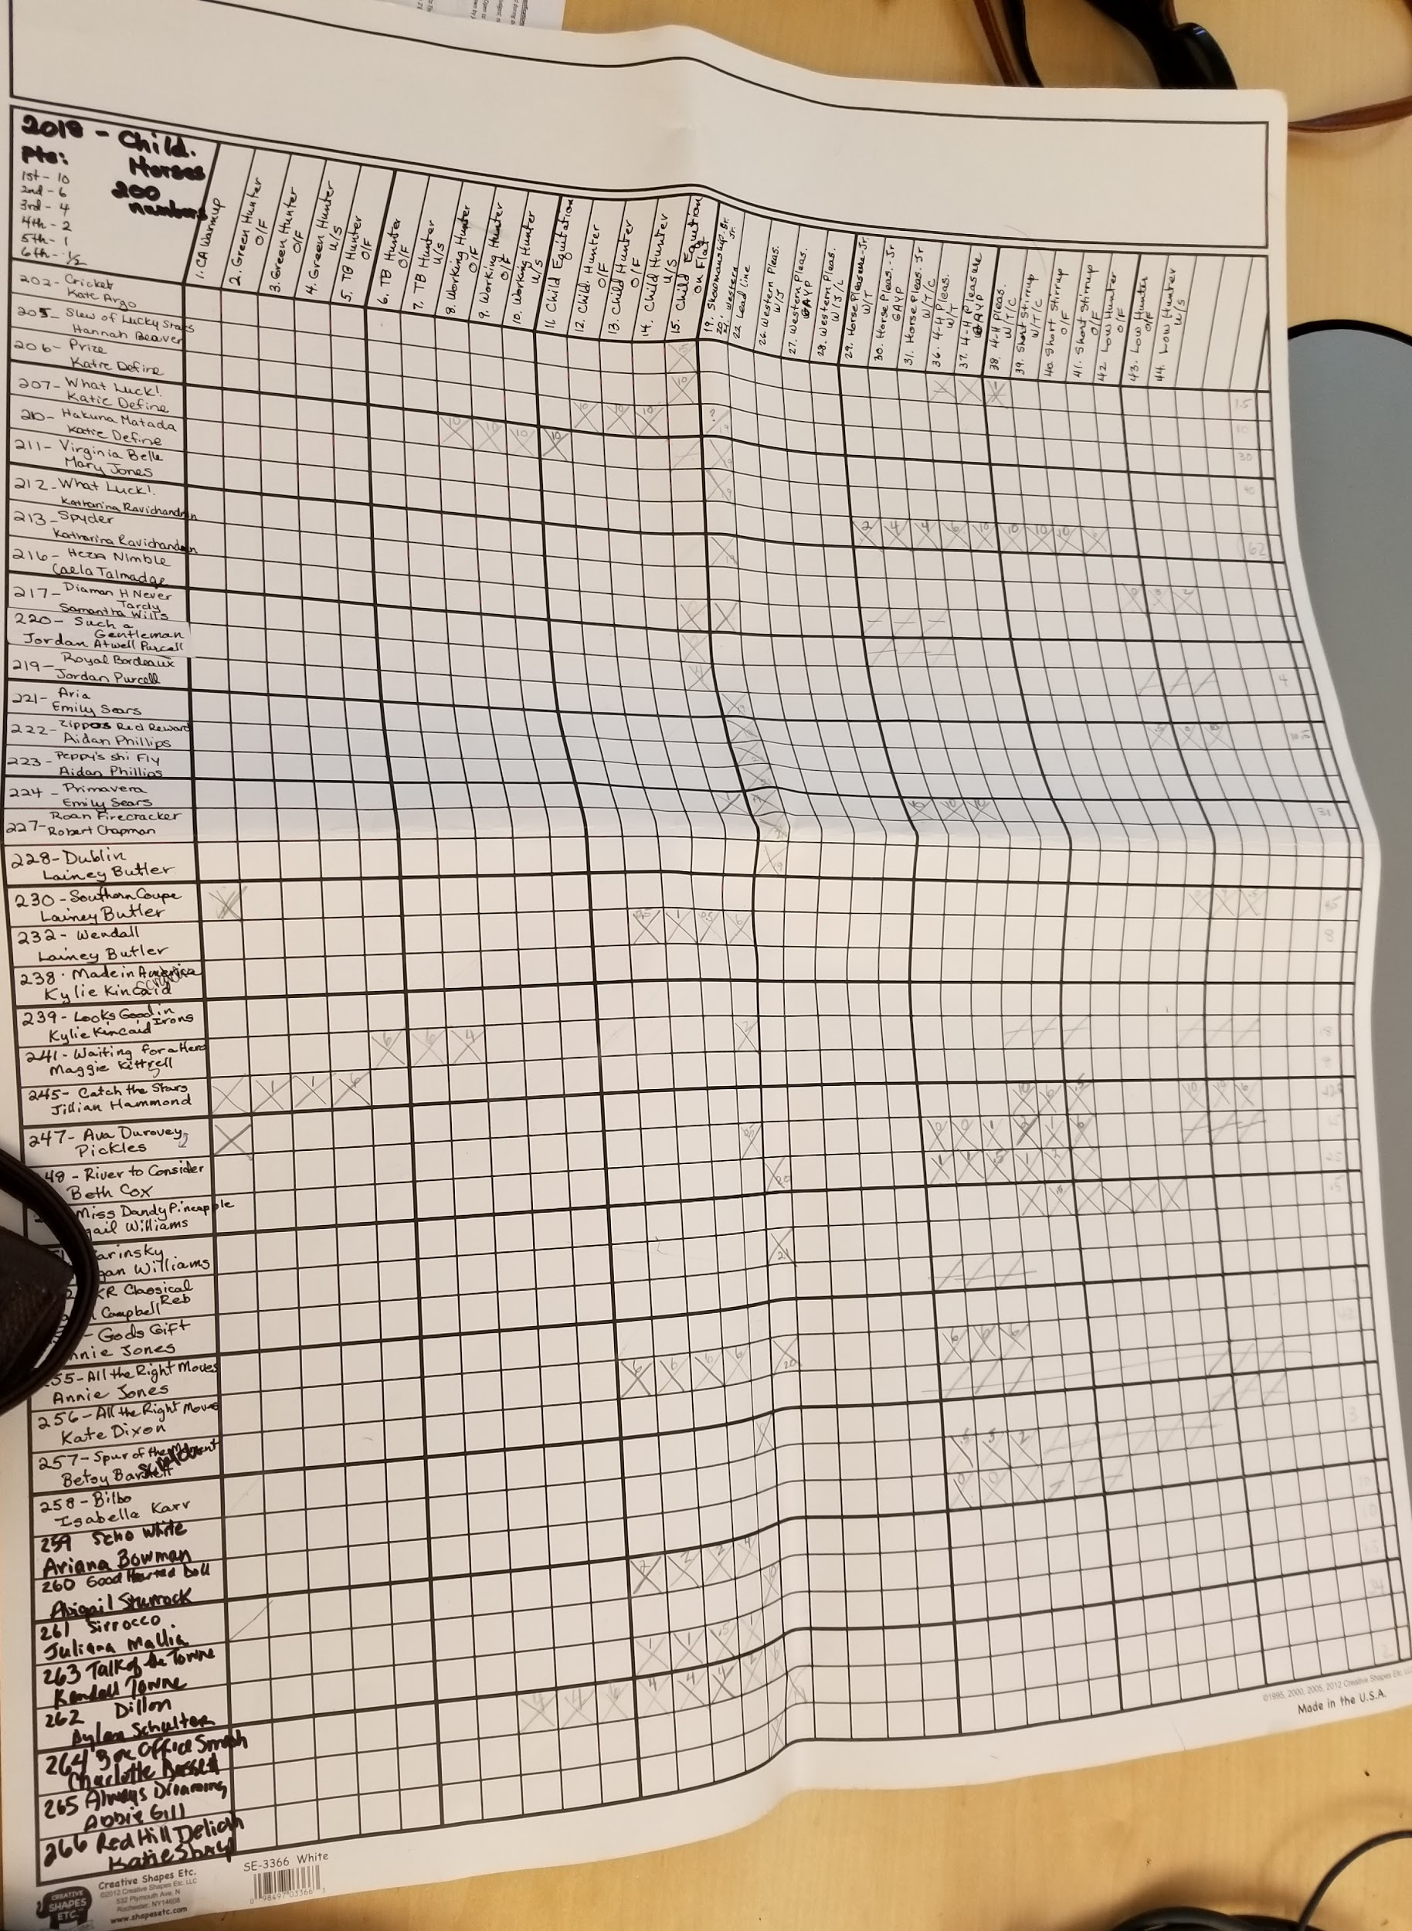
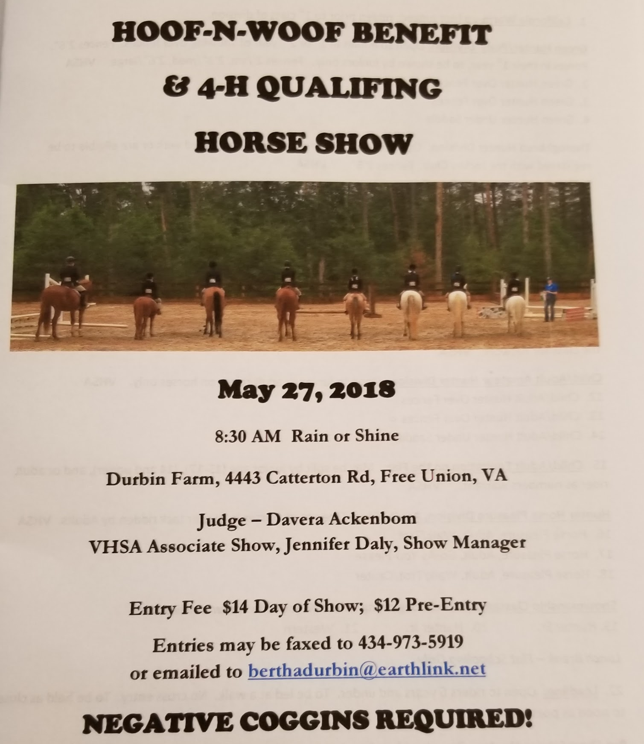
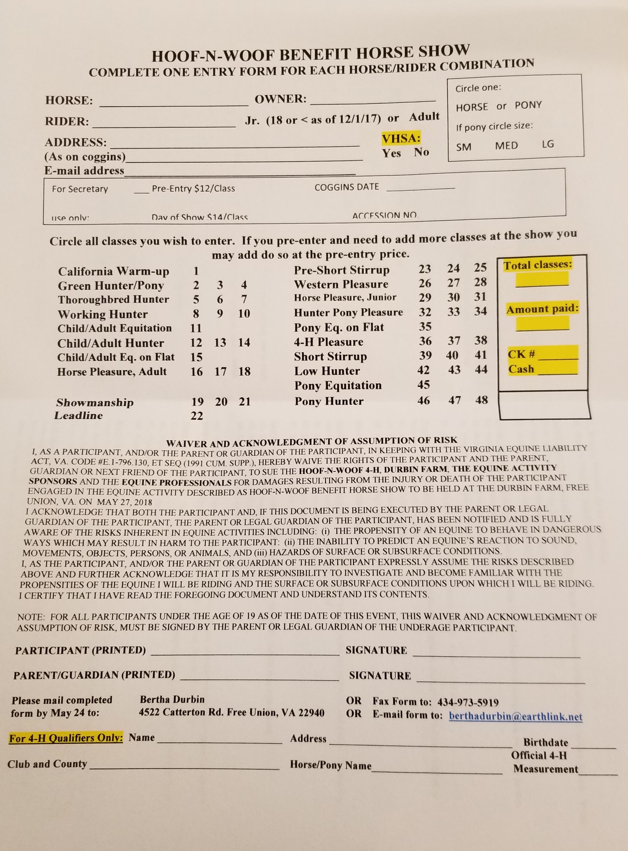
Our Project
Notes:
Shannon

Slide 5
Overview of Requirements
Organize relationships between horses, riders, shows, divisions, combos, and classes
Add/Edit/Delete Models as needed
Bill a horse-rider combination
Organize and publish reports for 4-H and VHSA
Create easy navigation for users with limited experience with technology
Score classes and rank the Division Champion and Reserve Champion
Print labels for the combos registered in the Show
Notes:
Shannon

Slide 6




Frameworks & Technologies Used
Python 3
Pdfrw
Crispy_forms
Pyabel
ReportLab
Xlutils
Django 2.1
Bootstrap
Git
Travis CI
Notes:
Lalita

Slide 7
Significant Requirements Changes
Printing a table of all the 4H horse-rider combinations
The preregistration status is specified for each combo instead of each added class to a combo
Adjusting certain model or form fields (e.g. making Horse’s accession number alphanumeric instead of just numeric)
Making the billing a combo page the same as the combo detail page
Notes:
Rhea

Slide 8
What Worked Well
Pair Programming
Frequent client communication to better understand requirements
Shifting tasks based on who finished what or who was more eager to do
Online communication (Slack)
Scheduling meetings
Getting along
Notes:
Rhea

Slide 9
Demo

Slide 10
Difficulties
Migration issues
Synchronization
Travis CI and Unit Tests
Using unfamiliar frameworks
Working on the same features
Adapting to changing customer requirements
Understanding the navigation and terminology of horse shows
Notes:
Anna

Slide 11
Overcoming Obstacles
Pair Programming
Frequently pushing code
Using Trello to organize and coordinate work
Pushing significant changes to a fork of master branch before directly merging
Swarming on unfinished sections
Debugging why Travis CI failed
Cleaning user stories & defining minimum requirements carefully
Notes:
Gina

Slide 12
Future Work
Extending scoring capabilities
Print Horse Show Program
Online registration
Hosting other types of shows
Making the web pages more dynamic and responsive
Adding icons to buttons
Improved navigation
Notes:
Shivani

Slide 13
Acknowledgements
We would like to thank our client, the Hoof-N-Woof 4-H administration, particularly Bertha Durbin and Rebecca Adams who met with us on a bi-weekly basis to work with us on refining the requirements, clarifying horse show terminologies and rules, testing the application features and providing valuable feedback during the design process. Their cooperation and support along the way was crucial to the final outcome of our horse show administration application.
Notes:
Shivani

Slide 14
Questions?
Notes:
Lalita

Slide 15
http://bit.ly/2Kn31uH

