Slide 1

IMPACT OF AN ELECTRONIC HEALTH RECORD–INTEGRATED MULTIDISCIPLINARY FOOT WOUND PATHWAY IN THE EMERGENCY DEPARTMENT
Jackson Agraz, Pavel Chernyavsky, Genesis Gilliard, Moira Smith, Noel Mukubwa, Joshua Eby, Caroline Tippett, Robert Becker, Daniel Wolfe, Sarah Wendel

Slide 2
I have nothing to disclose.
I have no conflicts of interest.

Slide 3
Background
Burden
ED Challenges
Impact
1.6M US patients/year
High infection + amputation risks
Complex
Multidisciplinary
Variable care
Delays
Increased LOS
High cost
Creates an opportunity for standardization at the point of ED decision-making

Slide 4
Evaluate whether a standardized limb preservation pathway reduces:
Emergency department and hospital LOS
Objective
Specialty consultation patterns
Utilization of MRI

Slide 5
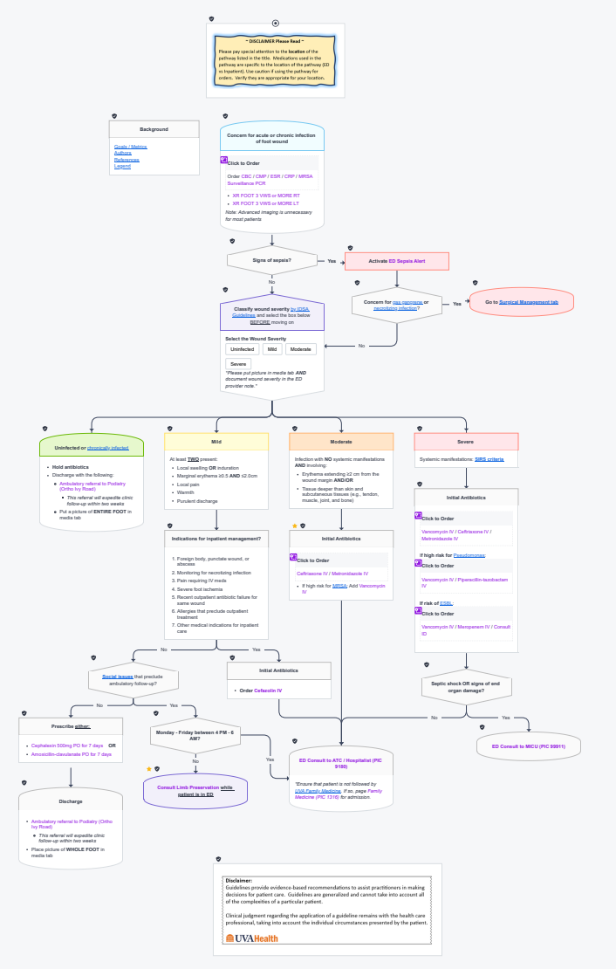
What is the Limb Preservation Pathway?
Clinical decision support
Standardized:
Diagnostic evaluation
Disposition
Early subspecialty involvement
Later integrated into the EHR

Slide 6

Patient encounters from the University fo Virginia Emergency Department (~75,000 ED annual visits)
Adults ≥ 18 years
Chief complaint of:
foot wounds
diabetic foot care
lower extremity infections
skin ulcers
other wound-related presentations
ICD-10 related to foot infections AND chief complaint. match
Exclusions: LWBS, missing coding match
Study Design and Population
Pre pathway
June - May 2024
Paper pathway
June - December 2024
1,287 total eligible encounters
702 encounters were admitted
EHR- integrated pathway
January - September 2025
Notes:
ICD 10 codes and CC match after discharge allowed to avoid the traumatic patient presentations to only include foot wound path

Slide 7
Study Outcomes
Primary | Secondary
Hospital LOS Admission rates ED LOS | MRI utilization Consultation patterns Limb preservation service Orthopedic surgery

Slide 8
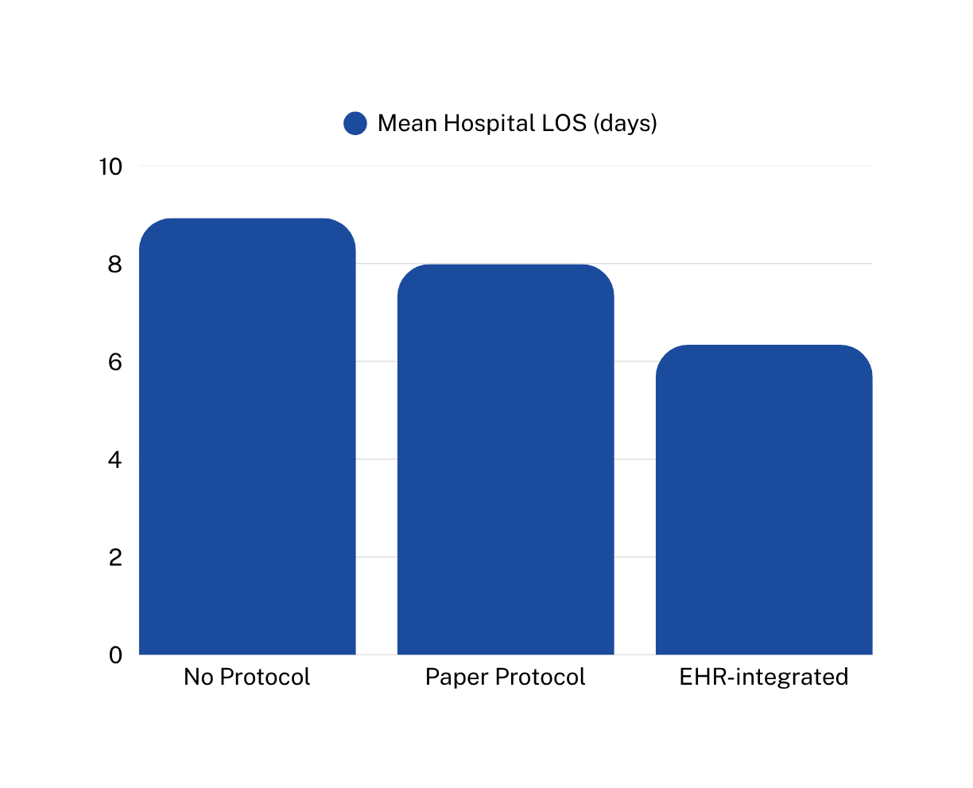
Results - Hospital LOS
No Protocol:
Mean LOS = 8.93 days
SD = 8.87
Paper Protocol:
Mean LOS = 7.99 days
SD = 10.3
EHR-integrated:
Mean LOS = 6.34 days
SD = 5.33
LOS decreased overall by ~2.6 days after the EHR integrated pathway was implemented
Notes:
The standard deviation reflects variability in the patient's LOS. The ones that are relatively large indicate a wider range of hospital courses which is expected in a population like this (mild infection = shorter days more severe/surgical need = longer stays). However the variability appears to be lower in the EHR phase of implementation, which might suggest more standardization in patient care.

Slide 9
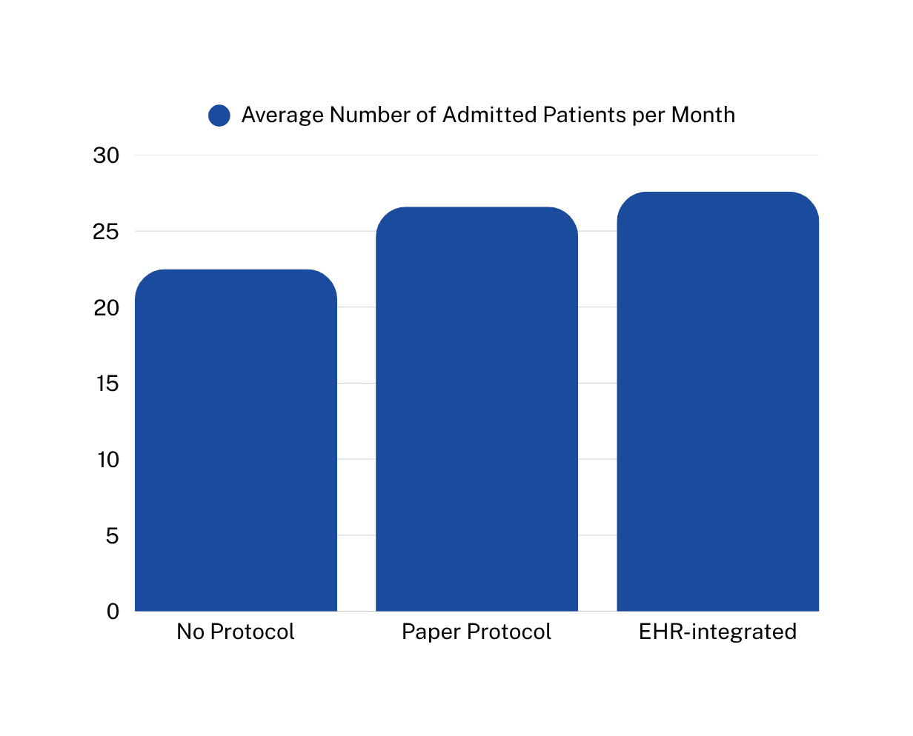
Results - Admission Rates
No Protocol:
270 admitted Patients
12 month period
Average = 22.5 patients/month
Paper Protocol:
239 admitted patients
9 month period
Average = 26.6 patients/month
EHR-integrated:
193 admitted patients
7 month period
Average = 27.6 patients/month

Slide 10
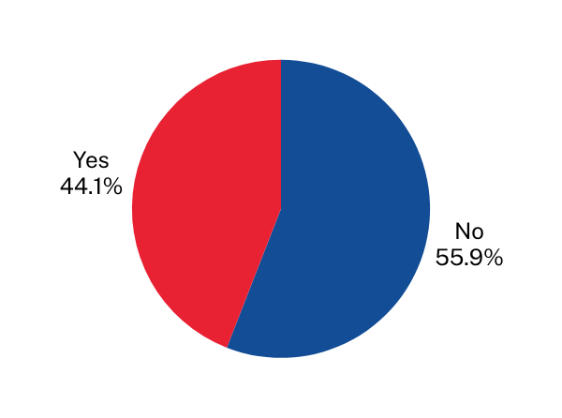
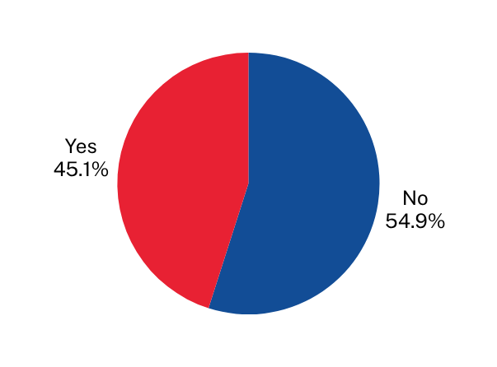
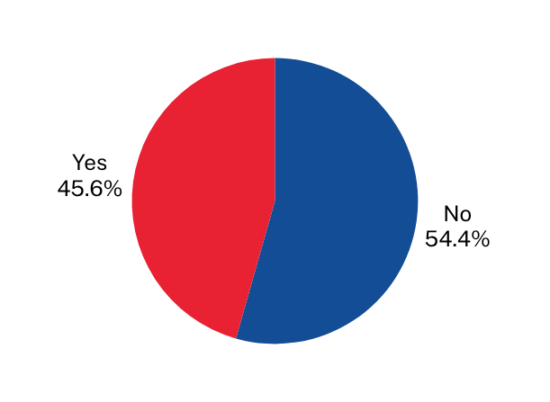
No Protocol
Paper Protocol
EHR-integrated
Results - Imaging
MRI Obtained: Yes = 119 patients (44.1%) No = 151 patients (55.9%)
MRI Obtained: Yes = 87 patients (45.1%) No = 106 patients (54.9%)
MRI Obtained: Yes = 109 patients (44.9%) No = 130 patients (55.1%)
No changes to image ordering practices throughout pathway implementation
Notes:
The standard deviation reflects variability in the patient's LOS. The ones that are relatively large indicate a wider range of hospital courses which is expected in a population like this (mild infection = shorter days more severe/surgical need = longer stays). However the variability appears to be lower in the EHR phase of implementation, which might suggest more standardization in patient care.

Slide 11
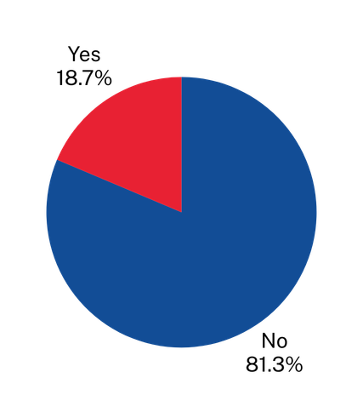
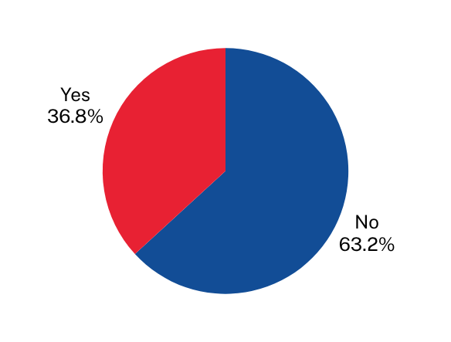
Results - Limb Preservation Consults
Was the Limb Preservation Consult used during patient care?
No Protocol
Paper Protocol
EHR-integrated
Limb preservation consultation service was not established during this phase
Yes - 36 patients (18.7%) No = 157 patients (81.3%)
Yes - 88 patients (36.8%) No = 151 patients (63.2%)

Slide 12
The Limb Preservation Pathway:
Decreased hospital LOS
Key Findings
Unchanged admission rates and ED LOS
No changes in MRI ordering practice
Increased limb preservation consultations

Slide 13
Why Did Hospital LOS Improve?
Improvements to:
Diagnostic evaluation
Standardized early decision-making
Early specialty involvement
Streamlined disposition pathways

Slide 14
Why This Matters
Impact of the Pathway
Reduction in hospital resource burden
Improves ED throughput
Standardizes complex wound care
Scalable CDS model for other conditions

Slide 15
Limitations
Single-center academic ED
ICD-10 + chief complaint identification bias
Concurrent expansion of limb preservation service
Lack of patient-centered outcomes (amputation, readmission, etc.)

Slide 16
The EHR-integrated pathway was associated with reduced hospital LOS and improved multidisciplinary coordination without increasing resource utilization
Conclusions
Embedded CDS tools for provider workflows can meaningfully improve complex care delivery

Slide 17
Thank you!
Questions?

