Slide 1
The decision Making system based on human rhythm detection
Runze Yan

Slide 2
Introduction
Circadian rhythms: circadian rhythms are physical, mental, and behavioral changes that follow a daily cycle (24h).
Circadian rhythms can influence sleep-wake cycles, hormone release, eating habits and digestion, body temperature, and other important bodily functions. Irregular rhythms have been linked to various chronic health conditions, such as sleep disorders, obesity, diabetes, depression, bipolar disorder, and seasonal affective disorder.
External environment can affect normal rhythms like working pressure, jet lag.
The goal of the decision making system is to help people quickly recover from these negative effects of external influence, and keep healthy status.
We use smart wearable devices to record human physiological data to detect the periods of human circadian rhythms.

Slide 3
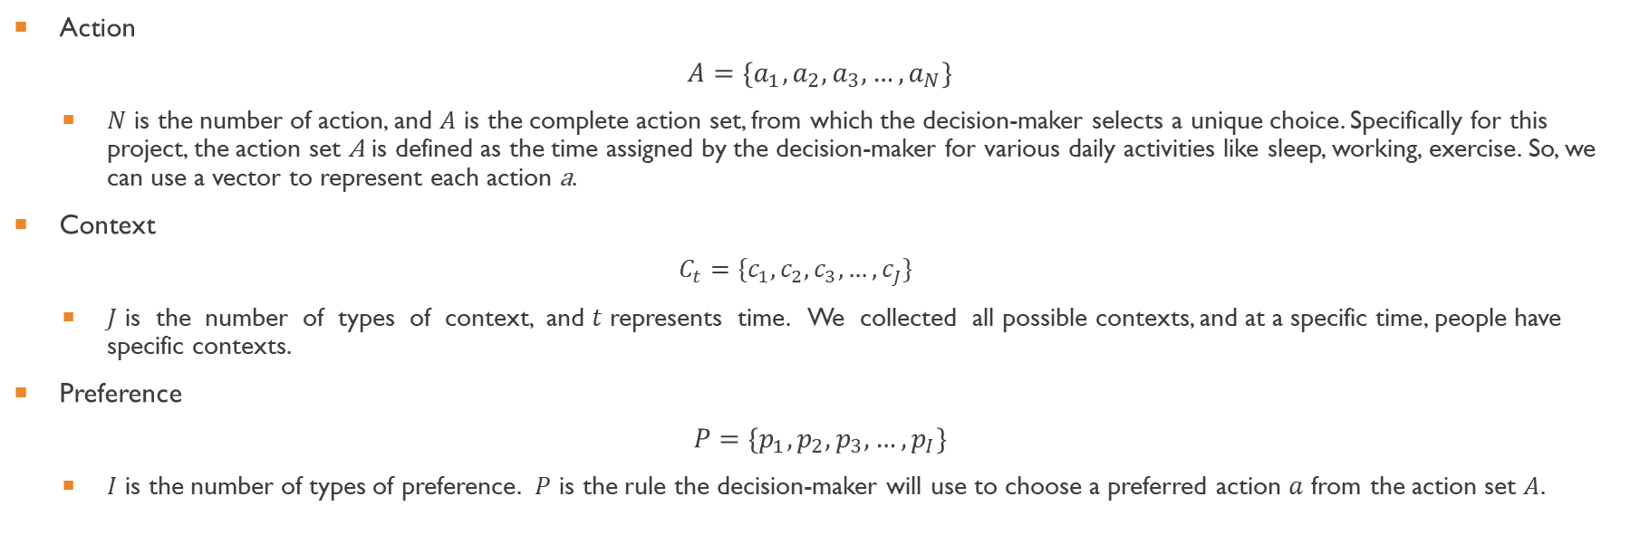
Predefined setting
Action
$$A=\{a_{1},a_{2},a_{3},…,a_{N}\}$$
$N$ is the number of action, and $A$ is the complete action set, from which the decision-maker selects a unique choice. Specifically for this project, the action set A is defined as the time assigned by the decision-maker for various daily activities like sleep, working, exercise. So, we can use a vector to represent each action a.
Context
$$C_{t}=\{c_{1},c_{2},c_{3},…,c_{J}\}$$
$J$ is the number of types of context, and $t$ represents time. We collected all possible contexts, and at a specific time, people have specific contexts.
Preference
$$P=\{p_{1},p_{2},p_{3},…,p_{I}\}$$
$I$ is the number of types of preference. $P$ is the rule the decision-maker will use to choose a preferred action $a$ from the action set $A$.

Slide 4
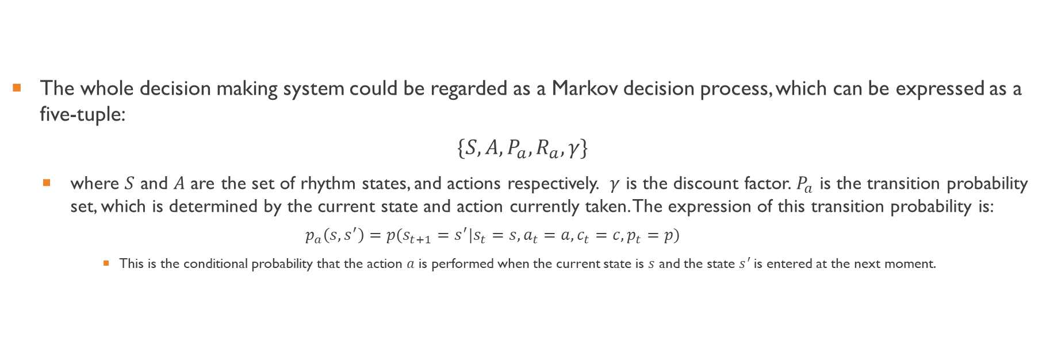
Markov decision process (MDP)
The whole decision making system could be regarded as a Markov decision process, which can be expressed as a five-tuple:
$$\{S,A,P_{a},R_{a},γ\}$$
where $S$ and $A$ are the set of rhythm states, and actions respectively. $γ$ is the discount factor. $P_{a}$ is the transition probability set, which is determined by the current state and action currently taken. The expression of this transition probability is:
$$p_{a}\left(s,s^{′}\right)=p(s_{t+1}=s^{′}|s_{t}=s,a_{t}=a,c_{t}=c,p_{t}=p)$$
This is the conditional probability that the action $a$ is performed when the current state is $s$ and the state $s^{′}$is entered at the next moment.
Notes:
It describes the probability from the current state s to the next state s’ when taking action a. This formula also take accounts the context and preference at state s.

Slide 5
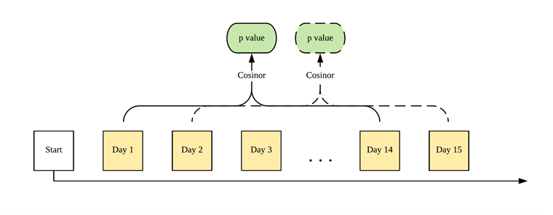
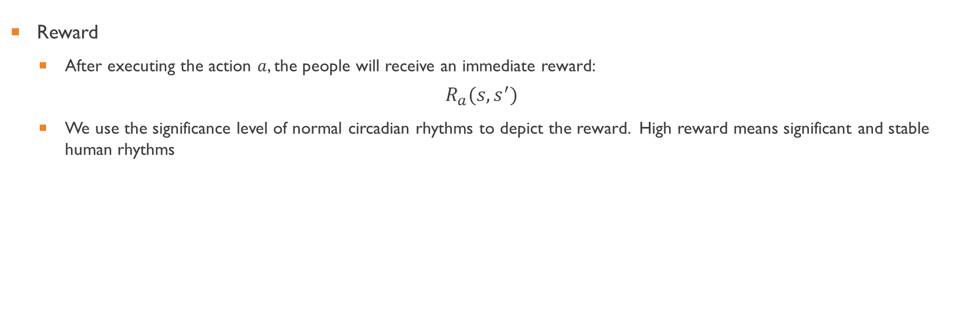
Reward
Reward
After executing the action $a$, the people will receive an immediate reward:
$$R_{a}(s,s^{′})$$
We use the significance level of normal circadian rhythms to depict the reward. High reward means significant and stable human rhythms
Notes:
Cosinor is an human rhythm detection algorithm. We input the physiological data, it can output the significant level of circadian rhythms. Since rhythm detection needs time long enough data, so I choose to use time window, and the size of the time window is set to two weeks. In this way, the high reward means significant and stable human rhythms. It is the reward at time t, and for the next time t+1, we move the time window forward one day.

Slide 6
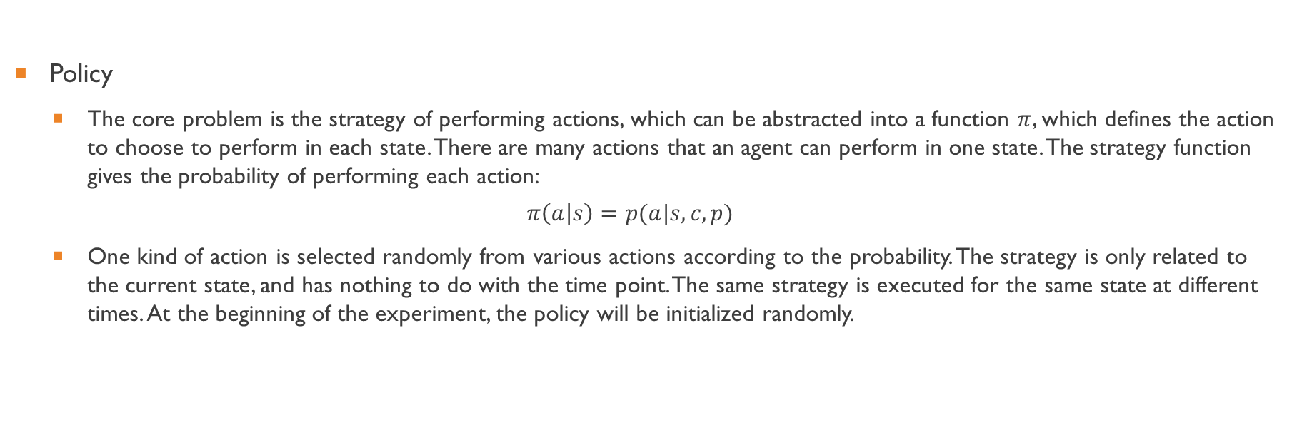
Policy
Policy
The core problem is the strategy of performing actions, which can be abstracted into a function $π$, which defines the action to choose to perform in each state. There are many actions that an agent can perform in one state. The strategy function gives the probability of performing each action:
$$π\left(a | s\right)=p(a|s,c,p)$$
One kind of action is selected randomly from various actions according to the probability. The strategy is only related to the current state, and has nothing to do with the time point. The same strategy is executed for the same state at different times. At the beginning of the experiment, the policy will be initialized randomly.
Notes:
The most important thing is to train the policy for markov decision system. The policy defines which action to take in each state. Here, we also consider the context, and preference.

Slide 7
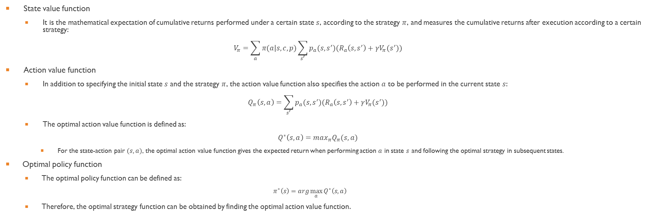
Value function
State value function
It is the mathematical expectation of cumulative returns performed under a certain state $s$, according to the strategy $π$, and measures the cumulative returns after execution according to a certain strategy:
$$V_{π}=\sum_{a}{π(a|s,c,p)}\sum_{s^{′}}{p_{a}(s,s^{′})(R_{a}\left(s,s^{′}\right)+γV_{π}(s^{′}))}$$
Action value function
In addition to specifying the initial state $s$ and the strategy $π$, the action value function also specifies the action $a$ to be performed in the current state $s$:
$$Q_{π}\left(s,a\right)=\sum_{s^{′}}{p_{a}(s,s^{′})(R_{a}\left(s,s^{′}\right)+γV_{π}(s^{′}))}$$
The optimal action value function is defined as:
$$Q^{∗}\left(s,a\right)=\max_{π}Q_{π}(s,a)$$
For the state-action pair $(s,a)$, the optimal action value function gives the expected return when performing action $a$ in state $s$ and following the optimal strategy in subsequent states.
Optimal policy function
The optimal policy function can be defined as:
$$π^{∗}\left(s\right)=arg\max_{a}{Q^{∗}\left(s,a\right)}$$
Therefore, the optimal strategy function can be obtained by finding the optimal action value function.
Notes:
What we want is the optimal policy function corresponding to the maximal value function.

Slide 8
Thank you
Questions

