Slide 1
Astronomy Image
Amirreza Dolatpour Fathkouhi
Fall 2024

Slide 2
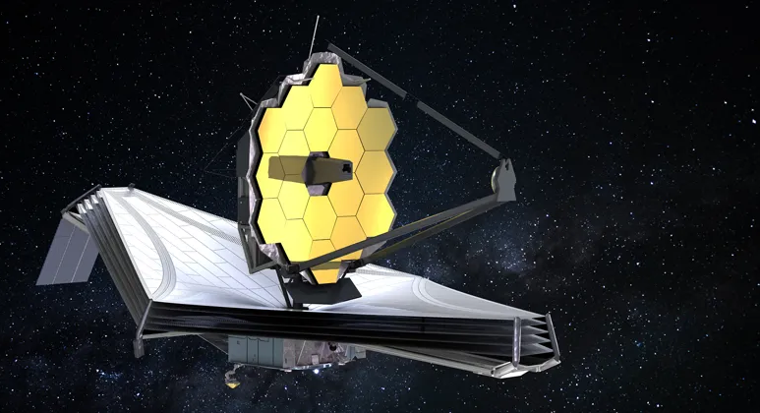
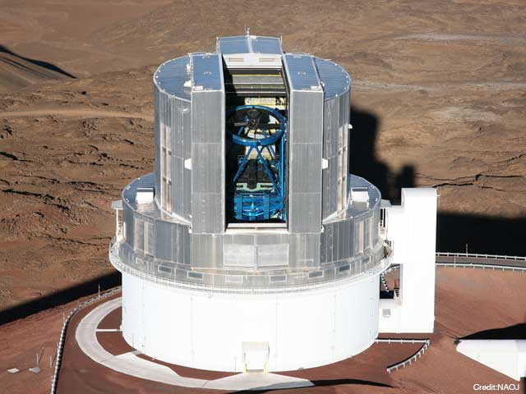


Astronomy Image Overview
Images:
Captured by satellites or telescopes.
Mainly consist of galaxies, stars and quasars.
Different surveys capture images with different resolutions:
SDSS, DESI, BOSS, EBOSS, etc.

Slide 3
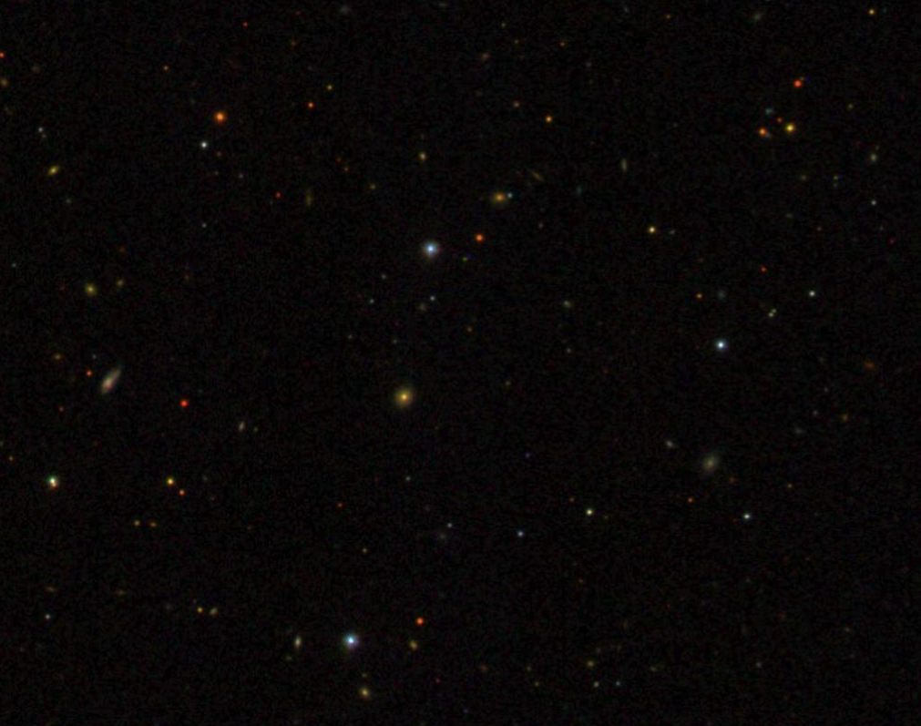
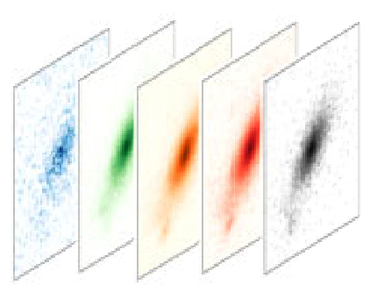
Astronomy Image Overview
Images can have different number of channels.
DESI and SDSS images have 3 and 5 channels, respectively.
Raw images contain various types of noise and anomalies.
Additionally, sparsity.

