Slide 1
DBT Data Analysis, Transformation, Testing
Data Engineering
School of Data Science
University of Virginia

Slide 2
Annoucements/Questions
Snowflake lab
Remember to use id in the URL
Click on the activation link to verify account
Updates from Liz

Slide 3
DBT is:
A Data Development Framework
A Data Transformation Workflow
A Data Test Framework

Slide 4
DBT is both open source, and SaaS
This tool is an example of both models:
Open source dbt-core is available as a python package and used via CLI
Open-source/SaaS model is Web based, and is free up to a point. Advanced features require a subscription.

Slide 5
DBT works with many other tools
It’s part of a larger process, and it is built to inter-operate with other Data Analysis, Data Engineering tools.
Snowflake
Airflow
Can be used in Circle/CI

Slide 6
DBT: SQL will execute remotely in SFlake
To execute our SQL we need to establish a connection to Snowflake
Setting up the connection will be done in YAML files.
In our lab this week, we’ll use the Snowflake account creds.
A prompt will walk you through entering id/names etc.

Slide 7
One common configuration for DBT
CircleCI
(DBT)
TRASFORMS
github
DATA
SOURCE
EXPORT
(Airflow)
EXTRACT & LOAD
(Snowflake)
Data Platform
github
github
CircleCI
CircleCI

Slide 8
ETL versus ELT
Assuming you have a target end point for data to be used by DSs/DAs and other clients.
ETL is traditional, like how we use a DB and Airflow
Extract Task
Transform Tasks
Load Tasks(Load to final stage, delivery)
ELT is how we use DBT with Snowflake
Extract and Load once
Transform data via models (Transform in place)

Slide 9
Basic Features of DBT
Model
Sources
Tests
Documentation
Deployment

Slide 10
Model
Key point of use => Modular sql
A DBT model is a single sql file containing a SELECT statement.
Each model is like a node in a graph describing data transformation
End points are deliverables

Slide 11
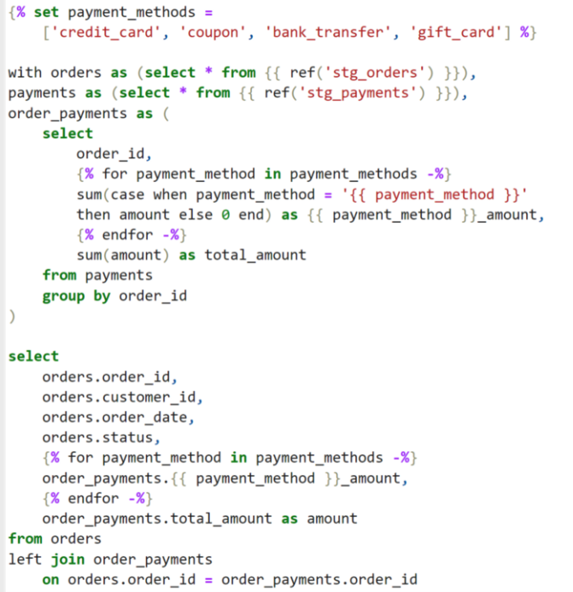
DBT uses Jinja for SQL templates
Jinja is widely used for web UI
In this context it’s used for SQL
But the concept is identical.
Write templatized code.

Slide 12
Jinja is itself a pretty powerful tool
Can ‘markup’ pages by replacing elements
But can also call executables ->
Note how we can embed calls in DBT using Jinja…
from {{ ref('my_first_dbt_model') }}

Slide 13
DBT: Templates are ‘compiled’
What do we mean by ‘compiled’?
When DBT sql templates are converted to explicit executable sql, they are said to be compiled.
Compile code, usually refers to the transformation of human readable code to machine executable code.
In this case, SQL is our universal ‘executable’
Compiled SQL can be found in the ‘target’ directory

Slide 14
Sources
Are a way to denote RAW data sources. Starting points.
SBT provides shorthand to refer to them “src(“
BUT ALSO…
Identifies them in DAG, example ->
This helps create nice graphs for
Design
Making sense of your data flow

Slide 15
Tests and Documentation
DBT is used to test data as much as transform it
Comes with some default tests, ‘unique’, ‘not_null’
You can create custom tests
DBT allows you to insert descriptions for you data elements

Slide 16
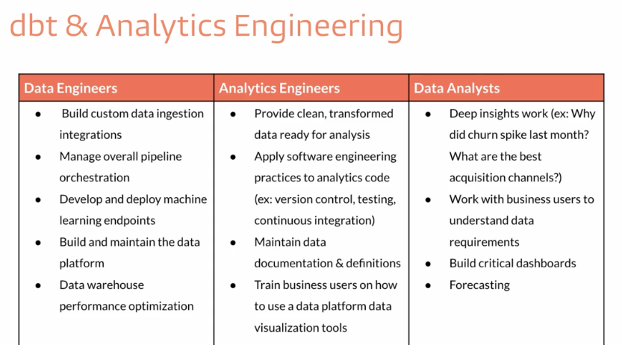

Slide 17
Recap. DBT allows you to…
Treat data transformation as Code
Yes, there’s Github again.
The ‘AsCode’ paradigm is kind of the ‘As a Service’, you’ll see it everywhere
Infrastucture as Code (Terraform)
Data Transformation as Code (DBT)
Configuration as Code (Chef, Puppet)
Meaning => code reviews, versioning, repeatability

