Slide 1
Vector Stores and
Random Projection
Distributed Computing
School of Data Science
University of Virginia

Slide 2
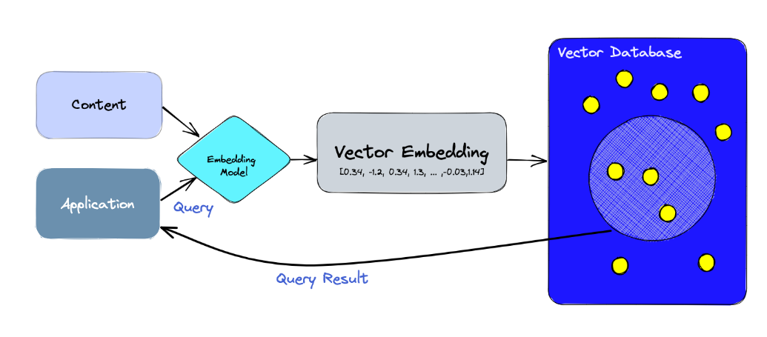
Vector Store Application: Semantic Search
Source: https://www.pinecone.io/learn/vector-database/

Slide 3
Vector Stores (Databases)
We learned that vector stores are purpose-built to manage vector embeddings

Slide 4
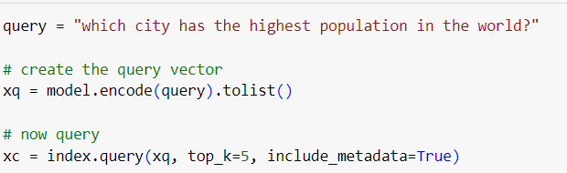
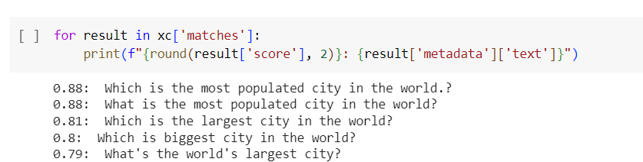
Semantic Search
We can do search via similarity matching (e.g., cosine similarity):

Slide 5
Approximate Nearest Neighbor (ANN) Search
Searching through vector store is expensive at scale
ANN search uses algorithms to more quickly return a sufficient match
Trades off between accuracy and speed
A good system can be fast and highly accurate
One important algorithm is random projection

Slide 6
Random Projection: Overview
Project high-dimensional (d) vectors into lower-dimensional subspace k
Uses random projection matrix
What are the important attributes?
Random Projection in Dimensionality Reduction: Applications to Image and Text Data.
E. Bingham and H. Mannila.

Slide 7
Random Projection: Overview
Project high-dimensional (d) vectors into lower-dimensional subspace k
Uses random projection matrix
What are the important attributes?
- columns have unit lengths
- k << d
- needs to preserve similarity measures
Random Projection in Dimensionality Reduction: Applications to Image and Text Data.
E. Bingham and H. Mannila.

Slide 8
Random Projection: Findings
In theory, the method preserves similarity measures
In practice, not many published results
Paper shows good results for
- noisy and noiseless images
- information retrieval from text documents
Similarity is preserved AND method is faster than competitors like PCA

Slide 9
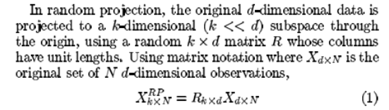
Random Projection: How it Works

Slide 10
Random Projection: Why does it Work?
Johnson-Lindenstrauss lemma
If points in vector space are projected onto randomly selected subspace of suitably high dimension, distances between points are approximately preserved

Slide 11
Research Questions and Methods
How much is similarity of two vectors distorted by RP?
How efficient is this method?
Similarity (e.g., Euclidean distance, dot product)
Compare various methods of dim reduction for range of k
For each k, compute new R and projection matrix

Slide 12
Research Questions and Methods
How much is similarity of two vectors distorted by RP?
How efficient is this method?
Similarity (e.g., Euclidean distance, dot product)
Compare various methods of dim reduction for range of k
For each k, compute new R and projection matrix
Methods:
- Random Projection (RP)
- Sparse Random Projection (SRP)
- Discrete Cosine Transform (DCT)
- Singular Value Decomposition (SVD)

Slide 13
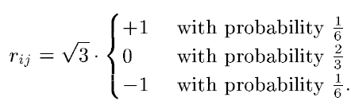
RP and SRP
RP generally samples from Gaussian distn
SRP can use a simpler distribution such as:

Slide 14

RP and SRP
RP generally samples from Gaussian distn
SRP can use a simpler distribution such as:
What is

Slide 15
Experiment 1: Noiseless Image Data
N = 1000 image windows drawn from 13 monochrome images
of natural scenes
Cropped 256x256 pixel images down to 50x50 windows
Each window presented as d-dim column vector (d = 2500)

Slide 16
Experiment 1: Noiseless Image Data
N = 1000 image windows drawn from 13 monochrome images
of natural scenes
Cropped 256x256 pixel images down to 50x50 windows
Each window presented as d-dim column vector (d = 2500)
1 | Compute Euclidean distances between pairs of original vectors.
2 | Compute Euclidean distances between pairs of dim reduced vectors.
3 | Compute the diff.
4 | Average over 100 pairs. Call this the error.

Slide 17
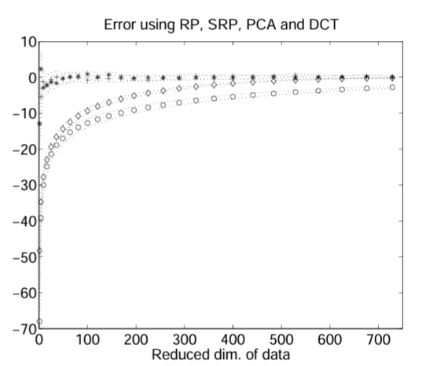

Experiment 1: Noiseless Image Data; Errors

Slide 18
Experiment 2: Text Data
N = 2262 documents drawn from 20 newsgroups corpus
Docs converted to term frequency vectors
Removed common terms
Normalized document vectors to unit length
Vocab size: 5000

Slide 19
Experiment 2: Text Data
N = 2262 documents drawn from 20 newsgroups corpus
Docs converted to term frequency vectors
Removed common terms
Normalized document vectors to unit length
Vocab size: 5000
1 | Compute dot product between pairs of original vectors.
2 | Compute dot product between pairs of dim reduced vectors.
3 | Compute the diff.
4 | Average over 100 pairs. Call this the error.

Slide 20
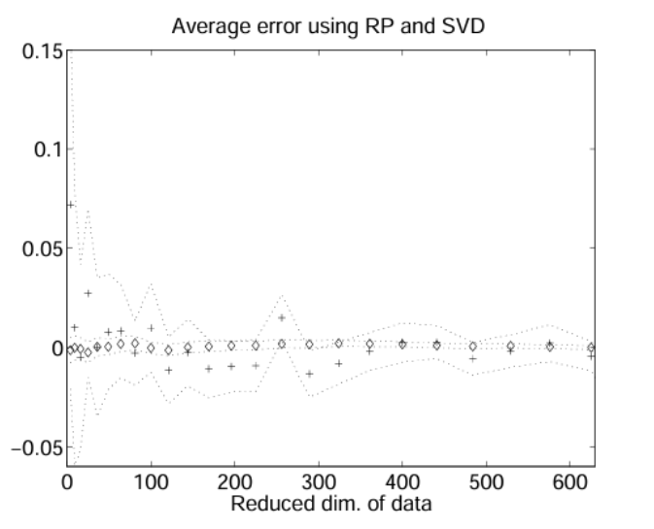
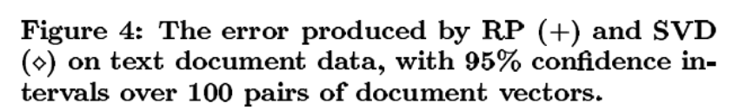
Experiment 2: Text Data; Errors
SVD works better but is much
more computationally expensive

Slide 21
Conclusions
Evidence that RP preserves similarity of data vectors and it’s fast
For images, RP worked better than PCA, DCT
For text, RP worked well but not as well as SVD
When there is high dimensional data, RP can be a good alternative to computationally infeasible methods

Slide 22
Thought Experiment
Given the semantic search lab, how could we apply RP to the data?

