Slide 1
Cloudflare Outage 11/18/2025
Distributed Computing
School of Data Science
University of Virginia

Slide 2
Background: Proxy Server
A proxy server is a computer or service that sits between you and the internet.
Commonly used for privacy / security
A proxy server is a computer or service that sits between you and the internet.
Commonly used for privacy / security

Slide 3
Background: Reverse Proxy
A reverse proxy hides the server
This is what Cloudflare does for its customers

Slide 4

Cloudflare
Cloudflare provides security including Distributed Denial of Service (DDoS)
Sits in front of services like OpenAI, X

Slide 5
Cloudflare
Cloudflare provides security including Distributed Denial of Service (DDoS)
Sits in front of services like OpenAI, X
Longer version:
- Protects entire corporate networks
- Helps customers build Internet-scale applications efficiently
- Accelerates any website or Internet application
- Wards off DDoS attacks
- Keeps hackers at bay

Slide 6
The Incident
- Outage hits platforms such as X and ChatGPT
- Spike in unusual traffic causes errors in Cloudflare's network
- Cloudflare says no sign of any attack or malicious activity
- Shares down 2.3% in morning trading
https://blog.cloudflare.com/18-november-2025-outage/

Slide 7
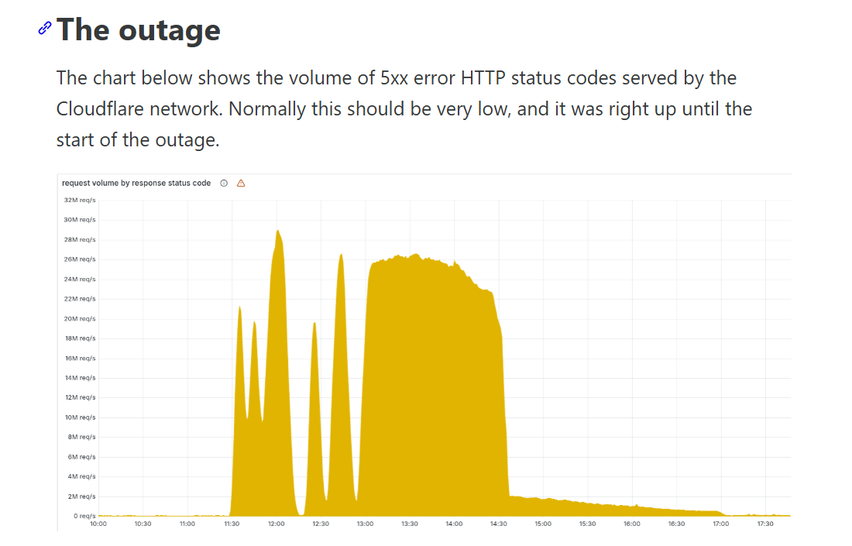

Slide 8
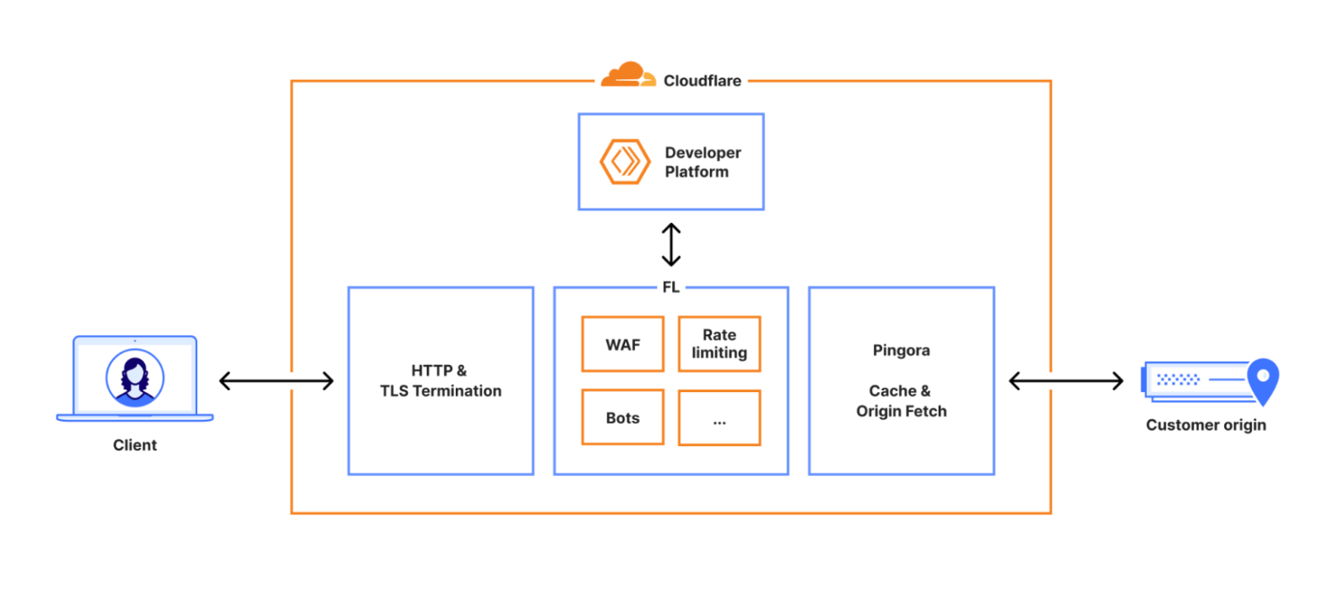
Cloudflare network
Every request to Cloudflare takes a well-defined path through their network.

Slide 9
Root Cause

Slide 10
Bot Management
“One of those modules, Bot Management, was the source of today’s outage.”
Bot Management uses ML model which produces scores to control which bots can access their sites

Slide 11
Bot Management
“One of those modules, Bot Management, was the source of today’s outage.”
Bot Management uses ML model which produces scores to control which bots can access their sites
Model takes feature config file
Feature file is refreshed every few minutes and published to entire network

Slide 12
ClickHouse
“A change in our underlying ClickHouse query behaviour that generates this file caused it to have a large number of duplicate feature rows.”
This changed the size of the previously fixed-size feature configuration file, causing the bots module to trigger an error.”

Slide 13
Distributed Data
A ClickHouse cluster consists of many shards.
To query data from all shards, Cloudflare has so-called distributed tables
in a database called default.
There is also the replica r0

Slide 14
The Change
“Since users already have implicit access to underlying tables in r0, we made a change at 11:05 to make this access explicit, so that users can see the metadata of these tables as well.”

Slide 15
The Assumption
“Unfortunately, there were assumptions made in the past, that the list of columns returned by a query like this would only include the default database:”

Slide 16
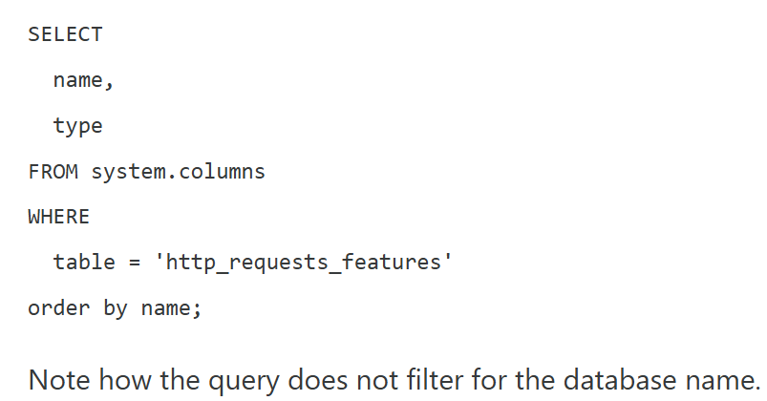
The Bad Query

Slide 17
The Bad Query
default.

Slide 18
The Duplicates
After the change at 11:05 the query above started returning “duplicates” of columns
because those were for underlying tables stored in the r0 database.

Slide 19
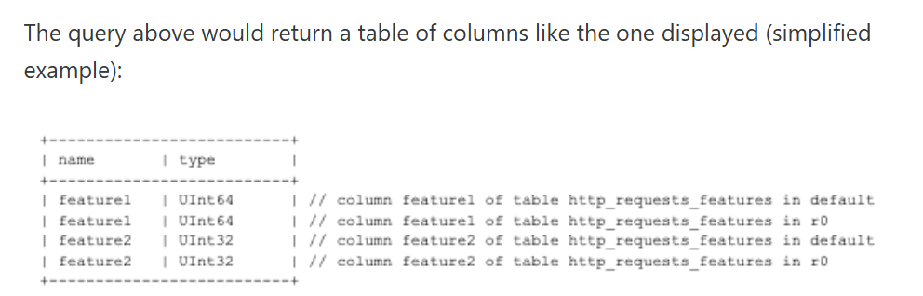
The Duplicates

Slide 20
The Limit
The Bot Management system has a limit on the number of
machine learning features that can be used at runtime

Slide 21
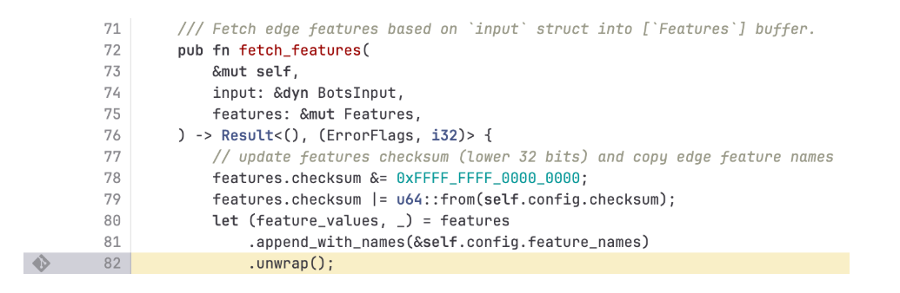
System Panic
When the bad file with more than 200 features was propagated to our servers, this limit was hit — resulting in the system panicking

Slide 22
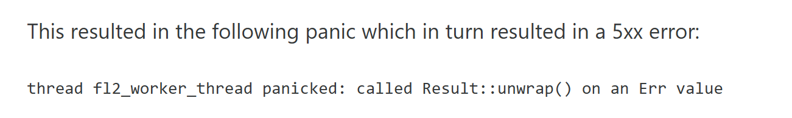
The Error

Slide 23
Cleanup Aisle 5
- Hardening ingestion of Cloudflare-generated configuration files in the same way as
user-generated input
- Enabling more global kill switches for features
- etc.

