Slide 1
Data Lakes vs.
Data Warehouses

Slide 2
Data Lake
Stores data with any structure, e.g.,
- transactional data
- videos (unstructured)
- config files (semi-structured JSON)

Slide 3
Data Lake
Not necessary to define schema...flexible
Amazon S3 is a popular commercial product
- Store data in buckets
- Object file storage
- Secure
- Scales easily

Slide 4
Data Warehouse
Stores set of relational databases
Schema defined in advance...not flexible
Examples: Amazon Redshift, Google BigQuery

Slide 5
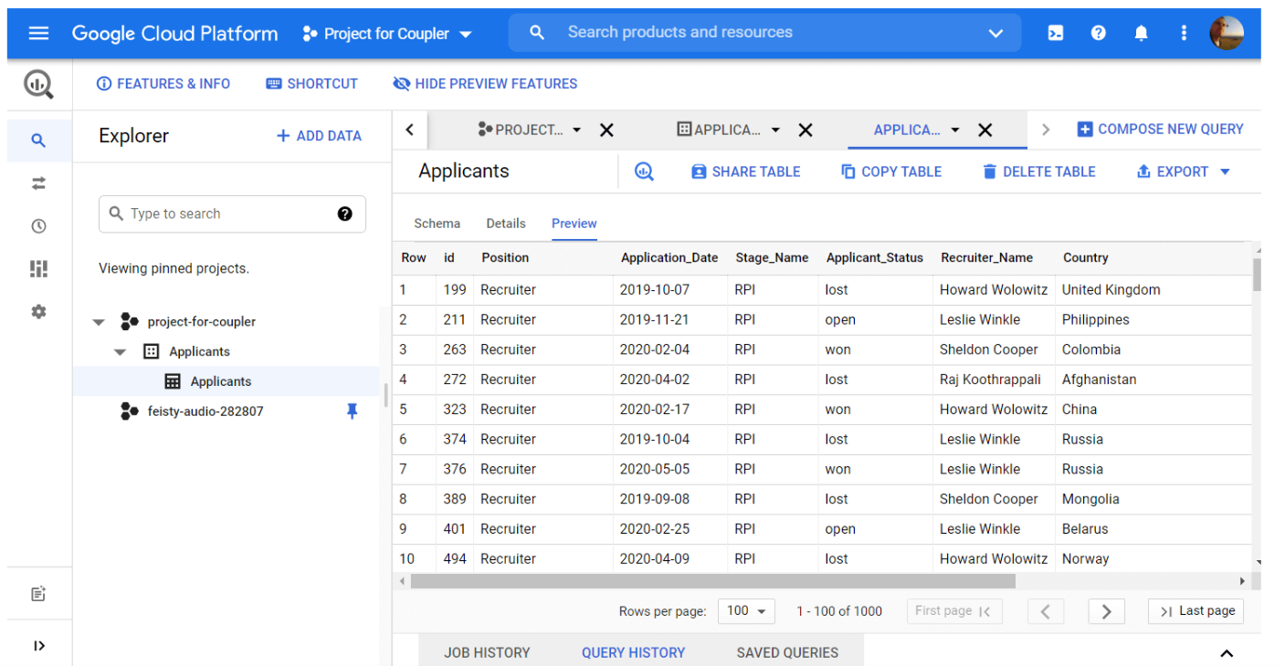
Data Warehouse GUI Example

Slide 6
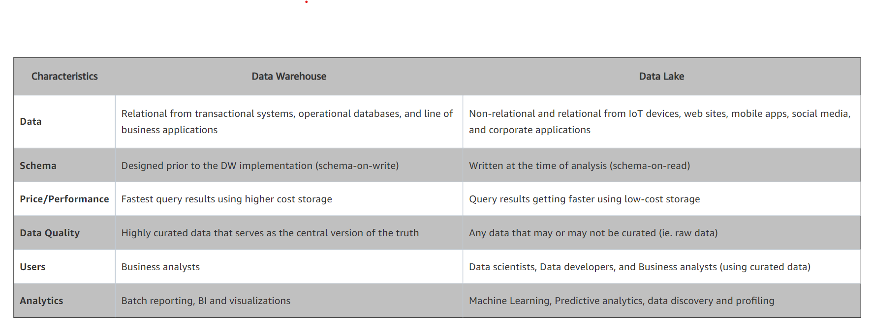
Comparison: Lake vs Warehouse
Source: https://aws.amazon.com/big-data/datalakes-and-analytics/what-is-a-data-lake/

