Slide 1
Catalyst Optimizer for Spark SQL
Distributed Computing
School of Data Science
University of Virginia
Last updated: September 14, 2026

Slide 2
The Engine Driving Spark SQL
Spark SQL is one of the most advanced modules in Spark
It comprises most of the codebase
The Catalyst optimizer is at the heart of Spark SQL
It uses advanced Scala features

Slide 3
The Engine Driving Spark SQL, contd.
The Catalyst optimizer operates on Spark Dataframes as well
For example if we run
Spark doesn't immediately execute each DataFrame operation
It starts with a logical plan which Catalyst optimizes

Slide 4
Trees are the Main Data Type
> Catalyst uses a general library representing trees,
applying rules to manipulate them
> Trees are composed of node objects
> Each node has a type, 0+ children
> Immutable, manipulated using functional transformations

Slide 5
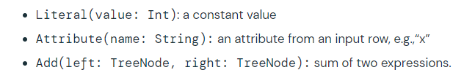
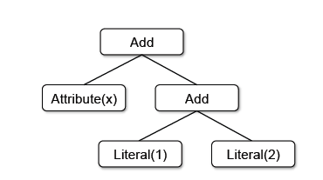
Trees for Evaluating Expressions
Simple example with three node classes:
Can build a tree for an expression like: x + (1 + 2)

Slide 6
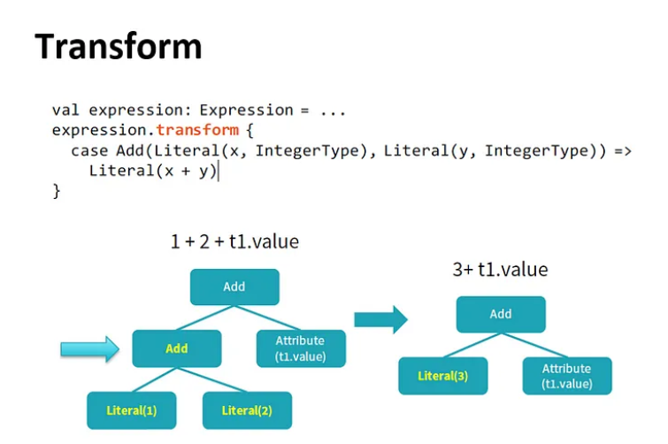
Rules
Manipulate trees with rules
Rules are functions that map a tree to another tree

Slide 7
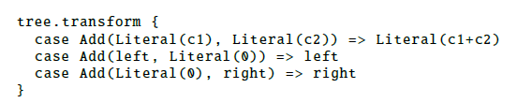
Transformations
One transform call can match multiple patterns:
In practice, rules may need to execute multiple times to fully transform a tree.
Catalyst groups rules into batches, executing each batch until tree stops changing
(fixed point).

Slide 8
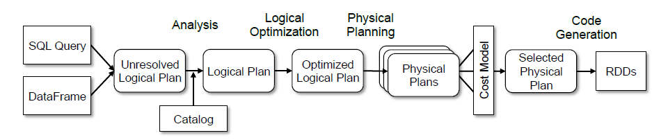
Transformation Framework
Catalyst implements transformations in four phases:
1) Analysis of logical plan
2) Logical plan optimization
3) Physical planning
4) Code generation to compile query to Java bytecode

Slide 9
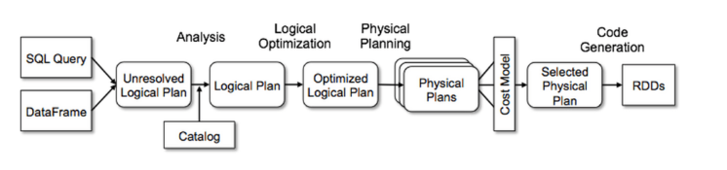
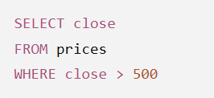
Analysis
Begins with relation to be computed from SQL parser or DataFrame
Consider this query:
Where is prices? Where is close?
What is the data type of close?
close is unresolved
Need to look at table to resolve

Slide 10
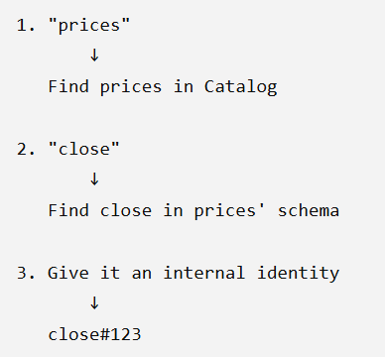
Analysis
Example query:
Catalyst analysis
does this:

Slide 11
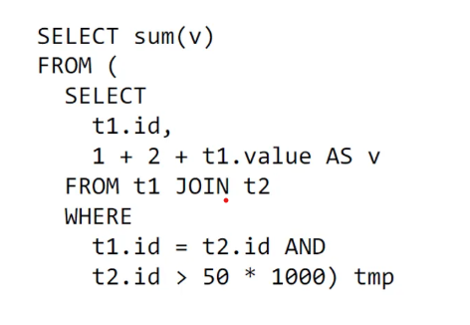
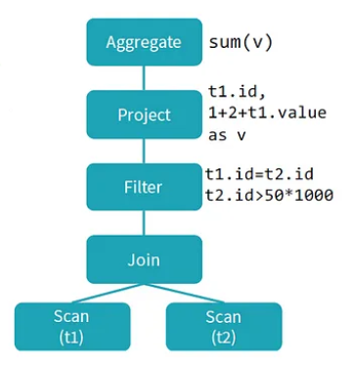
From Code to Logical Plan
SQL Code
Logical Plan
Logical Plan describes compute on datasets
without defining how to do compute
Physical Plan defines the computation

Slide 12
Plan Optimization
> Logical optimization applies rule-based optimizations to
logical plan (e.g., constant folding, predicate pushdown,
Boolean expression simplification)
> Generate several plans
> Apply cost model to each, based on physical plan
> Select the lowest cost plan

Slide 13
Background for Compute Optimization

Slide 14
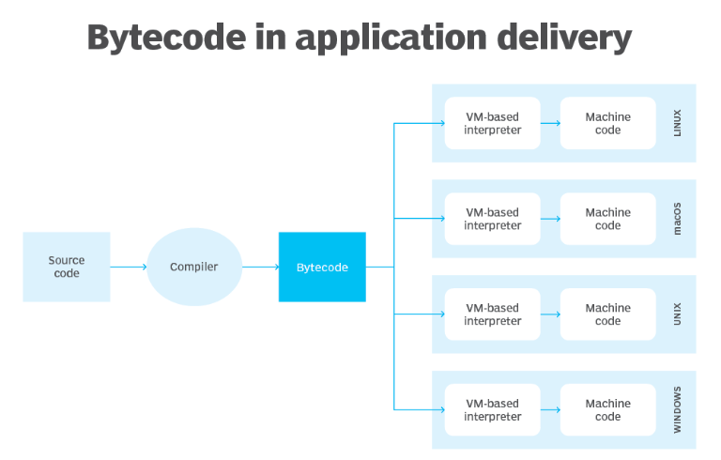
Bytecode
Bytecode is code that sits between source code (human readable) and machine code
Bytecode is platform independent (runs on any OS)

Slide 15
Java Virtual Machine (JVM)
JVM is software that takes bytecode
and compiles to machine code
It can run any language that can be
compiled to bytecode including:
> Java
> Scala
> Kotlin
> Groovy

Slide 16
Java Virtual Machine (JVM)
After JVM complies bytecode to machine code, machine code executes on CPU
Note: a specialized compiler generates machine code for GPU

Slide 17
Why is Scala Native in Spark?
At the time of Spark development, the competitor was Hadoop (for running Map Reduce)
Hadoop was coded in Java and runs on JVM
Java code can be quite verbose
Developers decided to use Scala:
- many engineers could develop in Scala
- less coding required
- compiles to bytecode for running on JVM

Slide 18
Compile Time vs Run Time
Compile time:
When programming code (source code) converted to machine code (executable code).
This is done by compiler. Example representation: 1110101111111110
- Compilers are optimized for hardware architecture.
- Processing at this step is often much faster vs runtime.

Slide 19
Compile Time vs Run Time
Run time:
The time a program is running alongside all external instructions needed for proper execution
Follows compile time
Not as fast to run code at this stage

Slide 20
Specific Optimizations

Slide 21
Constant Folding
Sometimes code includes simple calculations w constants (constant expressions):
seconds_in_day = 60 x 60 x 24
x = (2 + 3) * y
The compiler can identify and evaluate the expressions.
Spark SQL will recognize and allow for evaluating constant expressions
at compile time rather than computing at runtime (faster!)
seconds_in_day = 60 x 60 x 24 → seconds_in_day = 86400
x = (2 + 3) * y → x = 5 * y

Slide 22
Predicate Pushdown
Predicate is condition on query that returns true or false,
Usually in WHERE clause
Predicate pushdown filters data in database query
Reduces entries retrieved from database and improves
query performance
By default, Spark will automatically push down
valid WHERE clauses to database

Slide 23
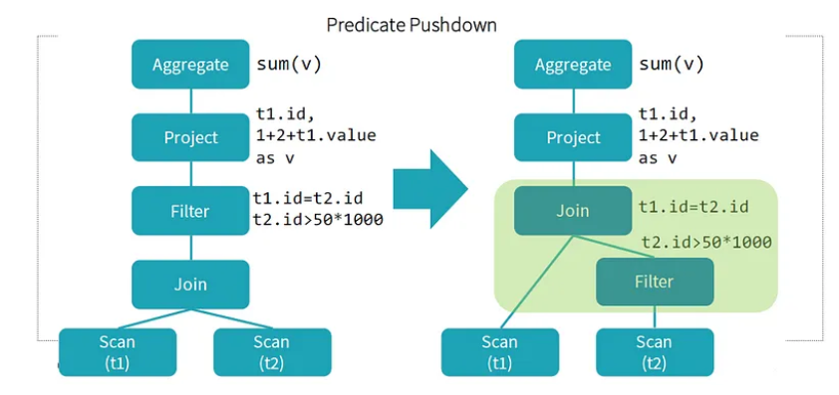
Predicate Pushdown example
- Notice two conditions in WHERE
- Can apply filter before doing the JOIN
- Reduces entries retrieved from database and improves
query performance
Optimized Logical Plan
Logical Plan

Slide 24
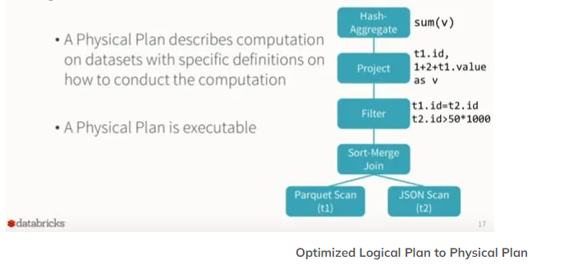
Physical Plan
Spark takes logical plan and generates physical operators matching execution engine

Slide 25
Physical Plan
For aggregation, Spark decides between hash aggregation and sort-based aggregation
Creating hash map in memory works better for small number of groups
As rows are processed, Spark uses hash map to accumulate aggregate values for each group

Slide 26
Physical Planning and Cost Model
What kinds of decisions can be made?
type of join, sequencing of filters, for example
Selects best plan based on cost model

Slide 27
Physical Planning and Cost Model
What kinds of decisions can be made?
type of join, sequencing of filters, for example
Selects best plan based on cost model
Paper: A Cost Model for SPARK SQL (Golfarelli & Baldacci)
- Takes into account network, CPU, and IO costs
- Set of Spark operations are analytically modeled based on the
cluster and application parameters, database statistics
- Experimental results show that execution time estimates have
average error of 14-20%; good enough to be useful

Slide 28
Code Generation

Slide 29
Code Generation
Consider this earlier calculation:
x + (1 + 2)
Without code generation, this would need to be interpreted for each row of data
With code generation, can translate to something that can be compiled

Slide 30
Code Generation
Strategy:
1) Convert SQL → Abstract Syntax Tree (AST)
Abstract because superficial things like spaces don’t matter
An AST is a tree representation of code. It is fundamental to compilers.
2) Have Scala evaluate the AST
3) Compile and run the generated code

Slide 31
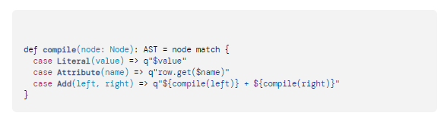
Code Generation Example
x + (1 + 2)
Function to translate tree to Scala AST
Strings with q are called quasiquotes
Quasiquotes allow programmatic construction of ASTs in Scala
which can be fed to Scala compiler

Slide 32
Evaluation Setup
Cluster of six EC2 i2.xlarge machines (one master, five workers)
Each with 4 cores, 30 GB memory, 800 GB SSD
running HDFS 2.4, Spark 1.3 (note this is a very early version)
Dataset was 110 GB of data after compression using columnar
Parquet format
Source: Spark SQL: Relational Data Processing in Spark. Armbrust et. al.

Slide 33
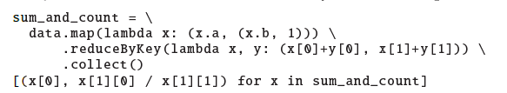
Evaluation
Dataset consists of 1 billion integer pairs (a, b) with 100,000 distinct values of a
Task: measure time taken to compute the average of b for each value of a.
Approach 1: RDDs
Approach 2: DataFrame API (from Spark SQL)

Slide 34
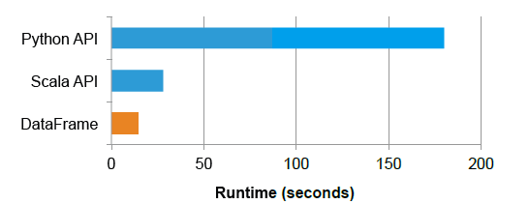
Evaluation
DataFrame API code is more concise
Also much faster as physical execution is compiled as JVM bytecode
“Python API” means RDD version

Slide 35
Sources
Spark SQL: Relational Data Processing in Spark. Armbrust et. al.
https://www.databricks.com/blog/2015/04/13/deep-dive-into-
spark-sqls-catalyst-optimizer.html
https://medium.com/@Shkha_24/catalyst-optimizer-the-
Power-of-spark-sql-cad8af46097f
https://docs.datastax.com/en/dse/6.8/dse-dev/
datastax_enterprise/spark/sparkPredicatePushdown.html
https://www.twilio.com/blog/abstract-syntax-trees#:~:text=In%20general%20an%20AST%20is,that%20represents%20a%20function%20call.
https://www.techtarget.com/whatis/definition/bytecode#:~:text=An%20example%20of%20bytecode&text=When%20an%20application%20is%20written,running%20on%20a%20target%20system.

