Slide 1
Design a Unique ID Generator
Distributed Computing
School of Data Science
University of Virginia
Last updated: Sep 15, 2026

Slide 2
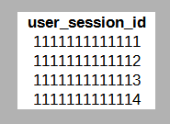
The Problem
Consider: Database table is partitioned and placed on
multiple servers (distributed system)
Need to generate and store unique session IDs or user IDs

Slide 3
Auto Increment
A database has an auto increment function that can generate
sequential numbers.

Slide 4
Auto Increment
A database has an auto increment function that can generate
sequential numbers.
Since the data is distributed, this won’t work…
there can be duplicates across the servers
server1
server2

Slide 5
UUIDs
One potential solution – universally unique identifier (UUID)
128-bit number used to identify information in computer systems
Very unlikely to create duplicates
UUIDs can be generated independently without coordination
between servers

Slide 6

UUID generator
Web server
Web server
Web server
Web server
ID gen
ID gen
ID gen
Each server has an ID generator. They operate independently.
> Hexadecimal format {0-9, a-f}
requires length 32 representation
> Each character represents 4 bits
UUID examples

Slide 7
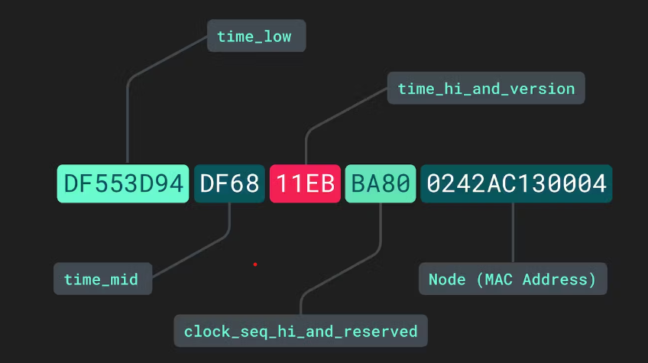
Anatomy of UUID
time_low holds first 32 bits of timestamp, for example

Slide 8
UUID Generation – PostgreSQL Example
> UUID is a subtype of the string data type
> It’s being used in the primary key
CREATE TABLE users (
id UUID NOT NULL DEFAULT gen_random_uuid(),
city STRING NOT NULL,
name STRING NULL,
address STRING NULL,
credit_card STRING NULL,
CONSTRAINT "primary" PRIMARY KEY (city ASC, id ASC),
FAMILY "primary"
(id, city, name, address, credit_card)
);

Slide 9
References
System design interview. Alex Xu.
https://www.mparticle.com/blog/what-is-a-uuid/

