Slide 1
CAP Theorem
Distributed Computing
School of Data Science
University of Virginia
Last updated: September 10, 2023

Slide 2
Cloud Systems and Distributed Systems
Distributed systems connect multiple physical / virtual nodes
in a network
All cloud systems are distributed systems

Slide 3
Background: Partition Tolerance
No distributed system is safe from network failures
Partition is communication break in distributed system
Partition tolerance:
Data processing system must continue to work even if
network partition causes communication errors
between subsystems

Slide 4
CAP Theorem
A tradeoff faced by distributed data store
Can only guarantee two of these three:
Consistency: Each read receives most recent write or an error.
All users see same data at same time.
Availability: Each request receives response.
No guarantee it contains most recent write.
Partition tolerance: System operates despite dropped/delayed
messages by network between nodes

Slide 5
CAP Theorem, contd.
When network partition happens, must decide between:
- cancel the operation (decrease availability, ensure consistency)
- proceed with operation (ensure availability, risk inconsistency)

Slide 6
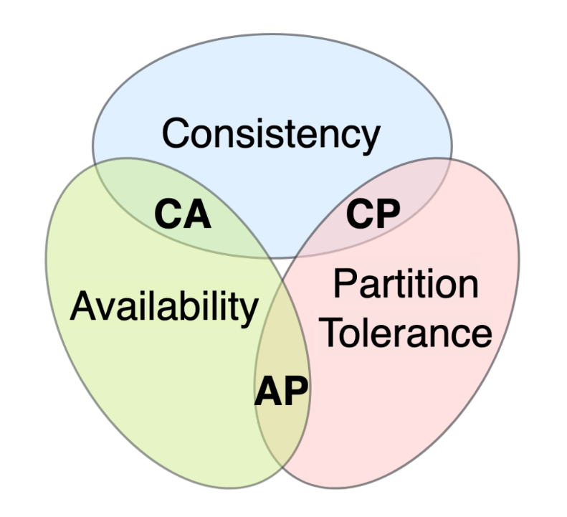
Options
Option CA: Data is not partitioned
In practice, CA distributed database cannot exist.

Slide 7
CP and AP Databases
CP: Consistency over Availability.
Traditional ACID guarantees.
Guarantee validity using transactions.
This is RDBMS like Postgres, MySQL, etc.
AP: Availability over Consistency. BASE philosophy.
BASE centers on eventual consistency.
Common in NoSQL (non-relational) database systems.

Slide 8
CP and AP Databases, contd.
What is required and what is the downside...
For CP?
For AP?

Slide 9
References
https://en.wikipedia.org/wiki/CAP_theorem
https://www.ibm.com/topics/cap-theorem

