Slide 1
Distributed Systems
(4th edition, version 01)
https://www.distributed-systems.net/
Chapter 02: Architecture

Slide 2
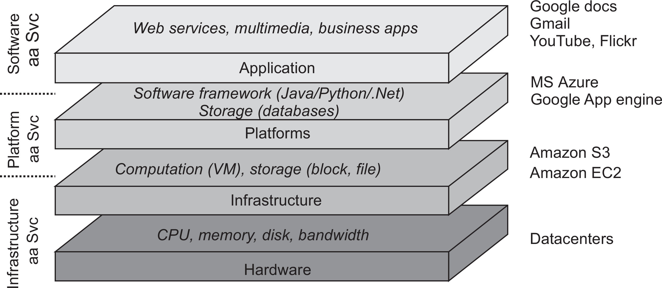
Architectures
Hybrid system architectures
Quick Reminder of Cloud Computing Stack
Cloud computing

Slide 3
Architectures
Hybrid system architectures
A bit about Amazon EC2 and S3
Cloud computing

Slide 4
Architectures
Hybrid system architectures
Amazon EC2 (Compute)
Secure and resizable compute capacity for virtually
any workload
Cloud computing

Slide 5
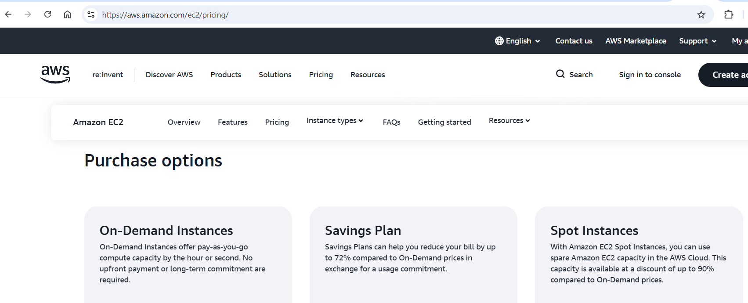
Architectures
Hybrid system architectures
Amazon EC2 (Compute) - Pricing
Cloud computing

Slide 6
Architectures
Hybrid system architectures
Amazon S3 (Storage)
Object storage built to store and retrieve any amount
of data from anywhere
Cloud computing

Slide 7
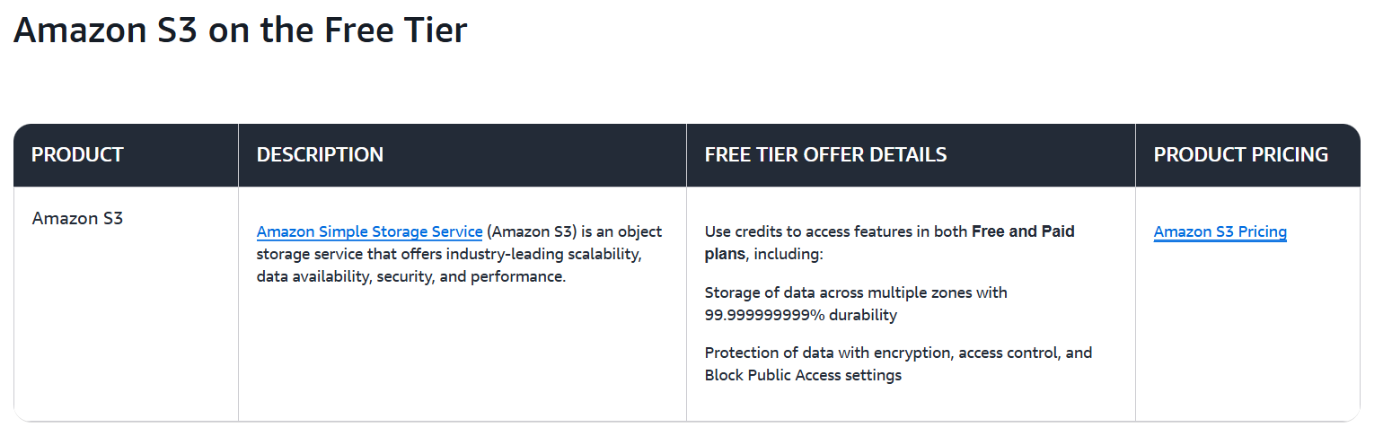
Architectures
Hybrid system architectures
Amazon S3 (Storage)
Object storage built to store and retrieve any amount
of data from anywhere
Cloud computing

Slide 8
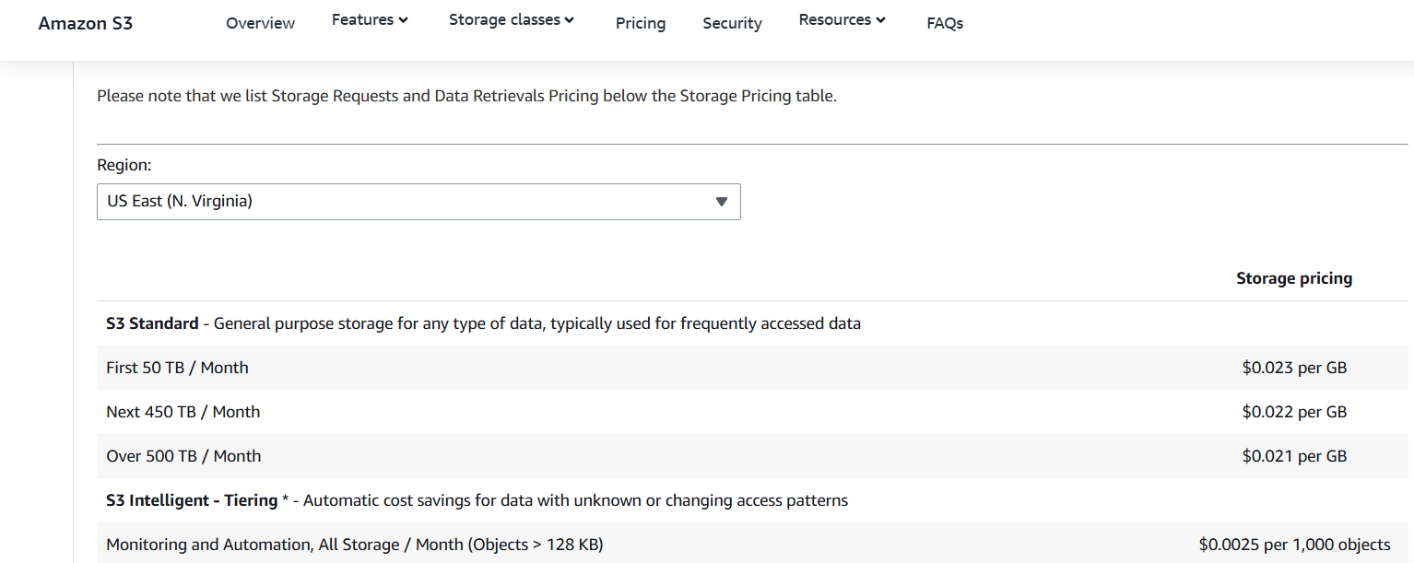
Architectures
Hybrid system architectures
Amazon S3 (Storage) - Pricing
https://aws.amazon.com/s3/pricing/
Cloud computing

