Slide 1
Catalyst Optimizer for Spark SQL
Distributed Computing
School of Data Science
University of Virginia
Last updated: September 9, 2023

Slide 2
The Engine Driving Spark SQL
Spark SQL is one of the most advanced modules in Spark
It comprises most of the codebase
The Catalyst optimizer is at the heart of Spark SQL
It uses advanced Scala features

Slide 3
Trees are the Main Data Type
Catalyst uses a general library representing trees,
applying rules to manipulate them
Trees are composed of node objects
Each node has a type, 0+ children
Immutable, manipulated using functional transformations

Slide 4
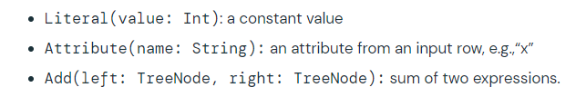
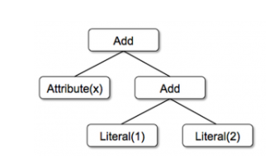
Trees for Evaluating Expressions
Simple example with three node classes:
Can build a tree for an expression like: x + (1 + 2)

Slide 5
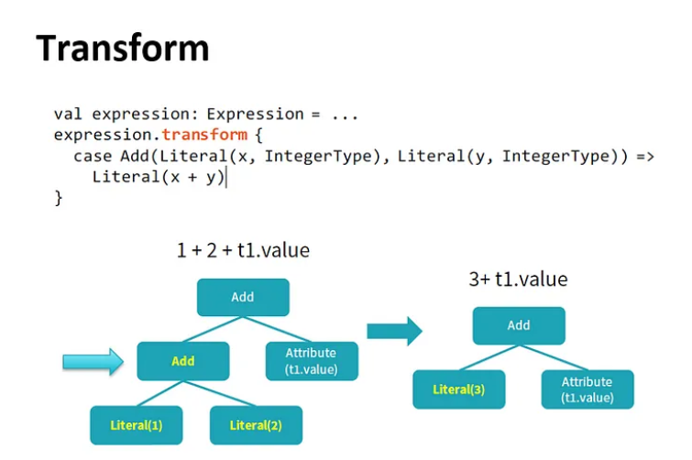
Rules
Manipulate trees with rules
Rules are functions that map a tree to another tree

Slide 6
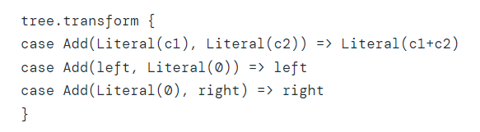
Transformations
One transform call can match multiple patterns:
In practice, rules may need to execute multiple times to fully transform a tree.
Catalyst groups rules into batches, and executes each batch until the tree stops changing.

Slide 7
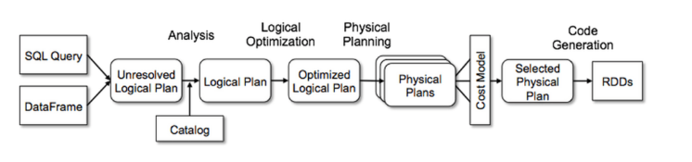
Transformation Framework
Catalyst implements transformations in four phases:
1) Analysis of logical plan
2) Logical plan optimization
3) Physical planning
4) Code generation to compile query to Java bytecode

Slide 8
Analysis
Begins with relation to be computed from SQL parser or
DataFrame
Consider this query:
SQL query SELECT col FROM sales
The type of col is not known. Not known if this attribute is in sales table.
Attribute called unresolved
Catalyst rules and Catalog object tracks tables to resolve
Builds unresolved logical plan tree

Slide 9
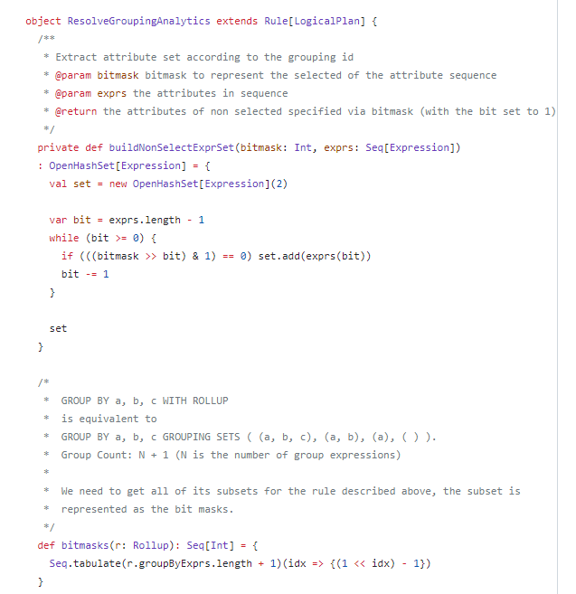
Analysis code snippet

Slide 10
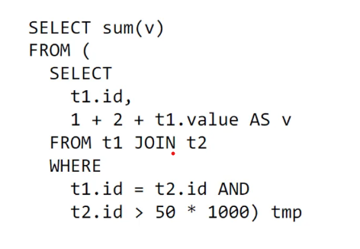
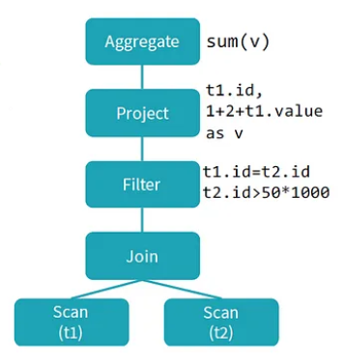
From Code to Logical Plan
SQL Code
Logical Plan
Logical Plan describes compute on datasets
without defining how to do compute
Physical Plan defines the computation

Slide 11
Plan Optimization
Logical optimization applies rule-based optimizations to
logical plan (e.g., constant folding, predicate pushdown,
Boolean expression simplification)
Generate several plans
Apply cost model to each
Select the lowest cost plan

Slide 12
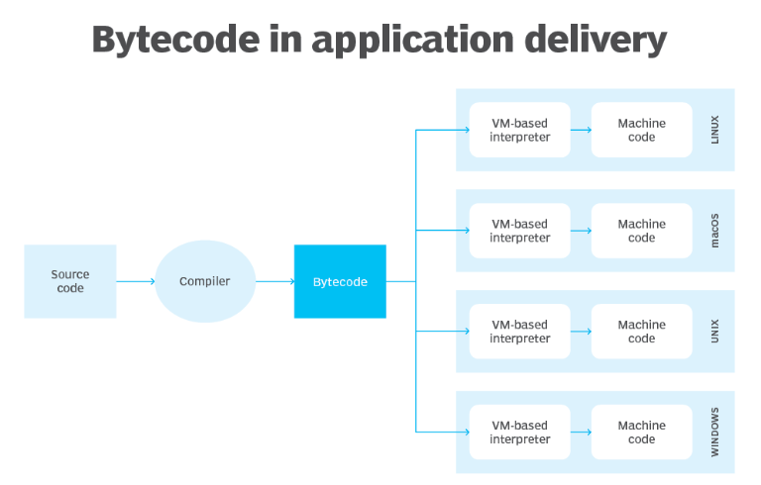
Constant Folding - background
First need to understand compile time vs run time
Compile time:
When programming code (source code) converted to machine code (executable code).
This is done by compiler. Example representation: 1110101111111110
Note: Spark is written in Scala, which needs to be compiled into Java Bytecode.
Java Bytecode is executed by Java Virtual Machine (JVM).
Some languages do not need to be compiled (Python)
Run time:
The time that a program is running alongside all
external instructions needed for proper execution
Follows compile time

Slide 13
Constant Folding
Sometimes code includes simple calculations w constants (constant expressions):
seconds_in_day = 60 x 60 x 24
x = (2 + 3) * y
The compiler can identify and evaluate the expressions.
Spark SQL will recognize and allow for evaluating constant expressions
at compile time rather than computing at runtime
seconds_in_day = 60 x 60 x 24 → seconds_in_day = 86400
x = (2 + 3) * y → x = 5 * y

Slide 14
Predicate Pushdown
Predicate is condition on query that returns true or false,
Usually in WHERE clause
Predicate pushdown filters data in database query
Reduces entries retrieved from database and improves
query performance
By default, Spark will automatically push down
valid WHERE clauses to database

Slide 15
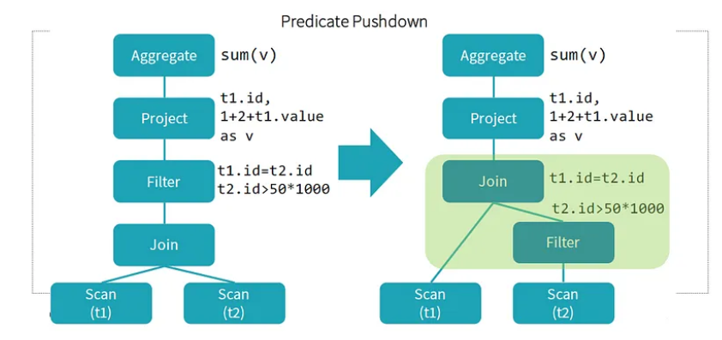
Predicate Pushdown example
- Notice two conditions in WHERE
- Can apply conditions to filter before doing the JOIN
- Reduces entries retrieved from database and improves
query performance

Slide 16
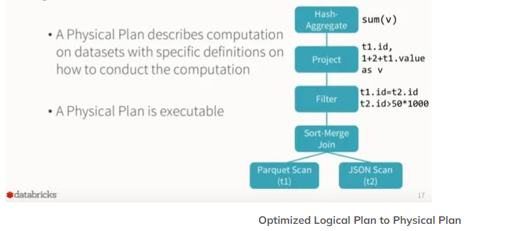
Physical Plan
Spark takes logical plan and generates physical operators matching execution engine

Slide 17
Physical Planning and Cost Model
What kinds of decisions can be made?
type of join, sequencing of filters, for example
Selects best plan based on cost model
Paper: A Cost Model for SPARK SQL (Golfarelli & Baldacci)
- Takes into account network, CPU, and IO costs
- Set of Spark operations are analytically modeled based on the
cluster and application parameters, database statistics
- Experimental results show that execution time estimates have
average error of 14-20%

Slide 18
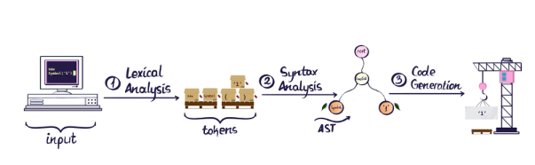
Code Generation background
In generating code for speedup, SQL is transformed to an
Abstract Syntax Tree (AST)
Abstract because superficial things like spaces don’t matter
An AST is a tree representation of code. It is fundamental to compilers.
Lexical analysis breaks code into tokens (doesn’t understand context)
Syntax analysis includes structure of code, builds the AST

Slide 19
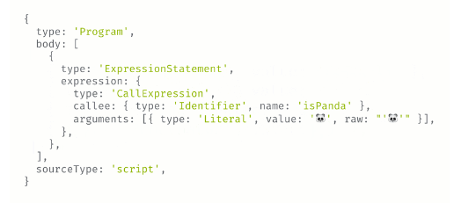

Code Generation background, contd.
Syntax analysis includes structure of code, builds the AST
The AST provides the context to manipulate the code into downstream code like machine code
Note that modifying raw text (before the AST is constructed) is error-prone as context is lost.

Slide 20
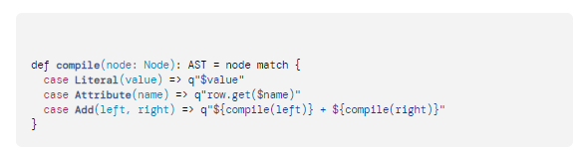
Code Generation
Back to the task: Generate Java bytecode to run on each machine
1. Catalyst transforms a tree representing SQL expression to Abstract Syntax Tree (AST)
Strings with q”” are called quasiquotes
Quasiquotes allow programmatic construction of ASTs in Scala
which can be fed to Scala compiler
2. Scala uses AST to evaluate the expression
3. Generated code is compiled and run

Slide 21
Sources
https://www.databricks.com/blog/2015/04/13/deep-dive-into-
spark-sqls-catalyst-optimizer.html
https://medium.com/@Shkha_24/catalyst-optimizer-the-
Power-of-spark-sql-cad8af46097f
https://docs.datastax.com/en/dse/6.8/dse-dev/
datastax_enterprise/spark/sparkPredicatePushdown.html
https://www.twilio.com/blog/abstract-syntax-trees#:~:text=In%20general%20an%20AST%20is,that%20represents%20a%20function%20call.
https://www.techtarget.com/whatis/definition/bytecode#:~:text=An%20example%20of%20bytecode&text=When%20an%20application%20is%20written,running%20on%20a%20target%20system.

