Slide 1
MLlib Method Summary
Distributed Computing
School of Data Science
University of Virginia
Last updated: September 24, 2024

Slide 2
MLlib DataFrames API
The interface makes it relatively easy to experiment across models
The common activities include:
- fit() to train a model
- transform() to make predictions
- evaluate() to assess predictive performance

Slide 3
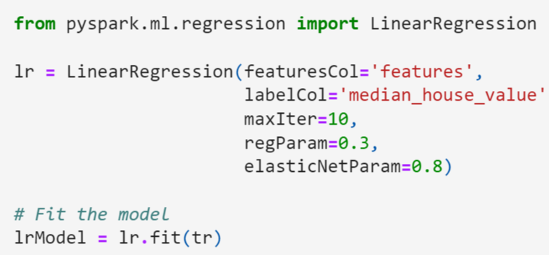
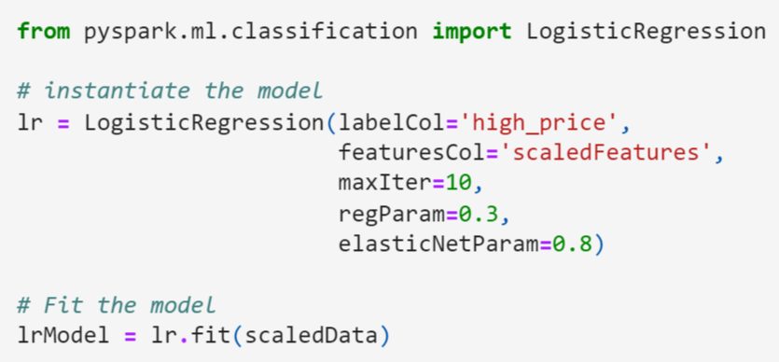
MLlib DataFrames API, contd.
Methods are analogous for different tasks e.g., regression, classification
Will call different library, different functions but ideas are the same
Regression
Classification

Slide 4
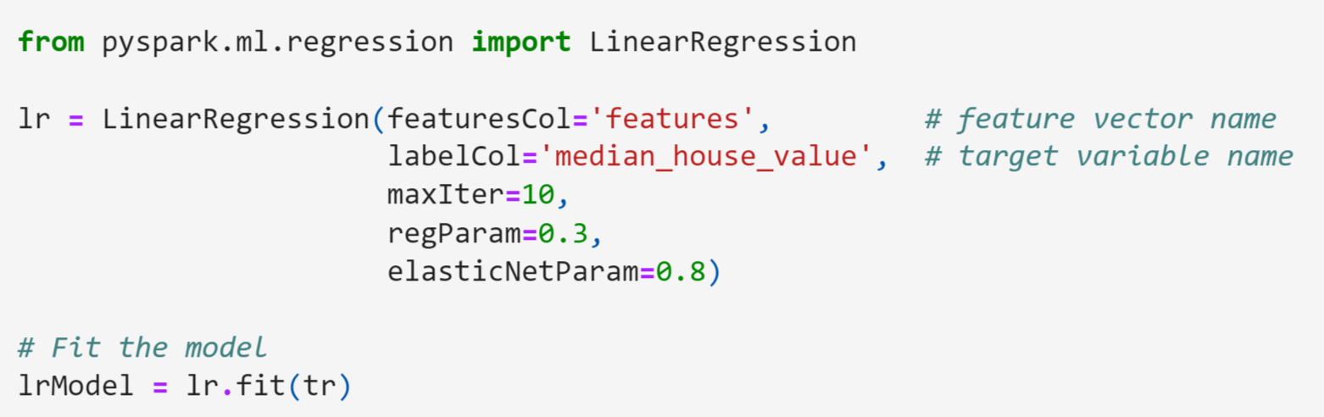
Train a Model
Import the model from the ml library
Instantiate the model by passing:
- name of features column
- name of label column
- hyperparameters

Slide 5
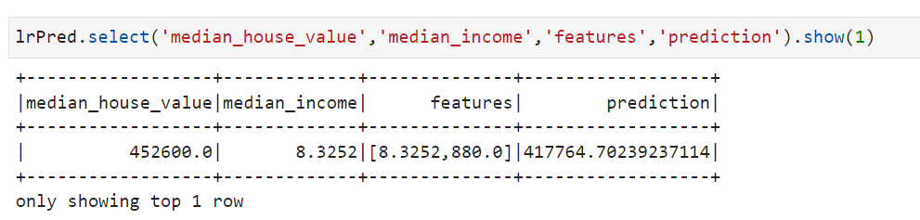
Make Predictions
Predict with the transform() method
Inspect a record with some columns

Slide 6
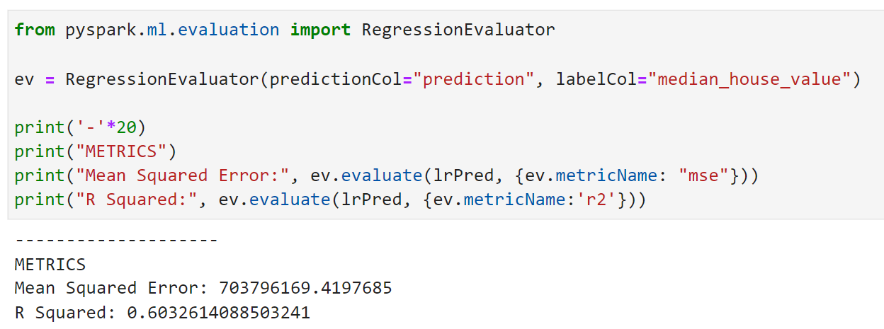
Assess Predictive Performance
Import an evaluator and call evaluate() method
Pass name of prediction column, label column
Inspect a record with some columns

