Slide 1
Catalyst Optimizer for Spark SQL
Distributed Computing
School of Data Science
University of Virginia

Slide 2
The Engine Driving Spark SQL
Spark SQL is one of the most advanced modules in Spark
It comprises most of the codebase
The Catalyst optimizer is at the heart of Spark SQL
It uses advanced Scala features

Slide 3
Trees are the Main Data Type
Catalyst uses a general library representing trees,
applying rules to manipulate them
Trees are composed of node objects
Each node has a type, 0+ children
Immutable, manipulated using functional transformations

Slide 4
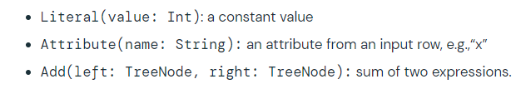
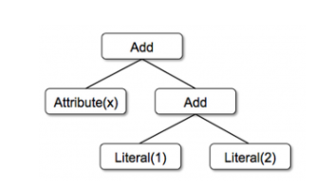
Trees for Evaluating Expressions
Simple example with three node classes:
Can build a tree for an expression like: x + (1 + 2)

Slide 5
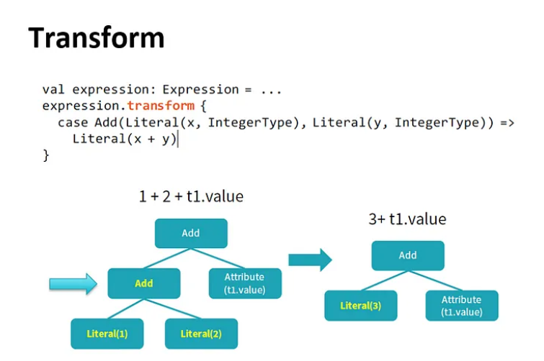
Rules
Manipulate trees with rules
Rules are functions that map a tree to another tree

Slide 6
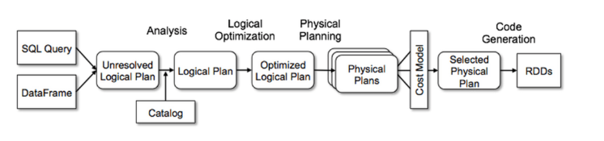
Transformation Framework
Catalyst implements transformations in four phases:
1) Analysis of logical plan
2) Logical plan optimization
3) Physical planning
4) Code generation to compile query to Java bytecode

Slide 7
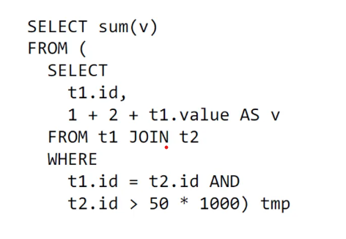
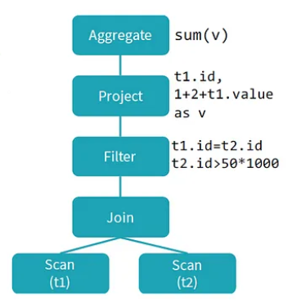
From Code to Logical Plan
SQL Code
Logical Plan
Logical Plan describes compute on datasets
without defining how to do compute
Physical Plan defines the computation

Slide 8
Plan Optimization
Mention rules to estimate costs
Evaluate several plans
Select the lowest cost plan

Slide 9
Predicate Pushdown
Predicate is condition on query that returns true or false,
Usually in WHERE clause
Predicate pushdown filters data in database query
Reduces entries retrieved from database and improves
query performance
By default, Spark will automatically push down
valid WHERE clauses to database

Slide 10
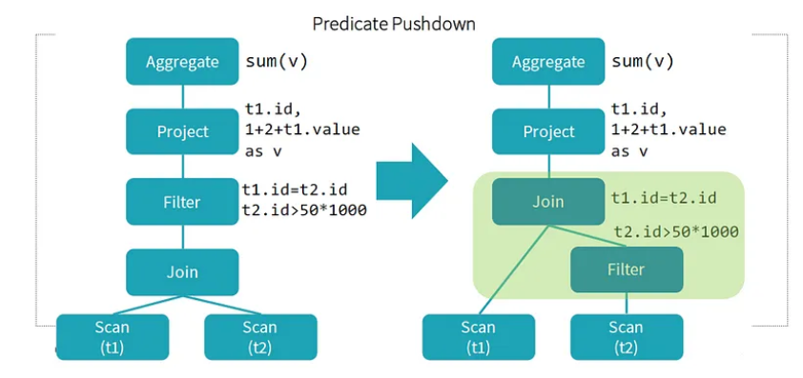
Predicate Pushdown example
- Notice two conditions in WHERE
- Can apply conditions to filter before doing the JOIN
- Reduces entries retrieved from database and improves
query performance

Slide 11
Sources
https://www.databricks.com/blog/2015/04/13/deep-dive-into-
spark-sqls-catalyst-optimizer.html
https://medium.com/@Shkha_24/catalyst-optimizer-the-
Power-of-spark-sql-cad8af46097f
https://docs.datastax.com/en/dse/6.8/dse-dev/
datastax_enterprise/spark/sparkPredicatePushdown.html

