Slide 1
Consistent Hashing for
Scalable Data Storage
Distributed Computing
School of Data Science
University of Virginia

Slide 2
Agenda
> Horizontal scaling
> Hash function
> Consistent hashing
> Hot spots and vnodes
> uhashring

Slide 3
Why Support Scaling?
As businesses grow,
- data volumes grow
- users increase
- workloads become more complex
Scaling supports this growth

Slide 4
Horizontal Scaling of Data
How can we provide a system that scales with size of dataset (elastic storage)?
Consistent Hashing provides a nice solution

Slide 5
Review: Hash Function
A hash function is any function that
maps data of arbitrary size to fixed-size values
The data is the key
Uses N buckets
Distributes data uniformly across buckets

Slide 6
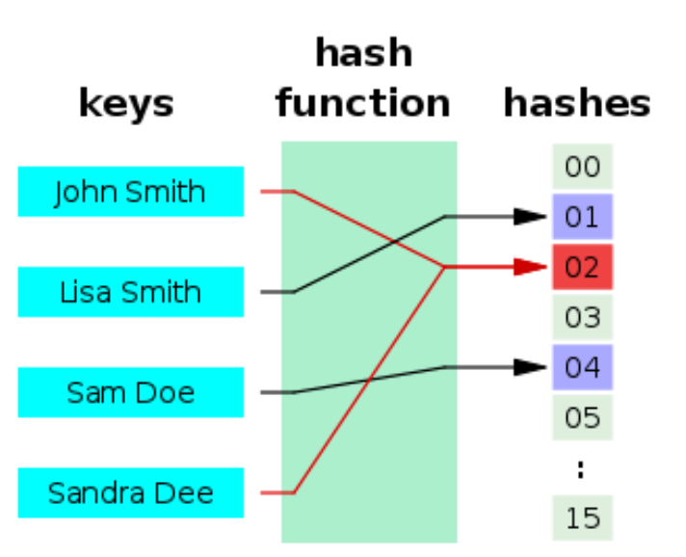
Review: Hash Function
One approach is mod N hash method:

Slide 7
Review: Hash Function
One approach is mod N hash method:
server_index = hash(key) mod N
N = 16 in this example

Slide 8
Does mod N hashing work?
Consider data scales by factor of 10
An additional server is added
Server pool is now size N+1 = 17

Slide 9
Does mod N hashing work?
Consider data scales by factor of 10
An additional server is added
Server pool is now size N+1 = 17
Problem: When N changes, the mod operation produces new server indexes
… for nearly all data!
This would shuffle data to different servers.

Slide 10
Does mod N hashing work?
Consider data scales by factor of 10
An additional server is added
Server pool is now size N+1 = 17
Example when hash value = 20
20 mod 16 = 4
20 mod 17 = 3

Slide 11
Consistent Hashing
A special kind of hashing which uses less shuffling of data
Uses object called a hash ring
Hashes are mapped into slots on a line
x0
xn-1
Source of this example:
https://www.acodersjourney.com/system-design-interview-consistent-hashing/

Slide 12
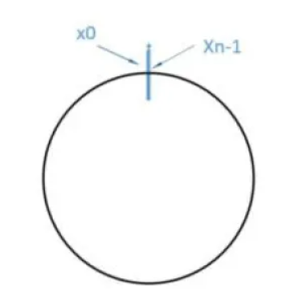
Consistent Hashing
A special kind of hashing which uses less shuffling of data
Uses object called a hash ring
Hashes are mapped into slots on a line
For the last value to connect to the first,
the space is shaped into a ring
x0
xn-1
Source of this example:
https://www.acodersjourney.com/system-design-interview-consistent-hashing/

Slide 13
Consistent Hashing Illustration
Tasks:
1. Insert key for data storage
2. Search for key (data retrieval)

Slide 14
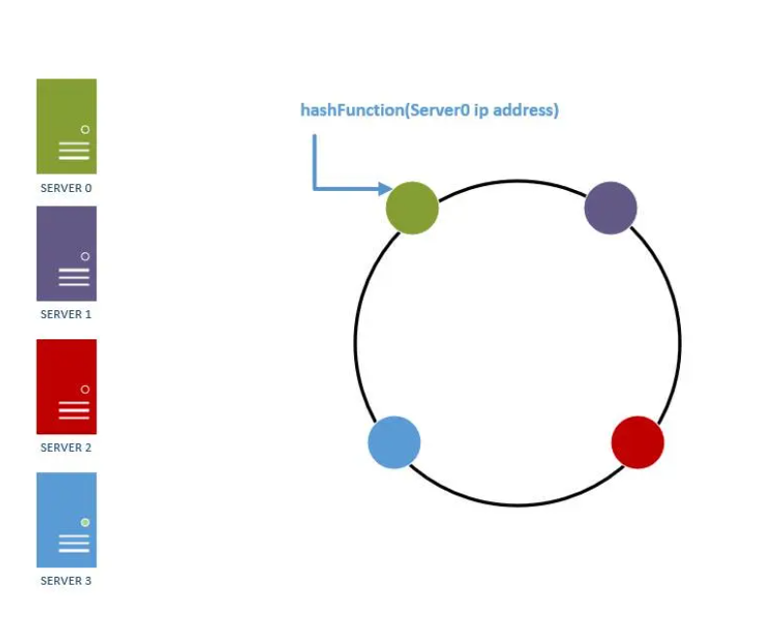
Consistent Hashing Illustration, contd.
We have four servers to place on a ring

Slide 15
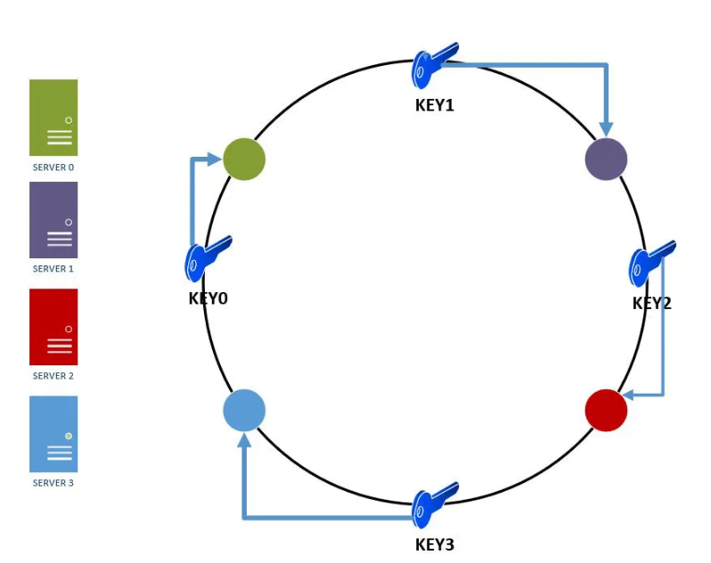
Consistent Hashing Illustration, contd.
Keys are placed on the ring
1. Key is either in same location as server or
2. Look up server by moving clockwise from key

Slide 16
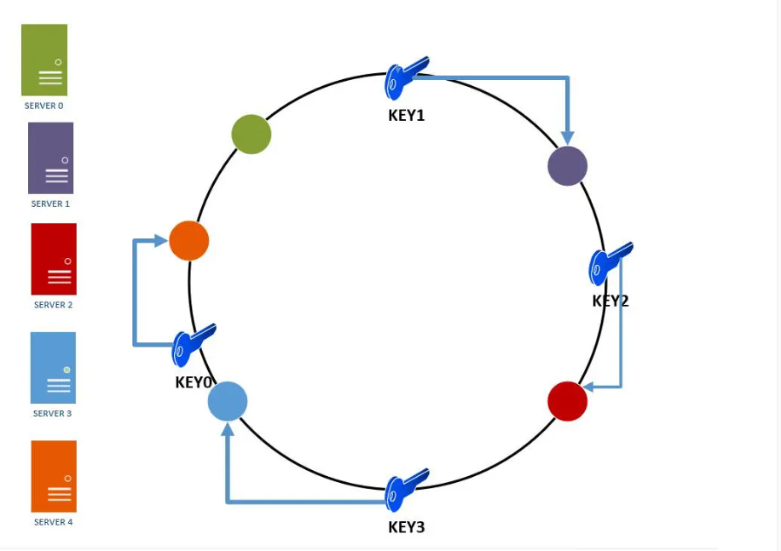
Consistent Hashing: Adding a Server
Adding a fifth server affects the ring:
key0 will be remapped from server0 to server4
Remaining keys stay on same servers,
which is a large benefit of the approach

Slide 17
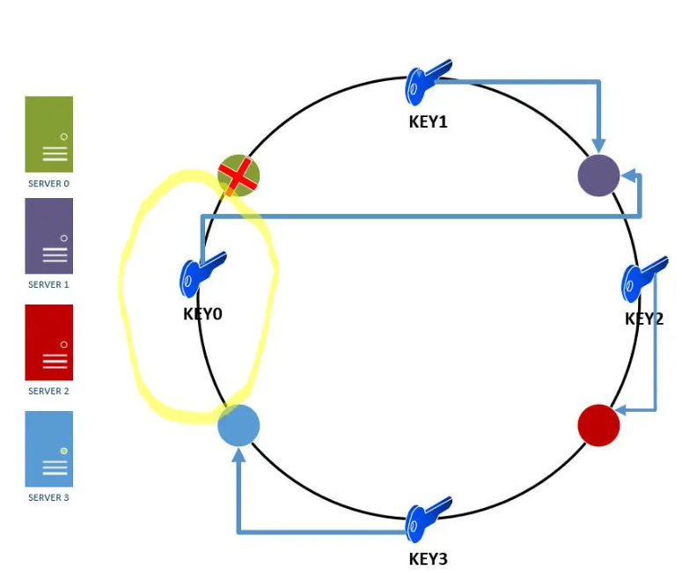
Consistent Hashing: Server Failure
In this illustration, there were 4 servers and one failed
key0 is mapped to the next available server
Remaining keys don’t move

Slide 18
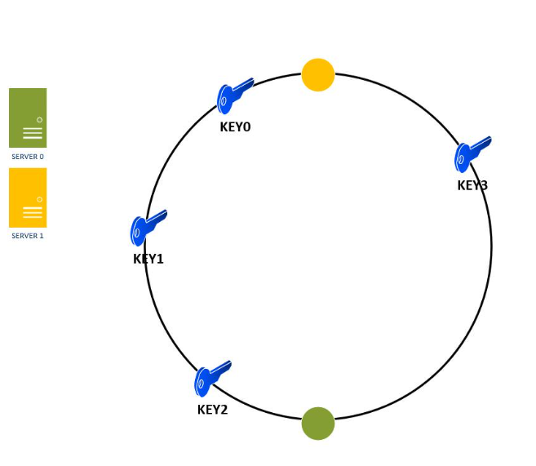
Hot Spots
The situation may arise where data is not uniformly distributed across servers
For example if a server fails, its data may be remapped to next server
In this figure, most keys will map to server 1
Server 1 is a hot spot

Slide 19
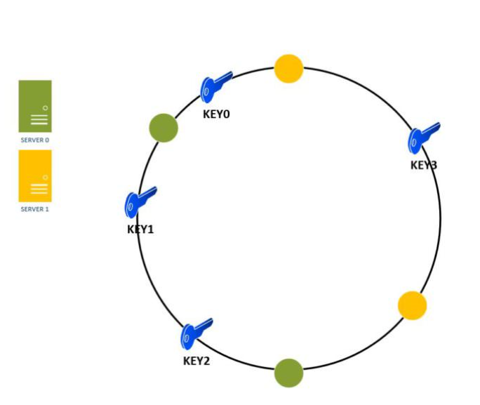
Hot Spots: Handled with Virtual Nodes
We can introduce replicas of each server on the ring
Replicas also called virtual nodes or vnodes
As the number of replicas increases, the key distribution becomes more uniform
Without vnodes
With vnodes

Slide 20
Hot Spots: Handled with Virtual Nodes
Virtual nodes are hashed independently and land at random point on ring
Vnodes map back to same physical machine
Without vnodes
With vnodes

Slide 21
Summary
> Consistent hashing solves horizontal scalability
- Only a small fraction of keys are rearranged
> To mitigate hot spots, vnodes can be used to balance data
- Each vnode maps back to same physical machine
- As number of vnodes increases, data becomes more balanced
> In practice, # vnodes chosen to balance uniformity vs lookup overhead

Slide 22
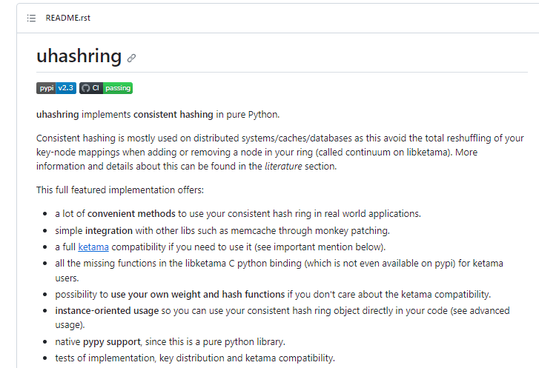
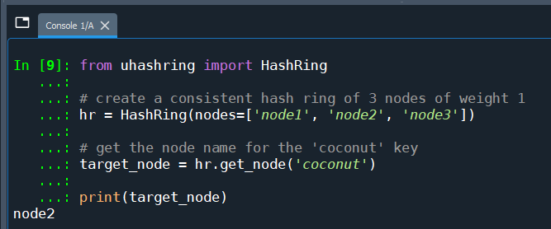
Example Implementation
Basic usage
Source: https://github.com/ultrabug/uhashring

Slide 23
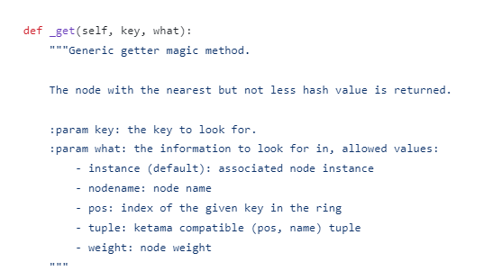
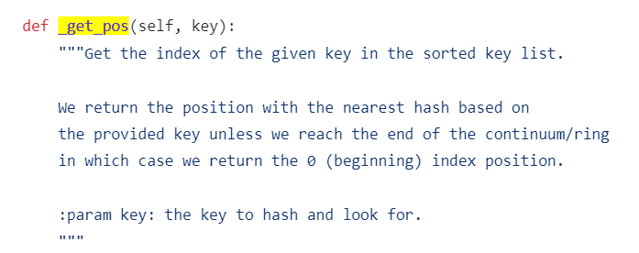
Lab: Dive into the Repo
Basic usage is defined here:
https://github.com/ultrabug/uhashring/blob/master/uhashring/ring.py
1. Review and experiment with this file to understand how it works
2. Where is the hash created?
3. Build rings with different numbers of nodes and notice how
get_node() output changes
Some useful methods:

