Slide 1
Schema Evolution
Big Data Systems
School of Data Science
University of Virginia

Slide 2
Motivation
We’ve been talking about data storage
Inevitably, as our system evolves over time, things change with it:
> Data: values, syntax, semantics (meaning)
> Contracts (what the system delivers, what we expect from it)

Slide 3
What is a Schema?
A schema is a contract between producers and consumers of data.
It is a formal description of:
> Structure (fields, types, relationships)
> Constraints (required vs optional)
> Semantics (what the data means)

Slide 4
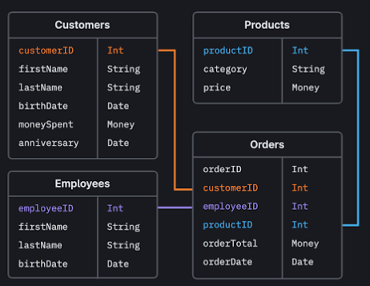
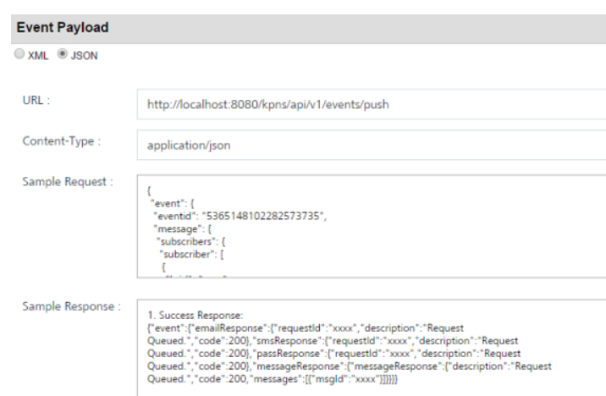
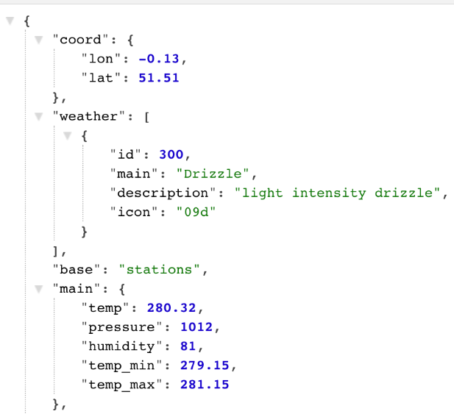
Examples of Schema
Database table definitions
API request/response formats
Event payloads
Serialized objects

Slide 5
Why do Schemas Evolve?
Schemas evolve because systems evolve:
> New features require new data
> Old fields become obsolete
> Requirements change over time
> Different teams move at different speeds

Slide 6
Why this Matters
Schema evolution affects:
> Databases
> Distributed systems
> Streaming pipelines
> Analytics & ML
> Compliance and auditing

Slide 7
Most Important Thing
Stable systems require changing schemas without things breaking.
In a past role, the most common cause of a breakage was the dreaded
“schema change”

Slide 8
Most Important Thing
Stable systems require changing schemas without things breaking.
In a past role, the most common cause of a breakage was the dreaded
“schema change”
What would cause a schema change?
> Renaming a field
> Dropping an old field

Slide 9
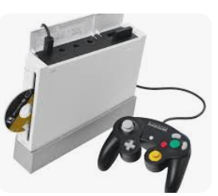
Backward Compatibility
New code can read old data.
New versions don’t break existing users.
Examples:
> Adding an optional field
> Providing defaults for missing fields

Slide 10
Forward Compatibility
Old version can handle new data/features without breaking.
Example:
> Ignoring unknown fields
> Avoiding required new fields

Slide 11
Common Schema Changes
By Risk Level
Usually safe
> Add optional field
> Add new enum value (restricted set of values)
> Relax constraints

Slide 12
Common Schema Changes, contd.
By Risk Level
Risky
> Remove fields
> Rename fields
> Change meaning without changing name

Slide 13
Common Schema Changes, contd.
By Risk Level
Dangerous
> Change data type (e.g., integer → float)
> Change field semantics silently
> Reorder fields in positional formats

Slide 14
Schema Evolution Strategies
Additive
Prefer adding fields over modifying/removing
Mark old fields as deprecated
Pros: safe, incremental
Cons: schemas grow over time

Slide 15
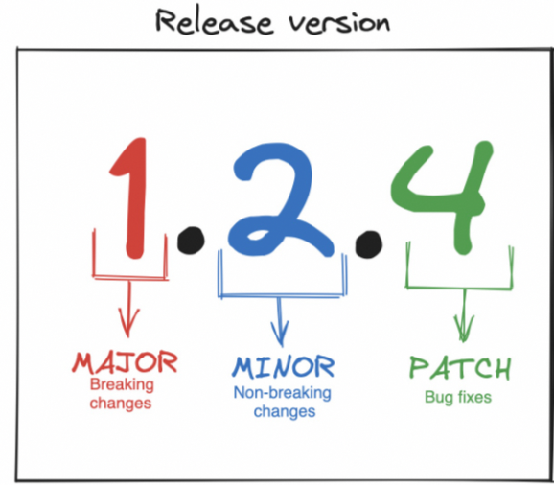
Schema Evolution Strategies
Versioned schemas
> Explicit version numbers
> Versioned endpoints or files
> Schema registries
- Centralized service that stores and manages data schemas
- Helps data producers & consumers agree on structure, compatibility

Slide 16
Schema Registry
How it works:
1⃣ Stores schemas centrally
2️⃣ Assigns version numbers
3️⃣ Enforces compatibility rules
4️⃣ Validates new schema updates
5️⃣ Allows consumers to fetch correct schema

Slide 17
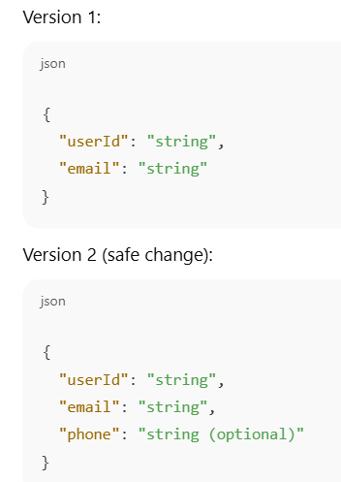
Schema Registry Example
If compatibility mode set to BACKWARD, registry will:
> Allow adding optional fields
> Reject breaking changes (like removing required fields)

Slide 18
Schema Evolution Strategies, contd.
Transformation layers
> Adapters or translators
> Migrate data at read or write time
Used when:
> Legacy data must coexist
> Hard breaks are unavoidable

Slide 19
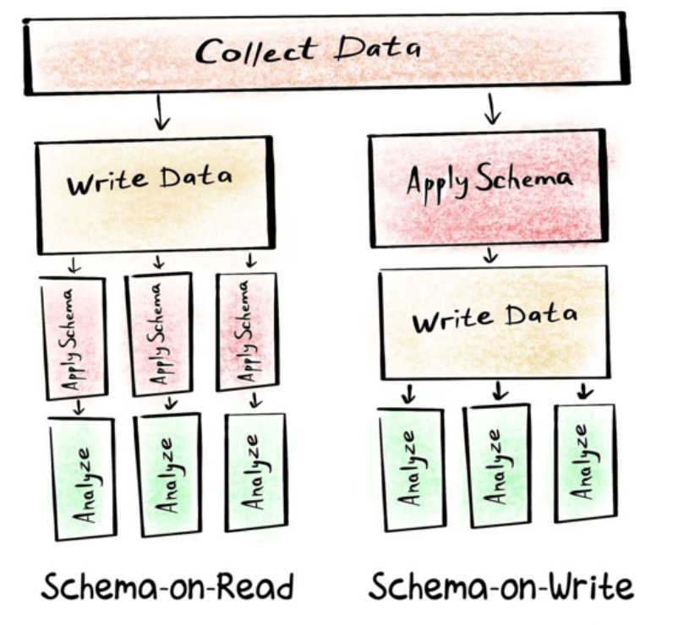
Schema-on-Write
Enforce schema before data is stored
Reject invalid data
Pros: data quality
Cons:
> harder evolution
> need to understand data
to define schema

Slide 20
Schema-on-Read
Interpret data when consumed
Flexible, tolerant of change
Pros: agility
Cons: complexity shifts downstream
Key idea:
Evolution strategy depends on where schema is enforced.

Slide 21
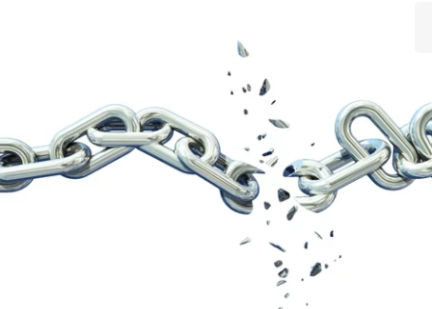
Failure Modes
> Silent corruption
> Partial compatibility
> Inconsistent interpretations
> Long-tail bugs from old data (edge / rare cases that show much later)
Worst case:
Systems work — but answers are wrong.

Slide 22
Failure Modes
Worst case:
Systems work — but answers are wrong
What might this look like?
> ML model scrapes a page for a predictor
> Predictor has moved / went missing
> Pipeline imputes with zeros for entire vector
> Model uses zero vector and returns predictions
> Everything works, but the output is wrong

Slide 23
Design Principles (Takeaways)
> Treat schemas as public APIs
> Prefer backward-compatible changes
> Version explicitly when breaking
> Document semantics, not just structure
> Plan for old data to live forever

