Slide 1
Distributed Storage
Big Data Systems
School of Data Science
University of Virginia
Last updated: September 24, 2026

Slide 2
Agenda
> Objects
> Filesystems
> Amazon S3
> HDFS

Slide 3
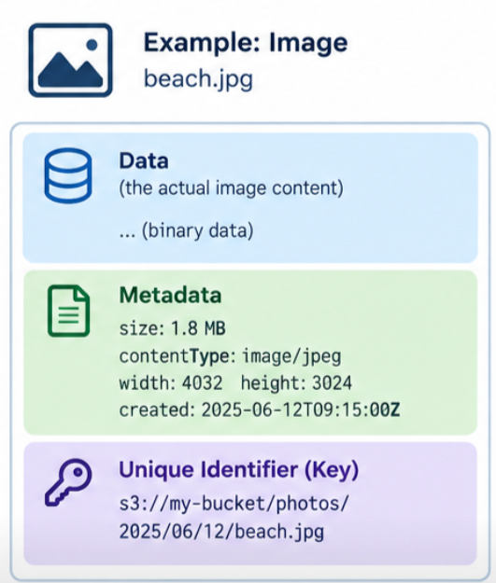
What are Objects?
Objects are fundamental units of data storage in cloud computing
Stored in flat namespace (not in a hierarchical structure)
Each object has three parts:
> data
> metadata
> unique identifier (key)

Slide 4

Objects: Additional Properties
> The priority of object storage is to support scale
> Objects are often immutable.
Typically overwrite an object rather than making edit.
> Since objects are identified by unique keys, they can be spread across
multiple servers and data centers

Slide 5
Filesystems

Slide 6
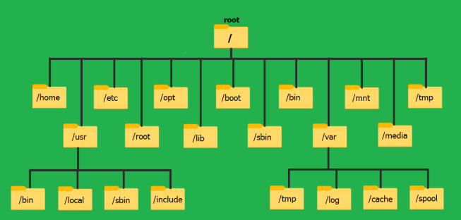
What is a Filesystem?
A filesystem (FS) is the method an operating system uses to organize, store, and retrieve files on a storage device
Here is the Linux FS:

Slide 7
Filesystem Properties
A real filesystem gives you things like:
> Hierarchical directories (that actually exist)
> In-place mutation (write at an offset)
> File locks (to prevent user overwrites and data corruption)
> Cheap metadata operations

Slide 8
Amazon S3 vs. HDFS
Next, we will look at:
> Amazon S3, which uses object storage for scale
> HDFS, which uses a distributed filesystem for throughput
> They intentionally offer different user contracts
regarding data consistency, performance, and functionality

Slide 9
Amazon S3

Slide 10

Introducing Amazon S3
> Amazon’s managed cloud storage solution
> Simple Storage Service; not so simple any more
> Handles durability, replication, scalability behind the scenes
> Object storage built to store and retrieve any amount of
data from anywhere

Slide 11
Amazon S3 Core Ideas
> Stores data as objects in buckets
> Each object has a key (string), metadata, and content
> Effectively infinite scale
> No cluster to manage

Slide 12
Amazon S3 Durability
Amazon S3 Standard and most S3 storage classes designed to provide 99.999999999% durability
(“eleven nines”) over a year.
What this means:
For every 10,000 objects stored, you'd expect to lose one object on average every 10 million years

Slide 13

However, in Recent News...
Amazon has acknowledged the permanent loss of some customer data that was hosted in
Bahrain and the United Arab Emirates.

Slide 14
Amazon S3 Replication
> S3 is durable thanks to replication across multiple
data centers and advanced data protection
> AWS automatically copies data across at least three
physically separated Availability Zones within a single region.

Slide 15
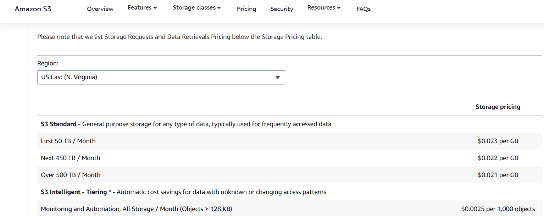
Amazon S3 Pricing
https://aws.amazon.com/s3/pricing/

Slide 16
Amazon S3 Limitations
> Higher latency than local disks or HDFS
> No true filesystem (“Directories” are just key prefixes)
- Access is via API calls, not file handles
- Overwrites are whole-object operations
- Can’t do in-place mutation
- No file locks

Slide 17
HDFS

Slide 18
About HDFS
> Traditional an on-premise solution (not hosted in cloud)
> Hadoop Distributed File System (HDFS) uses a directory structure
> Stores very large files (GB–TB scale) across a cluster of
commodity machines
> Built for batch analytics, especially MapReduce / Spark-style
workloads

Slide 19
About HDFS
> Write once, read many (append is allowed; random writes are not)
> Files split into large blocks (typically 128–256 MB)
> Each block replicated (3 copies) across different nodes for fault tolerance
> Optimized for high throughput, not low latency

Slide 20
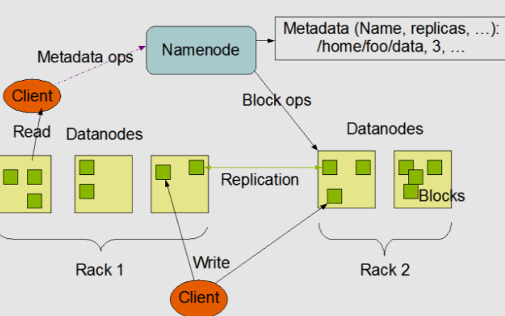
HDFS Architecture
> NameNode manages metadata (file paths, block locations, permissions)
> DataNode stores blocks of data
> Client asks Namenode where blocks live, then streams data directly from DataNodes

Slide 21
HDFS Strengths
> Excellent for large sequential reads/writes
- Due to block design
> Strong data locality (compute runs where data lives)
- NameNode directs compute to the data
- Replicas provide multiple places to run task
> Tight integration with Hadoop ecosystem (YARN, Spark)

Slide 22
When it Doesn’t Fit Well
> When you don’t have an Ops team to manage
> When you need low latency
> When you have a lot of small files

Slide 23
Where it’s Used
HDFS has been replaced by object storage for many workloads
> Still shows up for jobs running on-prem
> Useful when you need tight data locality
> Common when organization runs a Hadoop cluster

Slide 24
Key Takeaways
> S3 and HDFS were designed for different purposes
> We saw their tradeoffs around scalability and throughput
> Increasingly, object stores are used for distributed storage
- They can be decoupled from compute

