Slide 1
Distributed Storage
Big Data Systems
School of Data Science
University of Virginia

Slide 2
Agenda
> Objects
> Filesystems
> Amazon S3
> HDFS

Slide 3
What are Objects?
Objects are fundamental units of data storage in cloud computing
Stored in flat namespace (not in a hierarchical structure)
Each object has three parts:
> data
> metadata
> unique identifier (key)

Slide 4
Objects: Additional Properties
> Objects are often immutable.
Typically overwrite an object rather than making edit.
> Since objects are identified by unique keys, they can be spread across
multiple servers and data centers

Slide 5
Filesystems

Slide 6
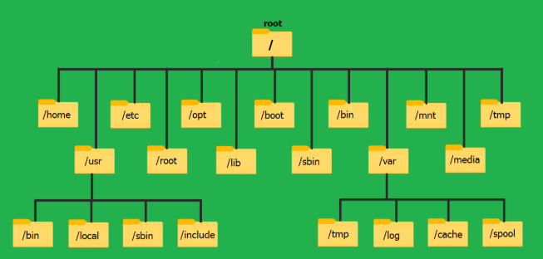
What is a Filesystem?
A filesystem (FS) is the method an operating system uses to organize, store, and retrieve files on a storage device
Here is the Linux FS:

Slide 7
Filesystem Properties
A real filesystem gives you things like:
> Hierarchical directories (that actually exist)
> In-place mutation (write at an offset)
> File locks (to prevent user overwrites and data corruption)
> Cheap metadata operations

Slide 8
Amazon S3 vs. HDFS
Next, we will look at:
> Amazon S3, which uses object storage for scale
> HDFS, which uses a distributed filesystem for throughput
> They intentionally offer different user contracts
regarding data consistency, performance, and functionality

Slide 9
Amazon S3

Slide 10
Introducing Amazon S3
> Amazon’s managed cloud storage solution
> Simple Storage Service; not so simple any more
> Handles durability, replication, scalability behind the scenes
> Object storage built to store and retrieve any amount of
data from anywhere

Slide 11
Amazon S3 Core Ideas
> Stores data as objects in buckets
> Each object has a key (string), metadata, and content
> Effectively infinite scale
> No cluster to manage

Slide 12
Amazon S3 Durability
Amazon S3 Standard and most S3 storage classes designed to provide 99.999999999% durability
(“eleven nines”) over a year.
What this means:
For every 10,000 objects stored, you'd expect to lose one object on average every 10 million years

Slide 13
Amazon S3 Replication
> S3 is durable thanks to replication across multiple
data centers and advanced data protection
> AWS automatically copies data across at least three
physically separated Availability Zones within a single region.

Slide 14
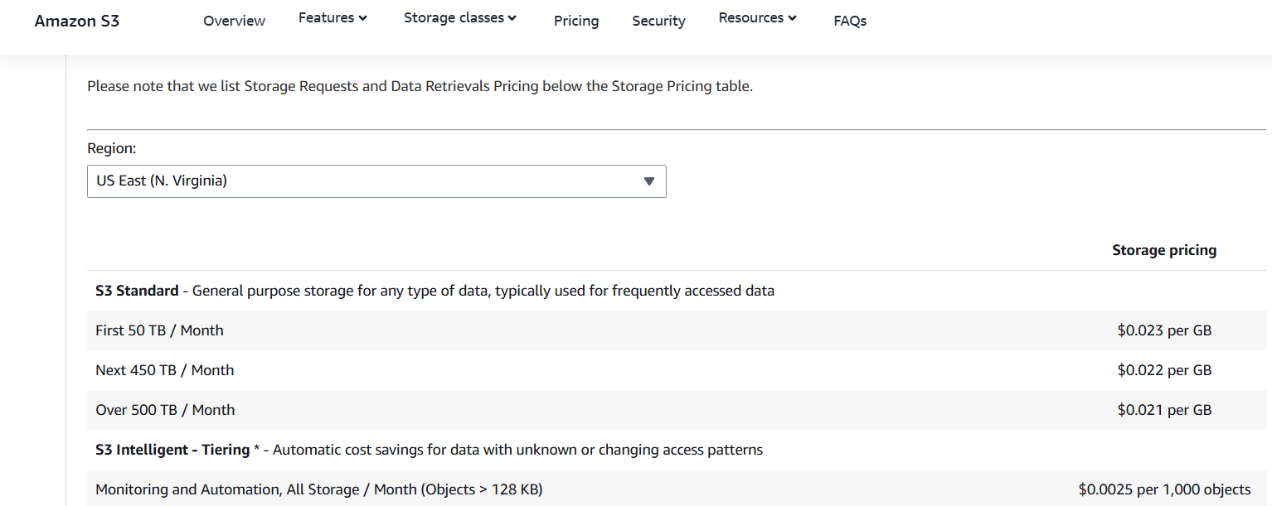
Amazon S3 Pricing
https://aws.amazon.com/s3/pricing/

Slide 15
Amazon S3 Limitations
> Higher latency than local disks or HDFS
> No true filesystem (“Directories” are just key prefixes)
- Access is via API calls, not file handles
- Overwrites are whole-object operations
- Can’t do in-place mutation
- No file locks

Slide 16
HDFS

Slide 17
About HDFS
> Hadoop Distributed File System (HDFS) uses a directory structure
> Stores very large files (GB–TB scale) across a cluster of
commodity machines
> Built for batch analytics, especially MapReduce / Spark-style
workloads

Slide 18
About HDFS
> Write once, read many (append is allowed; random writes are not)
> Files split into large blocks (typically 128–256 MB)
> Each block replicated (3 copies) across different nodes for fault tolerance
> Optimized for high throughput, not low latency

Slide 19
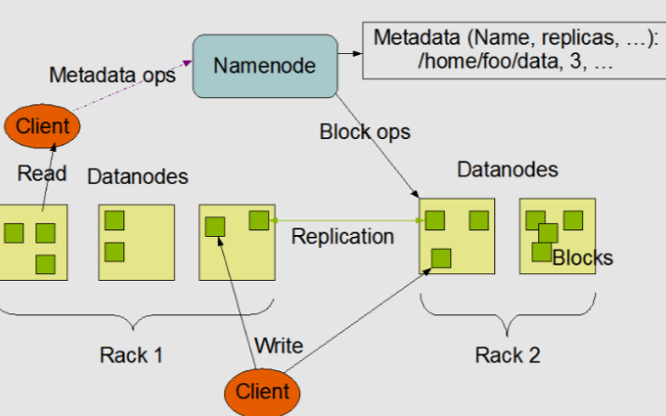
HDFS Architecture
> NameNode manages metadata (file paths, block locations, permissions)
> DataNode stores blocks of data
> Client asks Namenode where blocks live, then streams data directly from DataNodes

Slide 20
HDFS Strengths
> Excellent for large sequential reads/writes
- Due to block design
> Strong data locality (compute runs where data lives)
- NameNode directs compute to the data
- Replicas provide multiple places to run task
> Tight integration with Hadoop ecosystem (YARN, Spark)

Slide 21
When it Doesn’t Fit Well
> When you don’t have an Ops team to manage
> When you need low latency
> When you have a lot of small files

Slide 22
Where it’s Used
HDFS has been replaced by object storage for many workloads
> Still shows up for jobs running on-prem
> Useful when you need tight data locality
> Common when organization runs a Hadoop cluster

Slide 23
Key Takeaways
> S3 and HDFS were designed for different purposes
> We saw their tradeoffs around scalability and throughput
> Increasingly, object stores are used for distributed storage
- They can be decoupled from compute

