Slide 1
Schema Enforcement in Streaming
Big Data Systems
School of Data Science
University of Virginia

Slide 2
Reminder: What is a Schema?
A schema is a contract between producers and consumers of data.
It is a formal description of:
> Structure (fields, types, relationships)
> Constraints (required vs optional)
> Semantics (what the data means)

Slide 3
Examples of Schema
Database table definitions
API request/response formats
Event payloads
Serialized objects

Slide 4

Motivation
In streaming systems, data is:
Produced by many independent producers
Evolving continuously
Processed in real time, often without human intervention
Schema enforcement is even more critical in streaming systems

Slide 5
Motivation, contd.
Without schema enforcement:
A single malformed event can break downstream consumers
Silent data corruption propagates quickly
Analytics and models degrade before anyone notices

Slide 6
Schema Enforcement in Practice
Defining a formal structure for events
Validating events at ingestion or consumption
Controlling schema evolution over time
Streaming systems generally use schema-on-write
(validate when consuming)

Slide 7
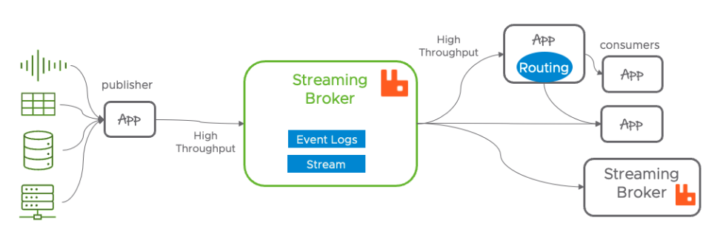
Where Enforcement Happens
Producer-side enforcement
Producers serialize data using a predefined schema
Invalid events never enter the stream

Slide 8
Where Enforcement Happens: Producer
Producer-side enforcement
Pros
> Prevents bad data early
> Less downstream complexity
Cons
> Harder to evolve because:
- Producers must strictly conform to schema before sending data
- Requires tight coordination across teams

Slide 9
Where Enforcement Happens: Broker
Broker / ingestion-layer enforcement
Stream broker or gateway validates events
Rejects or quarantines invalid messages

Slide 10
Where Enforcement Happens: Broker
Broker / ingestion-layer enforcement
Pros
> Centralized control
> Strong guarantees
Cons
> Adds latency
> Can become a bottleneck

Slide 11
Where Enforcement Happens: Consumer
Consumer-side enforcement
Consumers validate schema on read
Pros Cons
> Flexible > Bad data already propagated
> Allows heterogeneous consumers > Failure handling becomes complex

Slide 12

Schema Evolution in Streams
How to let schema change without breaking running pipelines?
Hard because:
> Old and new producers run simultaneously
> Consumers may lag behind
> Data cannot easily be “reprocessed”

Slide 13
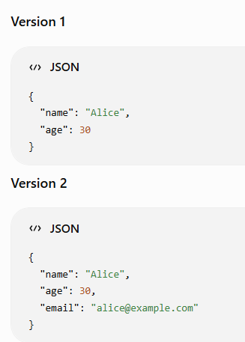
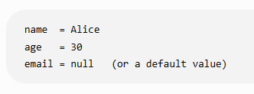
Compatibility Models
Compatibility-based versioning is the dominant approach
Backward compatibility
New consumers can read old data
Safe changes include adding optional fields or
providing defaults
When consumer sees version 1,
it provides default for missing email:

Slide 14
Compatibility Models, contd.
Forward compatibility
Old consumers can read new data
Requires new fields to be optional / ignorable
Full compatibility
> works in both directions
> harder to maintain but safest

Slide 15
Versioning Strategies

Slide 16
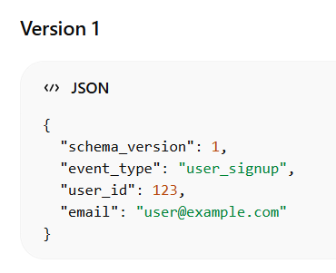
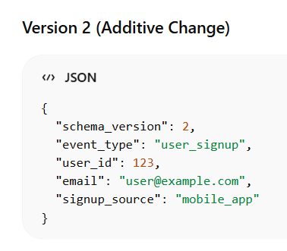
Strategy 1: Embed Schema Version
Embed schema version in each event
> Lightweight, self-describing messages
> Consumers handle multiple versions
> Event includes version

Slide 17
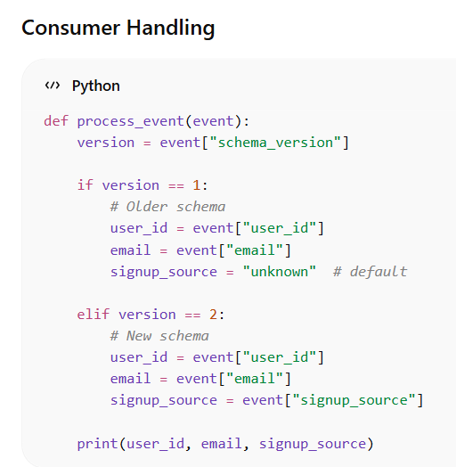
Strategy 1: Embed Schema Version
Embed schema version in each event
> Lightweight, self-describing messages
> Consumers handle multiple versions
> Event includes version

Slide 18
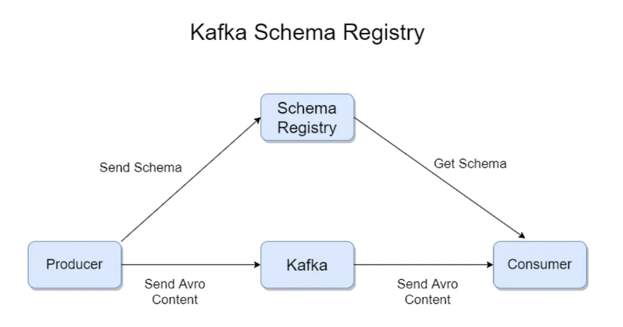
Strategy 2: External Schema Registry
Used by Apache Kafka + Apache Avro
> Centralized schema management and validation
> Enables compatibility checks (backward/forward)

Slide 19
Strategy 2: External Schema Registry
How it works:
1 | Instead of including the full schema in every message,
which adds overhead, producers send a compact schema ID
2 | A centralized repository manages and validate schemas of messages
3 | Consumers use this ID to fetch corresponding schema from
registry to deserialize and process the data correctly

Slide 20
Failure Modes

Slide 21
Failure Mode: Silent Schema Drift
Producers change payloads without coordination
Consumers continue running but produce wrong results
Most dangerous failure: nothing crashes.

Slide 22
Failure Mode: Hard Failures in Consumers
Deserialization errors:
Failure to convert raw bytes or text back into an object or structured data according to expected schema or format.
Consumer crashes or restarts
Backpressure builds:
As consumer/network slows, queue builds and system can run out of memory or crash

Slide 23
Failure Mode: Partial Enforcement
Some producers enforce schemas, others don’t
“Mostly valid” streams are worse than invalid ones

Slide 24
Performance and Scale
> Validation adds latency
> Schema lookups add network overhead
> Binary formats trade readability for throughput
Key tradeoff:
Strong enforcement vs low-latency ingestion

Slide 25
How this Interacts with Analytics & ML
> Feature pipelines assume stable schemas
> Model training breaks silently with schema drift
e.g., all data is missing from a feature and it’s set to default value
> Real-time dashboards mislead decision-makers

Slide 26
Design Principles (Takeaways)
> Enforce schemas as early as possible
> Make schema evolution explicit and versioned
> Prefer backward-compatible changes
> Monitor for schema violations continuously
> Treat schemas as APIs, not documentation
(Schema is a contract between producer & consumer, like an interface.)

