Slide 1
Data Lakes vs.
Data Warehouses
Big Data Systems
School of Data Science
University of Virginia

Slide 2
Data Lake
Stores data with any structure such as:
- transactional data
- videos (unstructured)
- config files (semi-structured JSON)

Slide 3
Data Lake, contd.
Not necessary to define schema … flexible
Amazon S3 is popular commercial product
- object file storage
- store data in buckets
- secure
- scales easily

Slide 4
Object File Storage
Data organized into objects
Each object contains:
- data
- metadata (key-value pairs describing object)
- unique ID (for retrieval)

Slide 5
Object File Storage, contd.
There are no actual folders (no directory structure)
Folders (e.g., in S3) are logical
Objects accessed via API or HTTP endpoints

Slide 6
Data Warehouse
Stores set of relational databases
Schema defined in advance … not flexible
Examples: Amazon Redshift, Google BigQuery

Slide 7
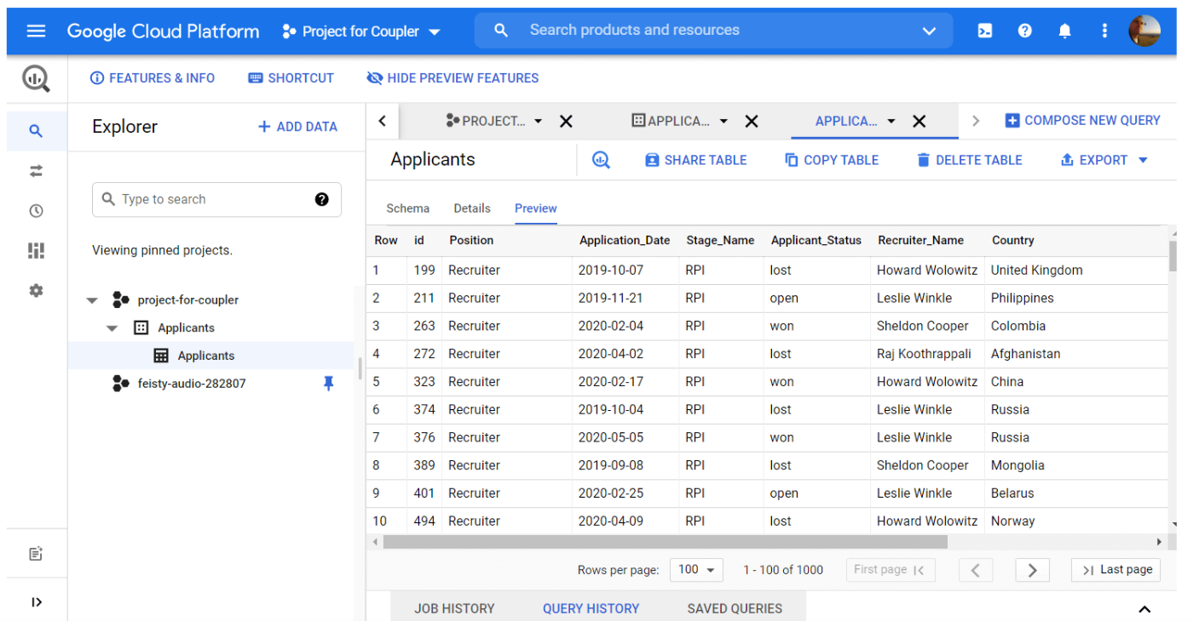
Data Warehouse: GUI Example

Slide 8
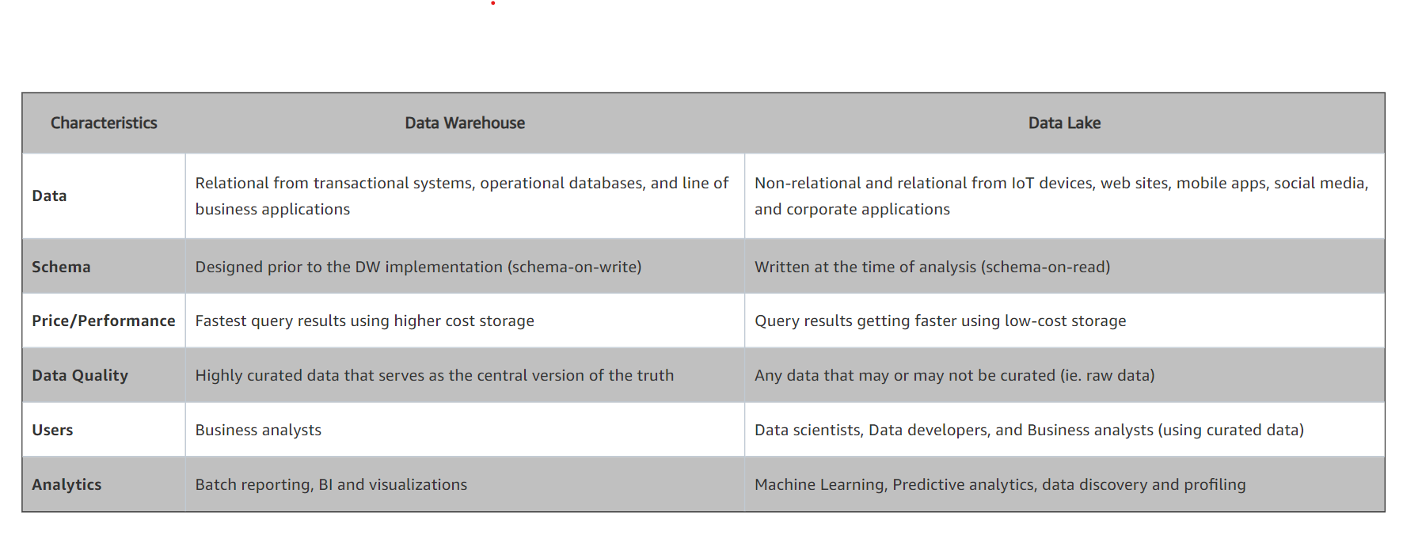
Comparison: Lake vs Warehouse
Source: https://aws.amazon.com/big-data/datalakes-and-analytics/what-is-a-data-lake/

