Slide 1
Overview of Federated Learning
Big Data Systems
School of Data Science
University of Virginia
Last updated: October 28, 2026

Slide 2
Agenda
> Federated Learning (FL) Background
> Federated Averaging (FedAvg)
> FL in Production
> Non-IID Data
> Differential Privacy
> Other Considerations and Challenges

Slide 3
FL Background

Slide 4
Decentralized vs Distributed Data
Decentralized
- Data is spread across machines
- No single entity controls all data
- No single entity sees all data
- Nodes can have their own policies and permissions
Distributed
- Data is spread across machines
- System has central authority

Slide 5
Setting
> Goal is to learn single, global ML model from decentralized,
sensitive data which cannot be moved from clients
> Clients may be mobile devices (cross-device)
or organizations (cross-silo)

Slide 6
Sampling
> Number of clients may be massive (mobile phones)
> For each round of training, algorithms randomly sample a small
set of clients C from total pool

Slide 7
Primitives
> Algorithms use primitives to separate concerns
> Examples:
- sum over selected clients
- broadcast to selected clients

Slide 8
Data Generating Mechanism
> Data generated locally
> Data remains decentralized

Slide 9
Orchestration
> Central server organizes training
> Central server never sees raw data

Slide 10
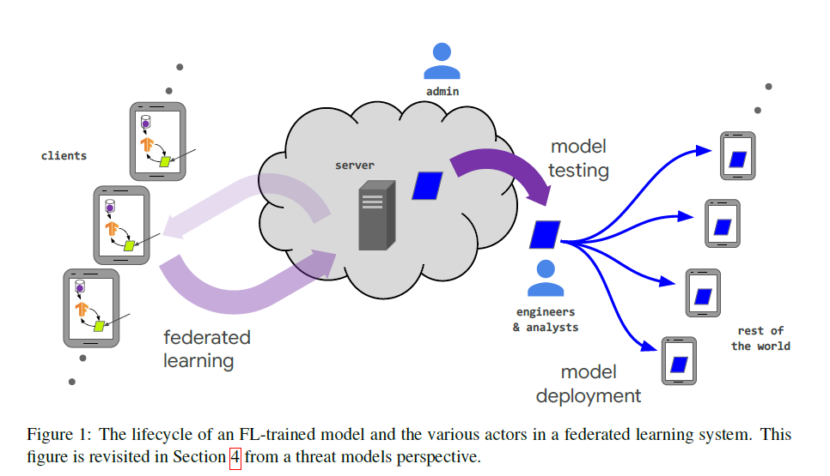
Lifecycle
Source: Advances and Open Problems in Federated Learning. Kairouz et. al.

Slide 11
Federated Averaging (FedAvg)

Slide 12
FederatedAveraging
Paper below introduces algorithm:
FederatedAveraging (FedAvg)
> Local SGD on each client
> Updated local models averaged by server
to form updated global model
Communication-Efficient Learning of Deep Networks from Decentralized Data. McMahon et. al.

Slide 13
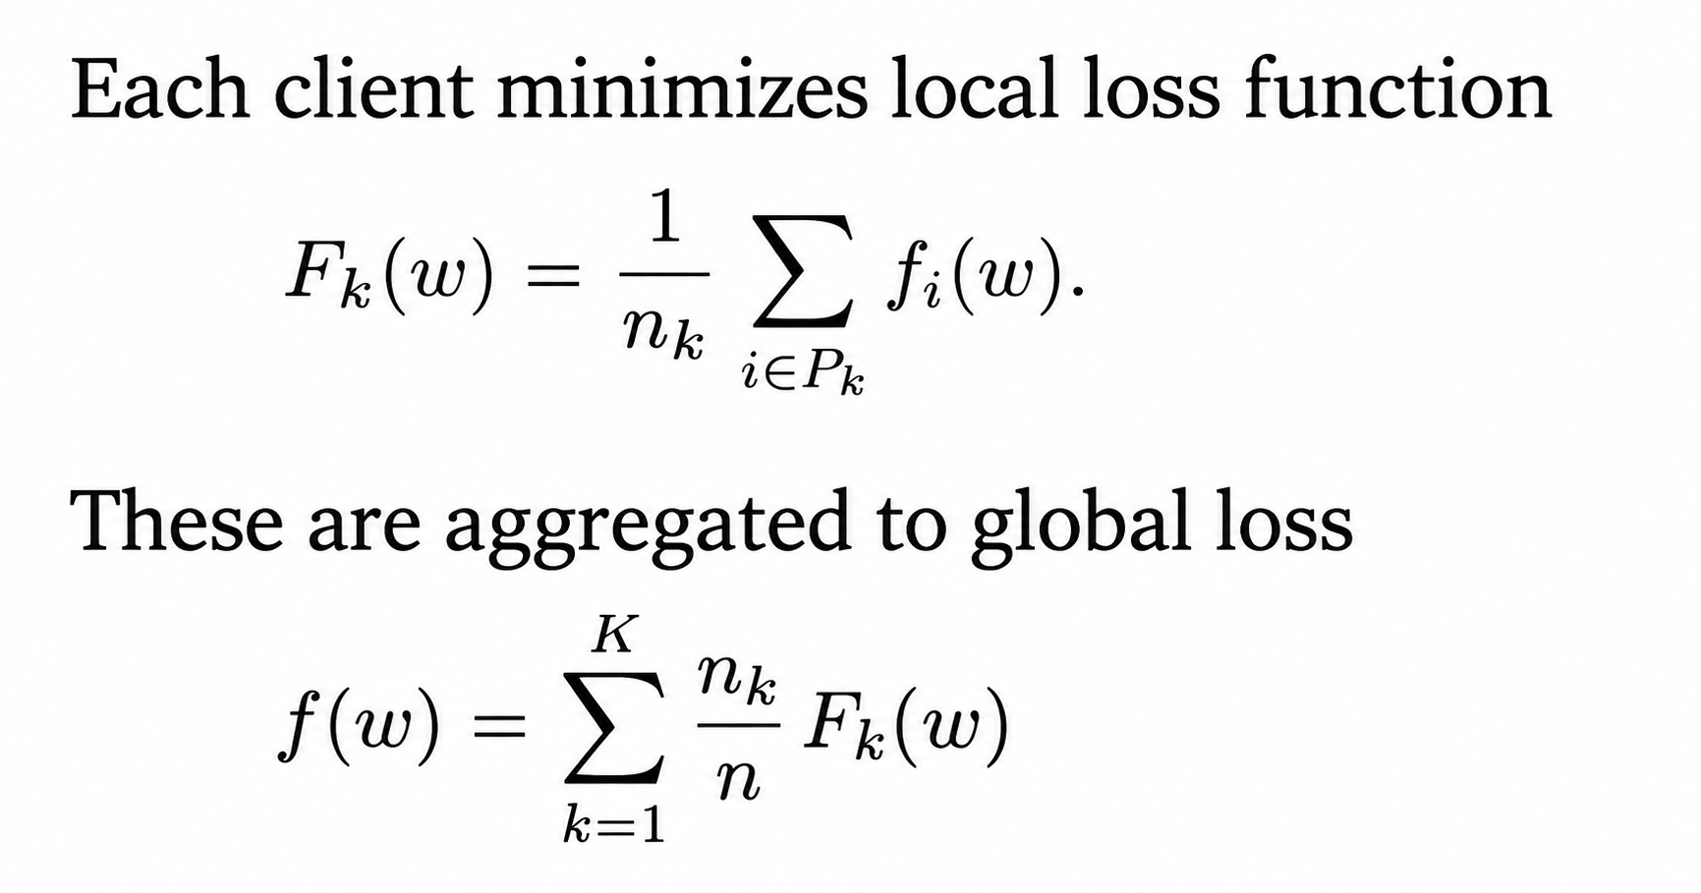
FedAvg Details

Slide 14
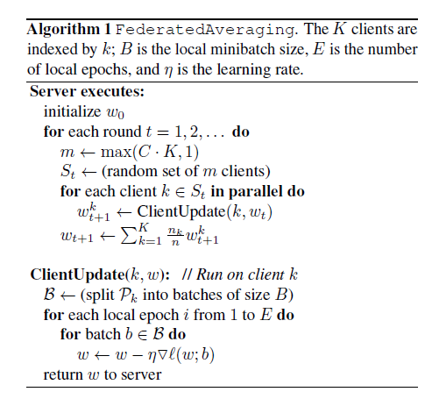
FedAvg Algorithm
Subset clients
Aggregate to global level
Local SGD

Slide 15
Design Parameter: Updates at Client
> Each round of FL requires sending model
weights or gradients over network
> Performing more updates at client can:
- reduce communication cost
- improve quality of local models

Slide 16
Design Parameter: Updates at Client, contd.
There is a tradeoff as downsides may include:
> Models drifting apart
> Slower convergence
> Global model may become biased if there is
overfitting

Slide 17
Design Parameter: Updates at Client, contd.
These factors need to be balanced
Rules of Thumb for production:
> (cross-device) 1–5 local epochs per round usually optimal
> (cross-silo) 5–50 local epochs per round often improves
convergence

Slide 18
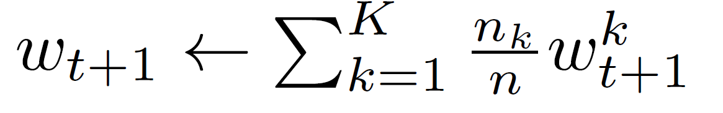
Design Parameter: Aggregation
FedAvg takes weighted avg of local models, in proportion to size of local datasets

Slide 19
FL in Production

Slide 20
Production Frameworks – NVIDIA FLARE
Open-source FL framework
Focused on cross-silo (hospitals, institutions, enterprises)
Built for production

Slide 21
Production Frameworks – NVIDIA FLARE
Production users include:
> Mayo Clinic
> Mass General Brigham
> NVIDIA partners in oncology & radiology
> Global medical imaging consortia

Slide 22
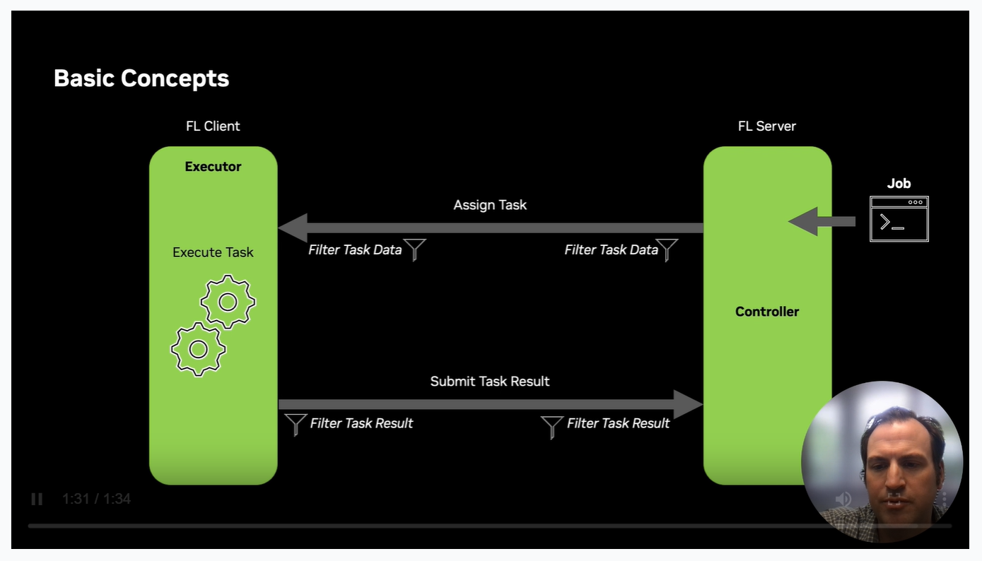
Production Frameworks – NVIDIA FLARE
> Privacy filters can be applied
> Jobs submitted to controller

Slide 23
Production Frameworks - FedML
Why it’s used:
> Cloud-native, lightweight, easy deployment.
> Handles on-device, edge, server-to-server FL.
> Offers MLOps, dashboards, experiment tracking.
Production users:
> Mobile OEMs
> IoT manufacturers
> Startups doing network optimization or personalization

Slide 24
Non-IID Data

Slide 25
IID Data
Many models require observations which are independent, identically distributed (IID)
FL is easiest when data is IID
But often, FL is conducted on non-IID data

Slide 26
Non-IID Data
Client-partitioned data may be non-IID:
> Two clients i and j may have different distributions
- Feature distribution skew
- Label distribution skew

Slide 27
Non-IID Data, contd.
> Same label, different features across i
> Same features, different label across I
> For single client, data may not be in random order
(ordered by frame in video)
> For single client, distn may change over time

Slide 28
Data Imbalance
Different clients may hold different amounts of data

Slide 29
Dataset Shift
Clients contributing to FL model training are subject to criteria
This may create bias: clients where model will be deployed may be different
Example: training on devices with more memory than is needed for inference

Slide 30
Differential Privacy

Slide 31
Goal of Differential Privacy
Differential Privacy (DP) protects individual data by adding noise
No single person’s information can be inferred from algorithm output

Slide 32
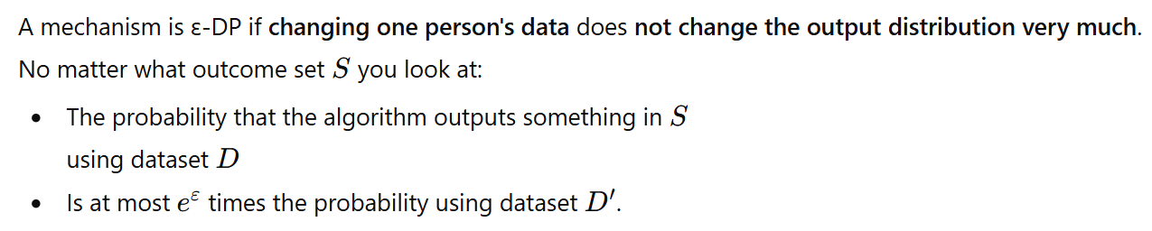
Mathematical Definition of Differential Privacy

Slide 33

Mathematical Definition of Differential Privacy

Slide 34
Effect of Differential Privacy
Adding noise trades off accuracy for privacy:
> Keeps data private, but result won’t be exactly right
> … but result may be “close enough”

Slide 35
Some Considerations for DP
Where is noise added, client-side or server-side?
What kind of noise should be added? (e.g., Gaussian, Laplace)
At what step to add the noise? (e.g., add noise to gradients)

Slide 36
How DP is implemented in FLARE
DP is optional in FLARE
Common method:
1. Compute local model updates
2. Clip update to fixed norm (to bound sensitivity)
3. Add Gaussian noise
4. Send to server

Slide 37
How DP is implemented in FLARE, contd.
Server aggregates noisy updates
> Maintains client privacy
> Global model still converges if noise is calibrated properly

Slide 38
Other Considerations and Challenges

Slide 39
Incentive Mechanisms
Often need to encourage honest participation
Particularly true when clients are competitors and there are free-riders
Can provide:
> Monetary incentives
> Model performance in proportion to contribution

Slide 40
Straggler Problem
Local-update SGD methods have all clients perform
the same number of local updates
This can introduce bottleneck if any client unpredictably slows down or fails (straggler).

Slide 41
Straggler Problem: Some Solutions
1) Deadline-based participation
Server sets max round time
> Clients finishing in time upload their updates
> Stragglers ignored for the round

Slide 42

Straggler Problem: Some Solutions
2) Asynchronous FL
> Server doesn’t sync rounds
> Client sends updates when ready
> Server updates global model with rule like:

Slide 43
Multi-Task: Local Fine Tuning
One popular approach to FL models with non-IID:
1. Begin with FL training of global model
2. Deploy model to each client
3. Fine tune client models locally

Slide 44
Multi-Task: Models Trained on Subsets
Another approach is to train models on specific subsets
This falls between global model and local models
Subsets may be formed by geo, characteristics, clusters, etc.

Slide 45
References
Communication-Efficient Learning of Deep Networks from Decentralized Data. McMahon et. al.
Purpose: Introduced Federated Learning
Advances and Open Problems in Federated Learning. Kairouz et. al.
Purpose: Broad paper surveying challenges

