Slide 1
Consistent Hashing for
Scalable Data Storage

Slide 2
Horizontal Scaling of Data
How can we provide a system that scales with increasing data?
Consistent Hashing provides a nice solution

Slide 3
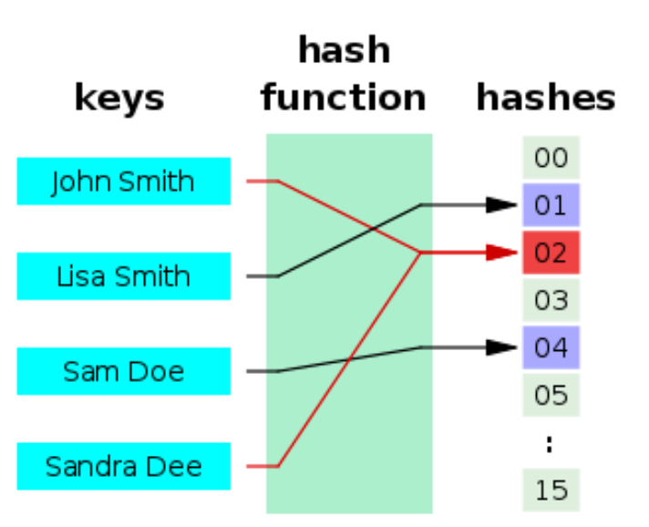
Review: Hash Function
A hash function is any function that
maps data of arbitrary size to fixed-size values
Simple and common method:
modulo division
hash(key) mod N
Partitions hashes into N buckets

Slide 4
Does mod N hashing work?
Need to distribute data uniformly across servers
One approach is this hash method:
server_index = hash(key) mod N
where N=16 is size of server pool

Slide 5
Does mod N hashing work?
Consider data scales by factor of 10
An additional server is added
Server pool is now size N+1 = 17
Problem: When N changes, the mod operation produces new server indexes...for nearly all data! This would shuffle data to different servers.
Example when hash value = 20
20 mod 16 = 4
20 mod 17 = 3

Slide 6
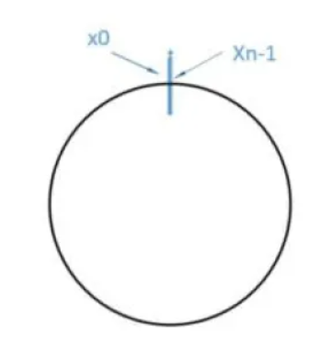
Consistent Hashing
A special kind of hashing which uses less shuffling of data
> k/N keys remapped on average, where k = # keys
Uses object called a hash ring
Hashes are mapped into slots on a line
For the last value to connect to the first,
the space is shaped into a ring
Source of this example:
https://www.acodersjourney.com/system-design-interview-consistent-hashing/

Slide 7
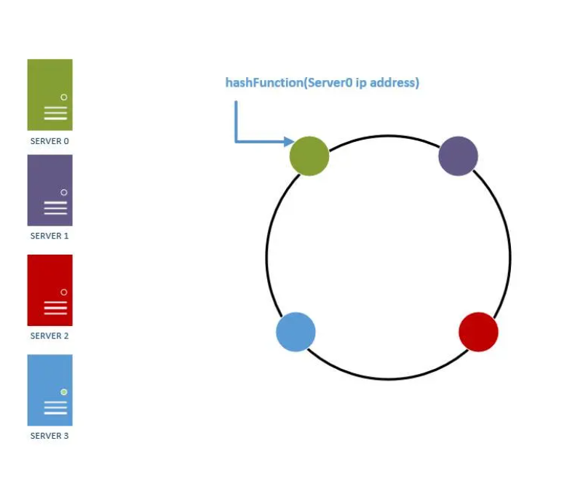
Consistent Hashing Illustration
1. Map servers and keys onto ring using uniformly distributed hash function
2. Server lookup: to determine which server a key is stored on,
Move clockwise from key position on ring until a server is found
Figure: Adding servers to ring

Slide 8
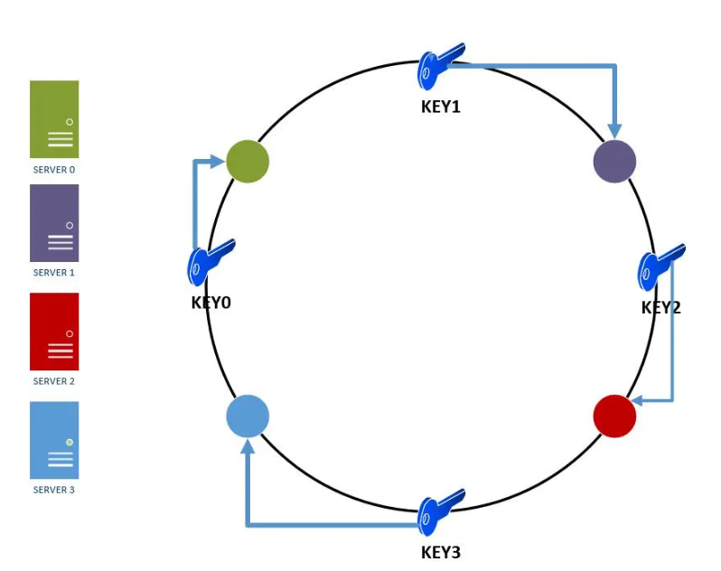
Consistent Hashing Illustration, contd.
Servers and Keys placed on ring
Look up server by moving clockwise from key

Slide 9
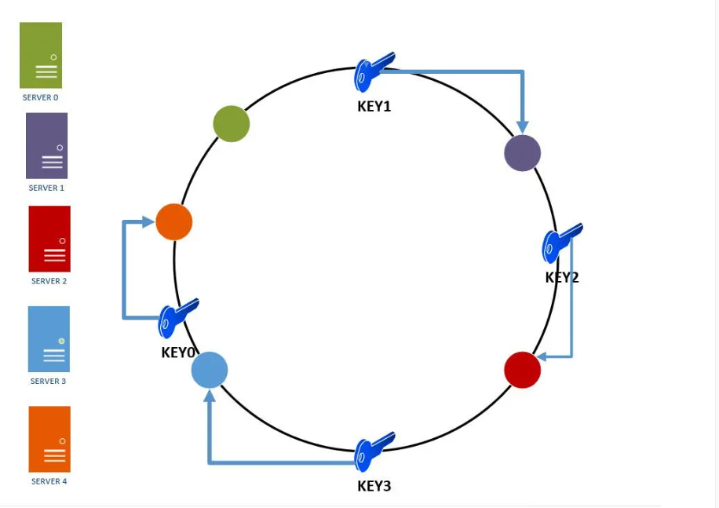
Consistent Hashing: Adding a Server
Adding a fifth server affects the ring:
key0 will be remapped from server0 to server4
The remaining keys remain on the same servers,
which is a large benefit of the approach

Slide 10
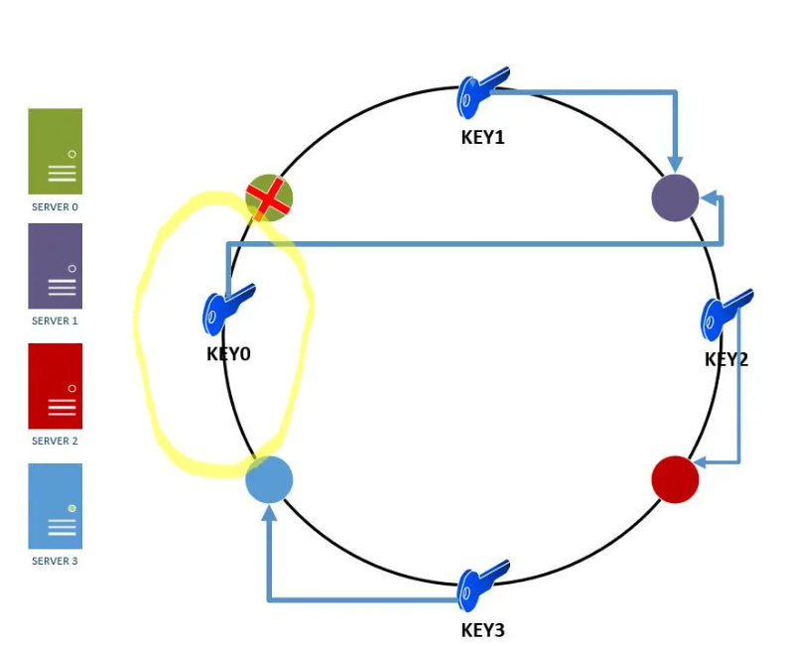
Consistent Hashing: Server Failure
In this illustration, there were 4 servers and one failed
key0 is mapped to the next available server
Remaining keys don’t move

Slide 11
Further Reading
The approach can be refined using virtual nodes
You might also want to review the coding to implement consistent hashing
See the source article for details:
https://www.acodersjourney.com/system-design-interview-consistent-hashing/

