Slide 1
ML Problem Framing
DS 6011: Capstone Part I
School of Data Science
University of Virginia
Last updated: September 2, 2023

Slide 2
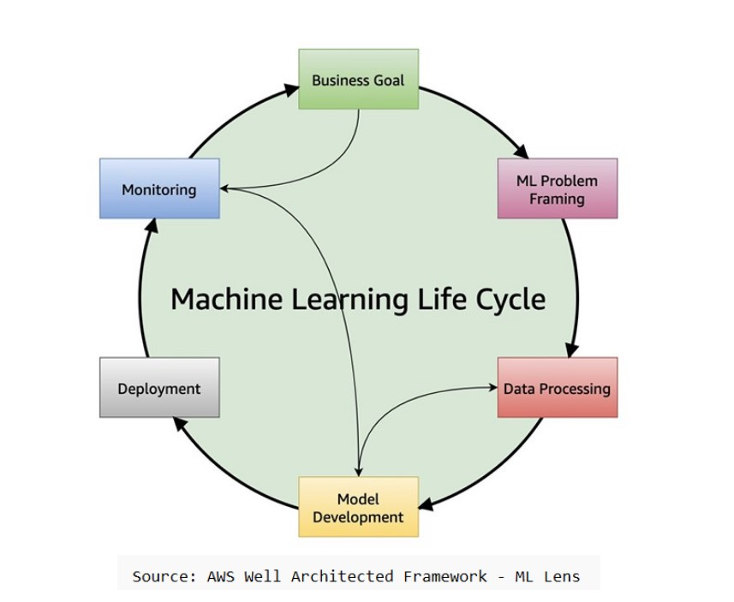
ML Life Cycle

Slide 3
ML Problem Framing
Following Business Goal step, we frame as ML problem
This assumes that ML is required for solution
In some cases, can solve with rules / analytics / queries

Slide 4
Goals of Problem Framing
1. Understand the use case and deliverables
(e.g., model to predict churn)
2. Consider approaches (e.g., supervised learning)
3. Data collection / uses / availability. Predictions and target.
4. Performance metrics (e.g., # false positive for each true positive)
5. Responsible AI: building models that are safe and unbiased

Slide 5
Approaches
Which of these approaches is appropriate for the problem?
Type | Description | Labeling Requirement
Supervised learning | Learn a function to map predictors to target | Data needs to be labeled
Semi-supervised learning | Learn from labeled data, infer unlabeled data, and repeat | A portion of data needs to be labeled
Unsupervised learning | Learn groupings and outliers | Labels not required
Reinforcement learning | Learn from environment by taking action in a state, receiving next state and reward | Labels not required but reward function is needed

Slide 6
Data
Is there documentation / data dictionary / data schema?
What data is available? Are there potentially useful predictors?
Is data labeled? Is there PII/PHI that needs to be masked?
How is data collected?
What specifics should be known about data?
Understand how data is missing / limited / incorrect

Slide 7
Performance Metrics
Need to understand success criteria for adoption
Is there a known benchmark (e.g., current model in production with F1
score of 70%)?
Metric will depend on type of problem (classification, regression)
Helps to think about impact to business for each type of error
1. False Positive (FP)
2. False Negative (FN)

Slide 8
Common Metrics – Binary Classifier
Metrics fall in range [0,1]. Higher is better.
Metric | Example
Recall fraction of positive cases detected | Recall = #(true positive) / #(positive cases) 100 customers that churn Of the 100, model predicted 70 as churn risk Recall = 70/100 = 0.70
Precision fraction of predicted positives that were correct | Precision = #(true positive) / #(predicted positive) 80 customers predicted to churn Of the 80 predicted, 70 churned Recall = 70/80 = 0.875
F1 score harmonic mean that balances recall, precision | F1 = 2 (recall x precision) / (recall + precision) = 2 (0.7 x 0.875) / (0.7 + 0.875) = 0.778

Slide 9
Common Metrics – Regression
Adjusted R-squared
Fraction of variation in target variable explained by predictors, adjusted for model complexity.
Higher is better.
Root Mean Squared Error (RMSE)
Measures the average difference between predicted values and target values.
Lower is better. Sensitive to outliers.
Mean Absolute Error (MAE)
Measures errors between predicted values and target values.
Lower is better. Robust to outliers.

Slide 10
Responsible AI
Is there bias in the data that should be considered?
Example: are there protected classes not represented?

