Slide 1
Project Planning and Management
DS 6011: Capstone Part I / Capstone Prep
School of Data Science
University of Virginia
Last updated: June 21, 2024

Slide 2
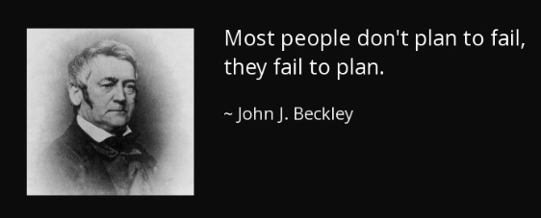

Slide 3
Agenda
Data science projects vs traditional software development
Timeline
Sprint Ownership
Coordinating tasks
Collaboration
Meetings with Sponsor

Slide 4
Data Science vs Software Projects
Data science projects are different from software development
There is a lot more research and iteration required
Doesn’t always fit a tidy schedule (2-week sprints)
DS is based on probability which brings uncertainty

Slide 5
Sprints for Data Science
Even still, activities can be time boxed:
e.g., dedicate 2 weeks for research on certain task
Start by working backward: get clear on what success looks like
Ask the sponsor: How will this be used in the future?
Make a list of stages (discovery, lit review, data processing, modeling)
Put the stages on a rough calendar

Slide 6
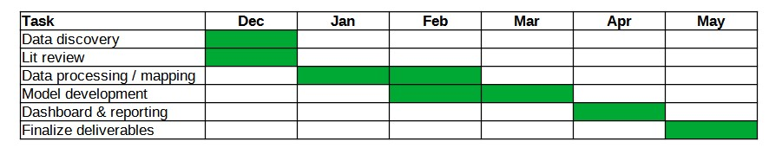
Timeline
Gantt chart example
When forming the timeline, take into account:
- capacity of team members
- holidays / time off
- important events
Share this timeline with sponsor, faculty mentor to get feedback, buy-in
Include in Project Plan and Progress Reports

Slide 7
Timeline Management
Gantt chart example
The chart will change over time and get more detailed
You might add more tasks
Can probably coordinate tasks (e.g., who is owner) without discussing with sponsor

Slide 8
Sprint Ownership
For a smooth student team dynamic, will be helpful to appoint Sprint Owner
The Sprint Owner will own the sprint by:
- making sure work is completed and organized
- preparing an agenda for sponsor meeting
- running the sponsor meeting

Slide 9
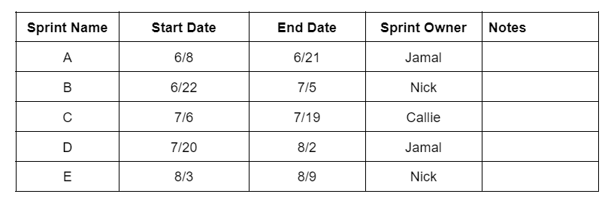
Appointing Sprint Owner
Figure out who the owner will be:
- In first student meeting, ask who would like to lead sprints
- If several people would like to lead, make a schedule and rotate
Rotation can be helpful as each student gets a turn leading
Save the schedule in your shared location (e.g., Google Drive doc)

Slide 10
Coordinating Tasks
For managing the project, it will be helpful to have these things in shared location:
1) Stack of tasks that need to get done:
- name of each task
- task description
2) Tasks in the current sprint
- task name
- task description
- who is working on the task
- owner of task: who is responsible
- status
- any blockers

Slide 11
Collaboration
As the team makes progress / completes sprints, want to share broadly
Team should decide how to do this (and it should go into team contract)
Examples:
- Can update work on current sprint by a certain date and ask members to review
- Can discuss at a meeting
- For blockers, may want to reach out for faster feedback (Teams, email)

Slide 12
Preparing for Meetings with Sponsor
Prepare an agenda and share with sponsor in advance of meeting
- can add to calendar invite
Prepare a deck for sponsor meeting. Should include:
- Agenda
- Reminder of success criteria (to ensure alignment)
- Timeline (discuss if it needs to change)
- What you’ve worked on during this sprint:
progress, findings, decisions, blockers
- Plan for next sprint: make sure people have bandwidth and adjust as needed.

Slide 13
Meetings with Sponsor
Discussing how to get questions answered
In first meeting, ask sponsor about best way to get questions answered
Example: They share a dataset with 100 columns and no data dictionary.
They may suggest a shared doc with list of questions and routine review
Get a sense of how detailed your discussion should be
As you review work, pause, take questions, ask if the details are useful, etc.
It’s important to get feedback, keep attention, and have clear next steps

Slide 14
Meetings with Sponsor, contd.
If something is unclear or you don’t know what to do next, ask!
Although this may be uncomfortable, don’t be shy

Slide 15
Important Early Steps
Starting the project can be awkward. Taking these early steps can help:
1) Create a shared location for work and ensure everyone can access
2) In first student meeting, ask who would like to lead sprints.
Making a schedule and rotating sprint owner can work well.
3) In first sponsor meeting, ask about best way to get questions answered
4) Find regularly recurring meeting times that will work and schedule them
e.g., weekly meeting with mentor, every other week with sponsor
can adjust as needed

