Slide 1
[TITLE]
DS 6011: Capstone Part I
School of Data Science
University of Virginia
Last updated: September 2, 2023

Slide 2
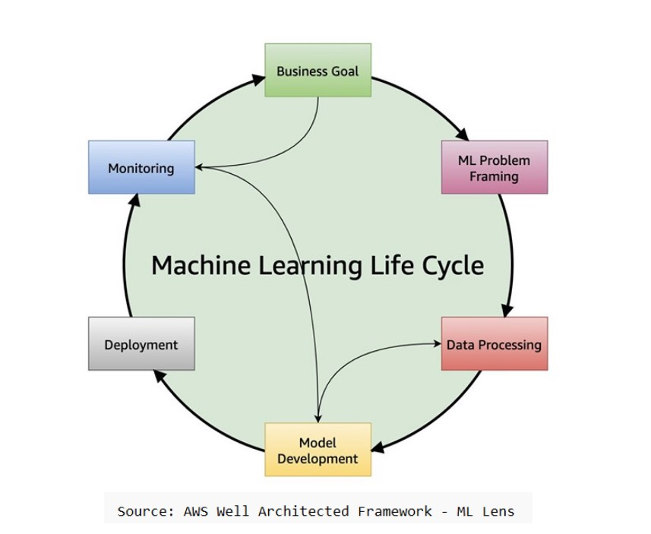
ML Life Cycle

Slide 3
Title
text

