Slide 1
Crucial Conversations
DS 6011: Capstone Part I / Capstone Prep
School of Data Science
University of Virginia
Last updated: September 24, 2024

Slide 2
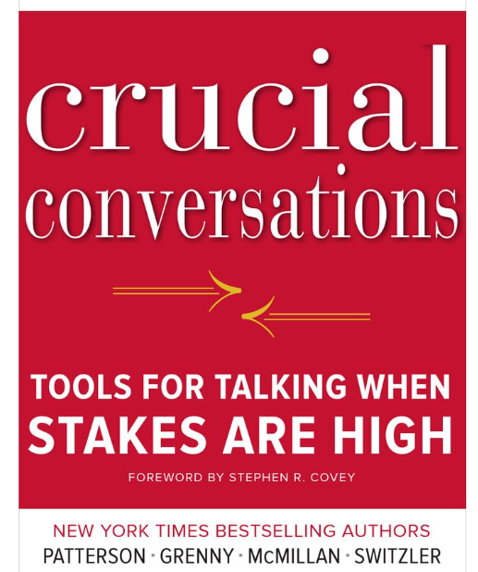

Slide 3
What is a crucial conversation?
Opposing views
Strong emotions
High Stakes – can have large impact on quality of life

Slide 4
Why should we care?
Do crucial conversations arise often?
For sure. With a manager, spouse, friend, neighbor, …
And sometimes we need to have them, but we avoid them

Slide 5
Why should we care?, contd.
Key skill of effective leaders, parents, teammates, loved ones is
capacity to skillfully address emotionally and politically risky issues

Slide 6
Loaded Questions and Honesty
Land mines in disguise as casual questions:
- How do I look?
- How do you like this new recipe I dropped on you?
- How are you liking my course?
- How are you liking this capstone project?
Bear in mind:
People care what you think, but they’d love to hear praise
At any age, people love (need) praise

Slide 7
False Tradeoff
We sometimes believe that to be effective,
we need to be brutally honest
This isn’t really true
It is possible to be effective with honesty and kindness

Slide 8
Broaching the Subject
You’ve been working at XYZ
and notice communication and leadership are ineffective.
You’re tired of it, honestly.
Bad strategy: Approach your boss and “tell him what you think.”
Better strategy: Approach your boss with curiosity, observations,
and potential solutions.

Slide 9
How well do we do?
People typically handle such conversations poorly
Why?
We’re designed wrong...for fight or flight
Brain diverts blood away from itself, to arms and legs

Slide 10
Dialogue
Skilled people find a way to convey all relevant information
Dialogue: free flow of meaning between 2+ people
How to get to dialogue?

Slide 11
Start with Heart
Begin with the right motives, and stay focused
We can feel attacked and defensive in these situations
The key is to ask yourself:
“What do I really want for me? for others? for the relationship?
How do I get these results?”

Slide 12
Make it Safe
How can someone be willing to accept tough feedback?
Can we take feedback from a friend?
Need to believe the person cares about you
First condition for safety: Mutual Purpose
Each person needs to feel respected and cared about

Slide 13
Contrasting
If you feel your message is not clear, use contrasting language.
The last thing I’d want to do is give the impression that your work
isn’t important
I value the work that you put in, but at the same time, if you could
review it before our meetings, it should help ensure correctness

Slide 14
Master My Stories
1) There’s a big project and you’re not selected for it.
2) After completing three rounds of interviews, you learn you
didn’t get the job.
3) You’ve worked on a capstone project for six months and the
results aren’t what you hoped for.
These situations can feel upsetting...maybe devastating.

Slide 15
Master My Stories, contd.
Crucial conversations (and outcomes) generate strong emotions.
We often create a story to explain the outcome
That story may involve a shortcoming / unfairness / injustice
The story can make us upset / angry

Slide 16
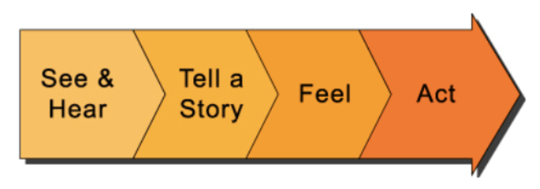
The Path to Action
See & Hear: We observe the situation
Tell a Story: We tell ourselves an explanatory story
Feel: We think about this story and have feelings
Act: Based on our thoughts and feelings, we take action

Slide 17
The Path to Action – The Interview
See & Hear: After 3 interview rounds, didn’t get job
Tell a Story: We’re not good enough for the job
Feel: Ashamed, disappointed
Act: Retreat / drink / wallow in self pity
Note:
There are many reasons interviewers don’t get jobs, outside of their control
(lost headcount, internal hire, hiring manager feels threatened, another
candidate is cheaper, etc.)

Slide 18
Toward Better Stories
If we take control of our stories, they won’t control us
To get better results, tell yourself better stories
How to do this?
- Consider the facts
- Notice your behavior
- Get in touch with your feelings

Slide 19
Situation 1
You’re managing a data scientist on an important project
In your mind, the results are wrong...again
The data scientist views himself as highly capable
There are other capable data scientists on the team with bandwidth
How should you handle this situation?

Slide 20
Situation 2
Your capstone mentor decides to expand the project scope
Apparently there’s a big potential customer and a pivot is needed
There are only two months left in the semester
How should you handle this situation?

Slide 21
Conclusion
Important to identify a crucial conversation and handle it well
Some skills include:
- Start with heart
- Master your stories
It takes practice to have effective crucial conversations
It is well worth the effort

