Slide 1
Project Planning
DS 6011: Capstone Part I
School of Data Science
University of Virginia
Last updated: September 30, 2023

Slide 2
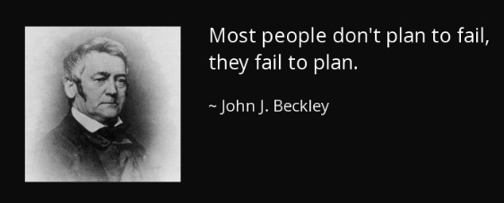

Slide 3
Agenda
Data science projects vs traditional software development
What do do: figuring out stages and sequence
Coordinating tasks
Collaboration
Meetings with Sponsor

Slide 4
Data Science vs Software Projects
Data science projects are different from software development
There is a lot more research and iteration required
Doesn’t always fit a tidy schedule (2-week sprints)
DS is based on probability which brings uncertainty

Slide 5
Sprints for Data Science
Even still, activities can be time boxed:
e.g., dedicate 2 weeks for research on certain task
Start by working backward: get clear on what success looks like
Make a list of stages (discovery, lit review, data processing, modeling)
Put the stages on a rough calendar

Slide 6
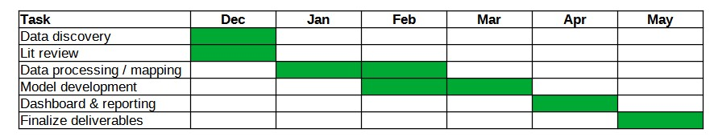
Timeline
Gantt chart
When forming the timeline, take into account:
- capacity of team members
- holidays / time off
- important events (e.g., SIEDS if participating)
Share this timeline with sponsor, faculty mentor to get feedback, buy-in

Slide 7
Timeline management
Gantt chart
The chart will change over time and get more detailed
You might add more tasks
Can probably coordinate tasks (e.g., who is owner) without discussing with sponsor

Slide 8
Coordinating Tasks
For managing the project, it will be helpful to have two things in a shared location:
1) Stack of tasks that need to get done:
- name of each task
- task description
2) Tasks in the current sprint
- task name
- task description
- who is working on the task
- owner of task: who is responsible
- status
- any blockers

Slide 9
Collaboration
As the team makes progress / completes sprints, want to share broadly
Team should decide how to do this (and it should go into team contract)
Examples:
- Can update work on current sprint by a certain date and ask members to review
- Can discuss at a meeting
- For blockers, may want to reach out for faster feedback (Teams, email)

Slide 10
Meetings with Sponsor
Prepare a deck for sponsor meeting. Should include:
- Agenda
- Reminder of success criteria (to ensure alignment)
- Timeline (discuss if it needs to change)
- What you’ve worked on during this sprint:
progress, findings, decisions, blockers
- Plan for next sprint: make sure people have bandwidth and adjust as needed.

Slide 11
Meetings with Sponsor, contd.
Get a sense of how detailed your discussion should be
As you review work, pause, take questions, ask if the details are useful, etc.
It’s important to get feedback, keep attention, and have clear next steps

