Slide 1
Useful Statistics and Error Analysis

Slide 2
Background
Suppose we have built an ML model that predicts three quantities:
(Calcium, Phosphorus, PTH)
We will look at some summary statistics of the data
We will look at some error metrics to understand the predictive performance
As we will learn, it is relatively easy to compute statistics and metrics... ...it often takes more work to measure the right things

Slide 3
About the Data
The data is all fictitious (simulated)

Slide 4
Summary Statistics
 | Mean | SD
PTH | 500 | 425
Calcium | 9.1 | 0.7
Phosphorus | 5.5 | 1.7
Based on these stats, which variable may be the hardest to predict?

Slide 5
Overall Error of Predictions
What are these metrics telling us?
Are they useful? What would be more useful?
RMSE (training set) | RMSE (test set)
0.28 | 0.30

Slide 6
Errors by Elements
What information does this add to our understanding?
What do we not know?
 | RMSE (test set)
PTH | 1.5
Calcium | 0.2
Phosphorus | 0.5

Slide 7
Histograms
Histograms show the full distribution
This is richer information than a statistic like a mean

Slide 8
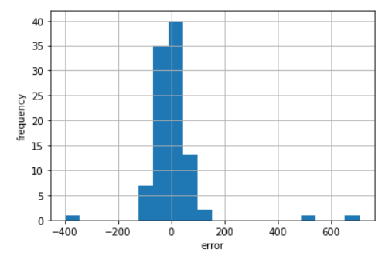
Histogram of Errors - PTH
How is this graph useful? Are there limitations?

Slide 9
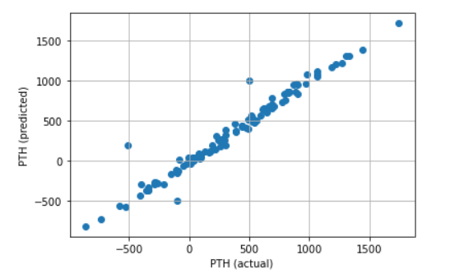
Predicted vs Actual
How is this graph useful? Are there limitations?

Slide 10
Using Errors to Improve the Model
Deep diving into errors (error analysis) can help improve the model:
For the largest errors,
- Are there patterns?
- Are these cases due to invalid data? Action: Might want to repair / exclude this data.
- Are we missing predictors? Action: Might want to test more predictors.

Slide 11
Empirical Distributions
For a random variable, the cumulative distribution function shows
the probability that the value is x or lower: F(x) = P(X <= x)
When we observe a batch of data, we can compute and graph this
over a range of values for x. Called the empirical distribution.
This provides much richer information than the mean, as we can
see the data across all percentiles.

Slide 12
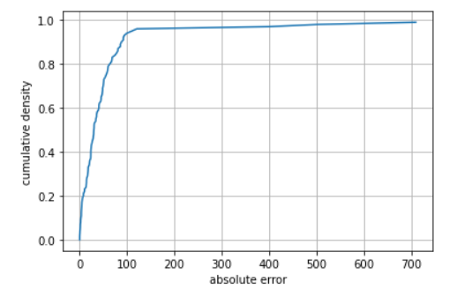
Empirical Distributions, contd.
Percentiles
What information does this graph provide?
median | 30.42
75%ile | 54.90
90%ile | 86.63

Slide 13
Takeaways
It can be tempting to: > produce / report a lot of statistics > try a battery of ML models Given available packages, this is often easy to do!
But often it is better to: - carefully consider which statistics are valuable - carefully analyze prediction errors Learnings from prediction errors can often improve results No model can overcome bad data

