Slide 1
[TITLE]
DS 6015: Data Science Capstone
School of Data Science
University of Virginia
Last updated: August 18, 2025

Slide 2
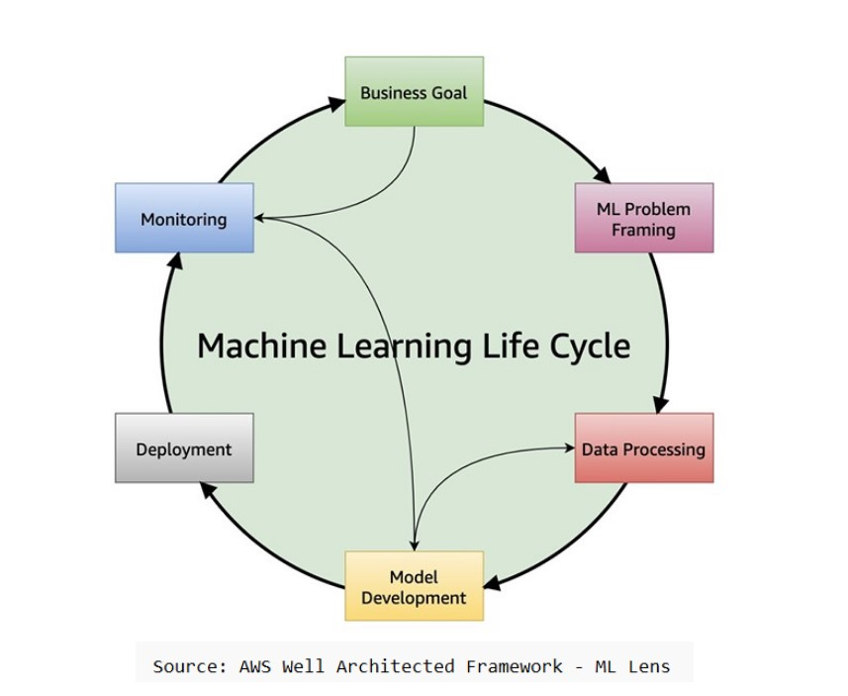
ML Life Cycle

Slide 3
Title
text

