Slide 1
ML Problem Framing
DS 6015: Data Science Capstone
School of Data Science
University of Virginia
Last updated: August 18, 2025

Slide 2
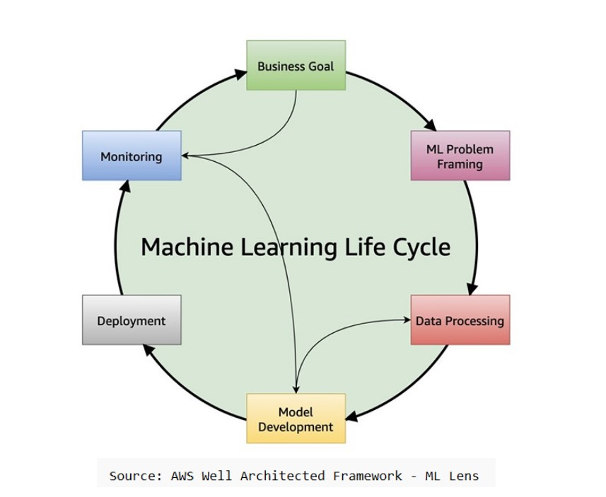
ML Life Cycle

Slide 3
ML Problem Framing
Following Business Goal step, we frame as ML problem
This assumes that ML is required for solution
In some cases, can solve with rules / analytics / queries

Slide 4
Goals of Problem Framing
1. Understand the use case and deliverables
2. Consider approaches (e.g., review literature)
3. Data collection / uses / availability. Predictions and target.
4. Performance metrics (e.g., # false positive for each true positive)
5. Responsible AI: building models that are safe and unbiased

Slide 5
Use Case and Deliverables
Clarify the use case: what needs to be done?
What does success look like?
What needs to be delivered? model / dashboard / etc.

Slide 6
Approaches
Which of these approaches is appropriate for the problem?
Type | Description | Labeling Requirement
Supervised learning | Learn a function to map predictors to target | Data needs to be labeled
Semi-supervised learning | Learn from labeled data, infer unlabeled data, and repeat | A portion of data needs to be labeled
Unsupervised learning | Learn groupings and outliers | Labels not required
Reinforcement learning | Learn from environment by taking action in a state, receiving next state and reward | Labels not required but reward function is needed

Slide 7
Literature
What papers may be helpful / relevant?
What code may be helpful / relevant?

Slide 8
Data
Is there documentation / data dictionary / data schema?
What data is available? Are there potentially useful predictors?
Is data labeled? Is there PII/PHI that needs to be masked?
How is data collected? Ideally, get walk-through of process.
What specifics should be known about data?
Understand how data is missing / limited / incorrect

Slide 9
Performance Metrics
Need to understand success criteria for adoption
Is there a known benchmark (e.g., current model in production
with F1 score of 70%)?
Metrics will depend on type of problem (classification, regression)
Helps to think about impact to business for each type of error
1. False Positive (FP) – predicted positive but incorrect
2. False Negative (FN) – predicted negative but incorrect

Slide 10
Common Metrics – Binary Classifier
Metrics fall in range [0,1]. Higher is better.
Metric | Example
Recall fraction of positive cases detected | Recall = #(true positive) / #(positive cases) 100 customers that churn Of the 100, model predicted 70 as churn risk Recall = 70/100 = 0.70
Precision fraction of predicted positives that were correct | Precision = #(true positive) / #(predicted positive) 80 customers predicted to churn Of the 80 predicted, 70 churned Precision = 70/80 = 0.875
F1 score harmonic mean that balances recall, precision | F1 = 2 (recall x precision) / (recall + precision) = 2 (0.7 x 0.875) / (0.7 + 0.875) = 0.778

Slide 11
Common Metrics – Regression
R-squared
Fraction of variation in target variable explained by predictors.
Falls in range [0,1]. Higher is better
Adjusted R-squared
Fraction of variation in target variable explained by predictors, adjusted for model complexity.
Higher is better.
Root Mean Squared Error (RMSE)
Measures the average difference between predicted values and target values.
Lower is better. Sensitive to outliers.
Mean Absolute Error (MAE)
Measures errors between predicted values and target values.
Lower is better. Robust to outliers.

Slide 12
Responsible AI
ML brings automation at scale
A large risk is bias
Often results from under-representation of a group
Example: are there protected classes not represented?
Protected class: group of individuals protected by law
Examples: Age > 65, Female

Slide 13
Measuring Class Imbalance
Several ways to measure class imbalance
One simple measurement:
for given class, #(majority cases) - #(minority cases)
Another is based on outcomes for a group:
Example: Females 20% more likely to be rejected for mortgage

Slide 14
Mitigating Class Imbalance
Different approaches to mitigate class imbalance including:
1) collecting more data for minority class (not always possible)
2) resampling minority class with replacement (in training set)

Slide 15
References
AWS Responsible Use of Machine Learning
https://d1.awsstatic.com/responsible-machine-learning/responsible-use-of-machine-learning-guide.pdf
AWS Machine Learning Lens
https://docs.aws.amazon.com/wellarchitected/latest/machine-learning-lens/machine-learning-lens.html

