Slide 1
Extensions to Q-Learning
Reinforcement Learning
School of Data Science
University of Virginia
Last updated: September 27, 2023

Slide 2
Double Q-Learning

Slide 3

Main Idea
DQN requires target estimates of this form:
The max() operation is used to estimate value
There may be noise in the system
Tends to produce a bias: overestimating value of Q
Paper: Deep Reinforcement Learning with Double Q-learning
Hado van Hasselt, Arthur Guez, David Silver. Google DeepMind

Slide 4
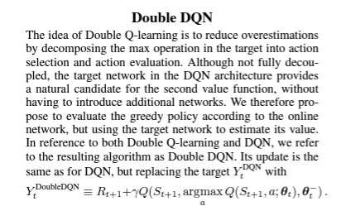
Main Idea
Decompose max() operation into action selection, action evaluation
Notice there are two Qs
- One determines greedy policy using online network
- Another fairly evaluates the policy using the target network

Slide 5
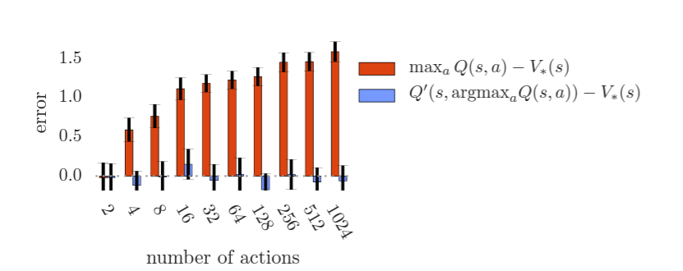
Bias Estimates
Consider state s where all true optimal action values are equal
As number of actions increases, bias will increase for DQN
However, for Double Q-Learning, bias remains small

Slide 6
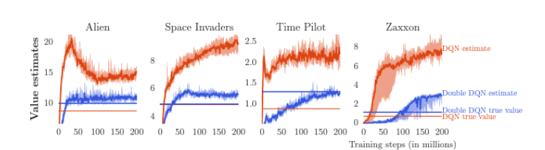
Bias Estimates - Atari
Horizontal lines are computed by running agents after learning concluded and averaging discounted returns
Corresponds to values if there were no bias

Slide 7
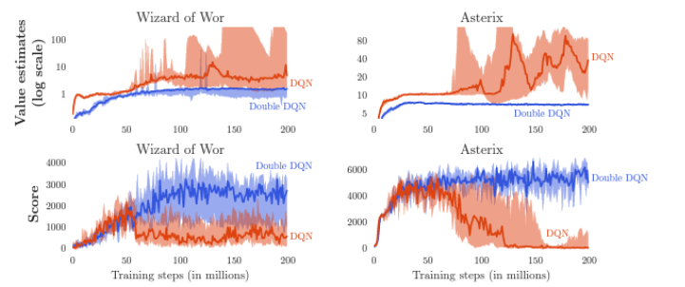
Bias Estimates – Atari, Extreme Cases
In these cases, overoptimism in DQN is extreme (red curve)
Where red separates from blue, bias increases
This has detrimental effect on score (Double Q-Learning outperforms)
Double Q-Learning is also more stable

Slide 8
Dueling Deep Q-Network

