Slide 1
Double Q-Learning
Reinforcement Learning
School of Data Science
University of Virginia
Last updated: September 25, 2023

Slide 2
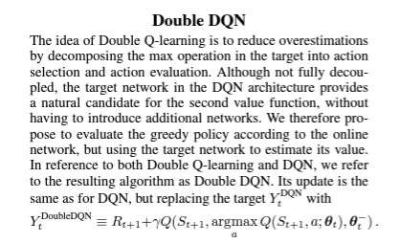
Main Idea
Paper: Deep Reinforcement Learning with Double Q-learning
Hado van Hasselt, Arthur Guez, David Silver. Google DeepMind

Slide 3
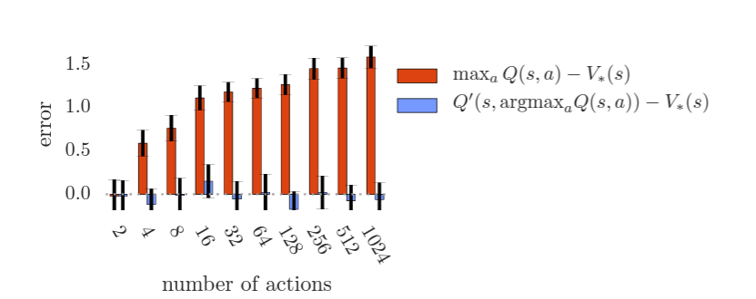
Bias Estimates

Slide 4
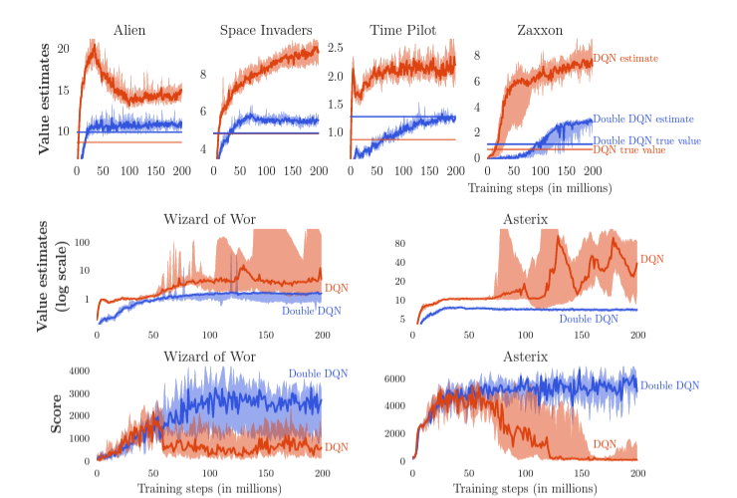
Bias Estimates - Atari

