Slide 1
Extensions to Policy Gradient
Reinforcement Learning
School of Data Science
University of Virginia
Last updated: October 31, 2023

Slide 2
REINFORCE

Slide 3
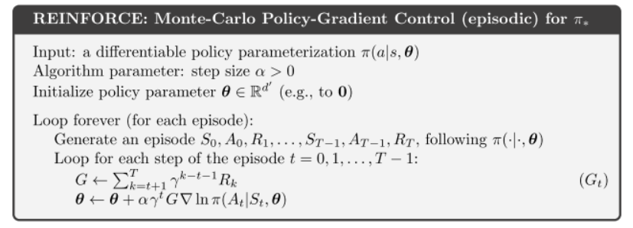
REINFORCE
REINFORCE is a Monte Carlo Gradient algorithm (uses full trajectories)
It works by:
1) simulating paths
2) calculating returns G from each path
3) taking update steps based on return and gradient of policy

Slide 4
REINFORCE Intuition
As we generate sample paths, we calculate return G over the paths.
The update step will increase parameter vector in direction of:
- greater return
- greater increase of probability repeating action At on future visits to state St

Slide 5

REINFORCE Limitations
REINFORCE can have high variance and converge slowly
We are estimating the gradient of the performance measure
Can be noisy due to factors including:
> Noise in environment
> Sparse rewards
> Length of sample trajectories can vary

Slide 6
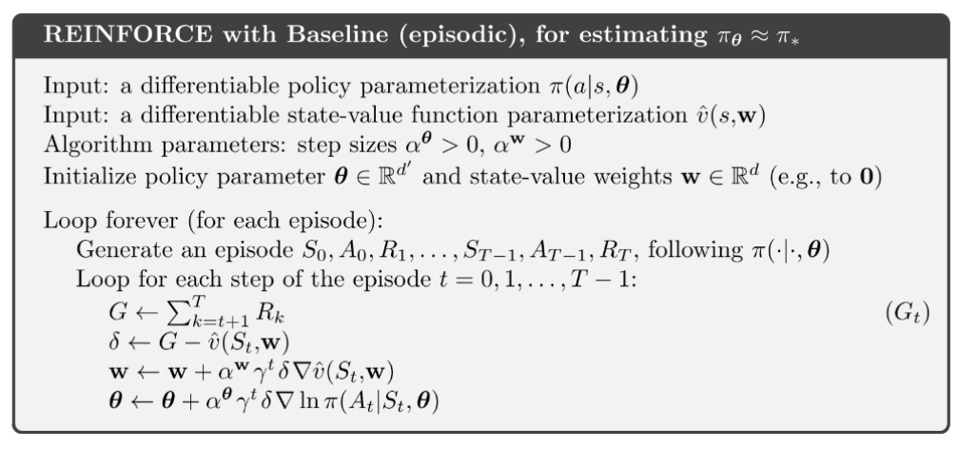
REINFORCE with Baseline
REINFORCE can have high variance and converge slowly
One solution: subtract baseline, which can be state value function
Value function as baseline

Slide 7


Introducing the Critic
The state value function estimate is based on first state of each transition (time t)
Another option is to use state value estimates from multiple time steps
Given two time steps, we can estimate a one-step return
We can collect many trajectories, calculate the returns, and train a neural network
By using this model, called the critic, it reduces the variance

Slide 8
Actor-Critic
We will use two parametrized functions:
> Policy function (actor)
> State-value function (critic). Evaluates the policy.
For each function the params are updated on each pass
Can use neural networks for the functions, given sufficient training data

Slide 9
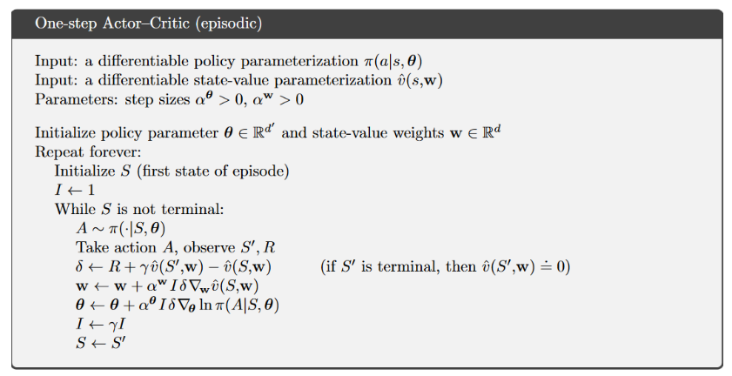
Actor-Critic Algorithm
There are two parametrized functions: one for policy (actor), one for state value (critic)
For each function the params are updated on each pass
Estimate of one-step return

