Slide 1
Course Wrap-up and Resources
Reinforcement Learning
School of Data Science
University of Virginia
Last updated: April 18, 2025

Slide 2
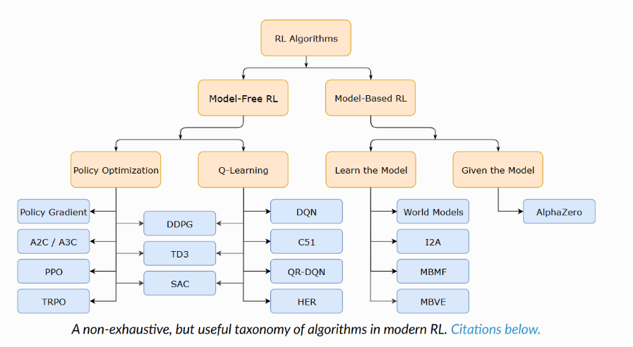
Taxonomy of RL Models
We focused on Model-Free RL
Source: https://spinningup.openai.com/en/latest/spinningup/rl_intro2.html

Slide 3
Model Selection
1) Model vs. Model Free
It’s generally quite hard to have a good model

Slide 4
Model Selection
1) Model vs. Model Free
It’s generally quite hard to have a good model
2) Continuous vs discrete state, action spaces
> To move from discrete to continuous spaces, we use an approximating function (model)

Slide 5
Model Selection
1) Model vs. Model Free
It’s generally quite hard to have a good model
2) Continuous vs discrete state, action spaces
> To move from discrete to continuous spaces, we use an approximating function (model)
> For continuous action spaces, we used Policy Gradient models

Slide 6
Model Selection
1) Model vs. Model Free
It’s generally quite hard to have a good model
2) Continuous vs discrete state, action spaces
> To move from discrete to continuous spaces, we use an approximating function (model)
> For continuous action spaces, we used Policy Gradient models
> For discrete action spaces, Q-learning methods can be very sample efficient

Slide 7
A Few Additional Resources
1 | DeepMind Lab - 3D learning environment based on id Software's Quake III Arena via ioquake3 and other open source software.
https://github.com/google-deepmind/lab
2 | Google DeepMind Achieves State-of-the-Art Data-Efficient Reinforcement Learning RL with Improved Transformer World Models
https://www.marktechpost.com/2025/02/05/google-deepmind-achieves-state-of-the-art-data-efficient-reinforcement-learning-rl-with-improved-transformer-world-models/

