Slide 1
Distributed RL Background: Actor-Learner
Reinforcement Learning
School of Data Science
University of Virginia
Last updated: February 28, 2025

Slide 2
Actor-Learner
Actor: An agent that interacts w environment, taking actions and having experiences (s, a, r, s’)
In distributed RL, we can use multiple independent actors to collect data

Slide 3
Actor-Learner
Actor: An agent that interacts w environment, taking actions and having experiences (s, a, r, s’)
In distributed RL, we can use multiple independent actors to collect data
Learner: Central entity receiving data from actors and updating gradients, and ultimately the policy

Slide 4
Actor-Learner
Actor-learner is a distributed architecture which separates action taking from learning
Benefits:
- Parallelism can improve training speed and sample efficiency
- Scalability: Actors can be deployed across threads, nodes for large scale

Slide 5
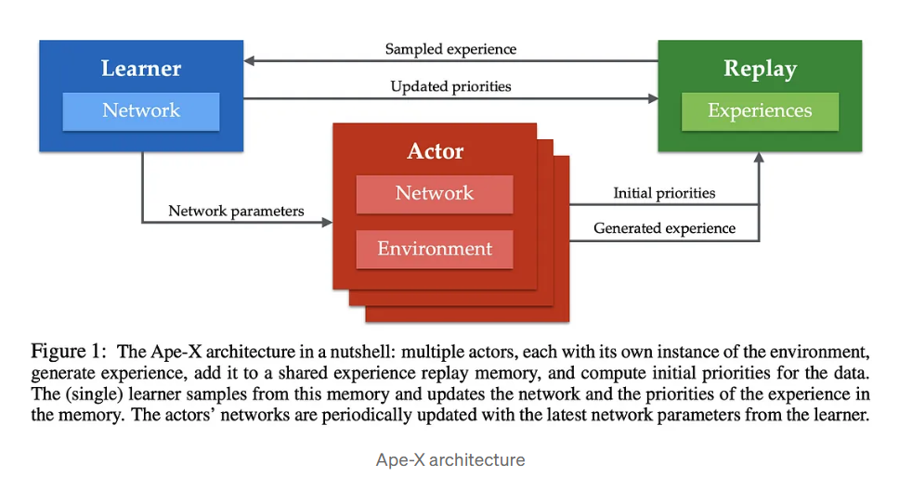
Example: Ape-X
Source: Distributed Prioritized Experience Replay. https://arxiv.org/abs/1803.00933

