Slide 1
Deep Learning Background
Reinforcement Learning
School of Data Science
University of Virginia
Last updated: September 11, 2023

Slide 2
Purpose
Quick motivation and overview of deep learning
For details on DL, see Deep Learning by Goodfellow et. al.

Slide 3
Function Approximation and Deep Learning
As the state space grows, it can work better to use a function to
approximate the Q function, rather than learn a table
Many approaches have been used for this function
Modern techniques favor deep learning

Slide 4
What is Deep Learning
Deep Learning (DL) is a subset of machine learning
Uses a neural network with multiple hidden layers
Unlike traditional ML where predictors are selected by a human,
In DL, predictors are learned as part of model training

Slide 5
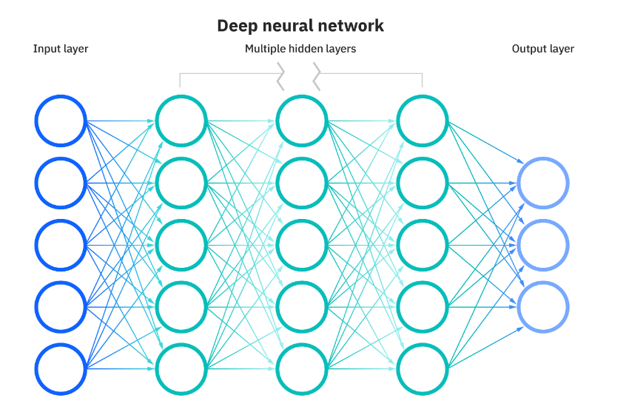
Deep Neural Network
Illustration of fully-connected multi-layer perceptron (MLP)

Slide 6
Deep Q-Network
Output layer can consist of values Q(s,a)

Slide 7
Architectures
Some Deep RL approaches use conventional architectures like:
- MLP
- Recurrent neural network (LSTM, GRU)
There are also customized Deep RL architectures:
- Dueling Networks
Will study these later

Slide 8
References
Deep Learning. Goodfellow, I., Bengio, Y. , Courville, A.
What are neural networks?
https://www.ibm.com/topics/neural-networks

