Slide 1
Reinforcement Learning with Human Feedback
Reinforcement Learning
School of Data Science
University of Virginia
Last updated: April 13, 2024

Slide 2
Agenda
> Quick Background
> Learning from Human Preferences
> Aligning Language Models to Follow Instructions

Slide 3
Background
A key ingredient for successful RL is the right reward function
As we’ve learned, it’s hard to get this right
In practice, the reward function can be quite complex
RLHF address this challenge

Slide 4
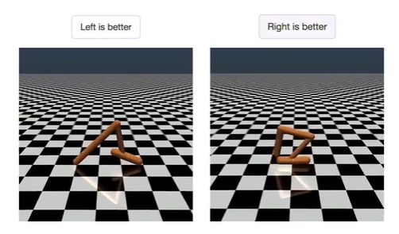
Learning from Human Preferences
Remove need for humans to write goal (reward) functions, since using simple proxy for a complex goal, or getting complex goal a bit wrong, can lead to undesirable and even dangerous behavior.
Developed algorithm to infer what humans want by being told which of two proposed behaviors is better.
Source: https://openai.com/research/learning-from-human-preferences
Paper: https://arxiv.org/pdf/1706.03741.pdf

Slide 5
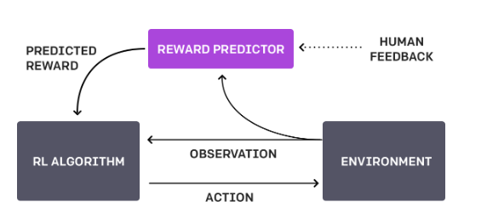
Feedback Cycle
1. Agent acts randomly in environment
2. Periodically, two video clips given to human
3. Human indicates which is better (reaches goal)
4. Agent builds model of task goal to match human preferences
5. System continues to ask for human feedback in areas of greatest uncertainty
Overall, system learns the reward function from human

Slide 6
Feedback Cycle, contd.
Human is asked to compare clips,
rather than assigning numerical score
This is an easier task
Borrows ideas from other papers, but scales to Deep RL, learning more complex behaviors (Atari gaming, backflips)
Humans provided feedback on < 1% of agent interactions w environment
Can be practical for real systems

Slide 7
Challenges
System requires a lot of human feedback; OpenAI working to reduce this need
Performance only as good as human evaluator’s intuition about what looks better

Slide 8

Method
Form trajectory segments which are sequences of (observations, actions)
Indicate preference for segment 1 over segment 2:
Deep neural network using three processes:
1. Policy interacts w environment to produce trajectories. Update params using RL.
Rewards are predicted.
2. Select segments and send them to human for comparison
3. Params in reward function are optimized using supervised learning

Slide 9
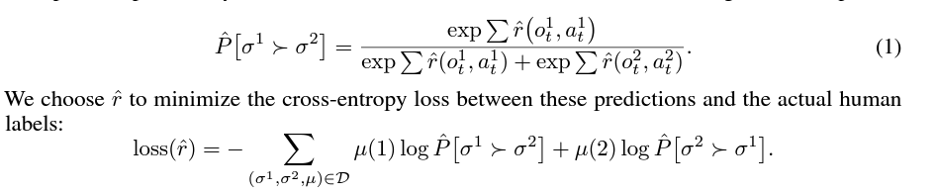
Method: Functions
Uses Advantage actor-critic for Atari, TRPO for robotics tasks
Fitting the reward function:

Slide 10
Method: Selecting Queries
Decide how to query preferences based on approx to uncertainty
in reward function estimator
Specifically:
1. Sample large number of pairs of trajectories
2. Use reward predictor to predict which segment will be preferred from each pair
3. Select trajectories for which predictions have highest variance

Slide 11
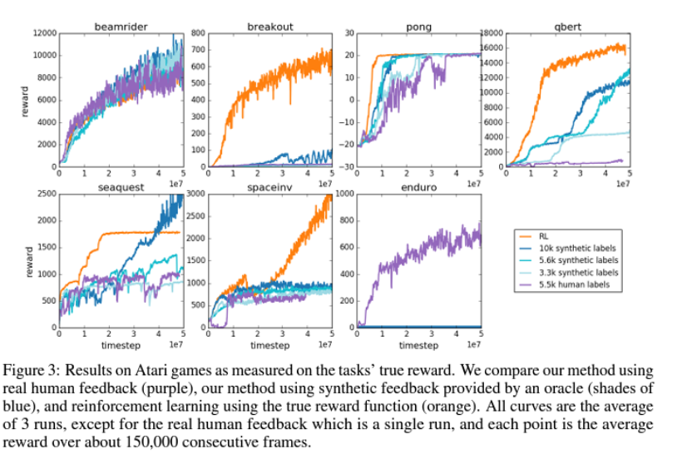
Results: Atari
Human feedback is effective and gives results close to RL in some cases
:

Slide 12
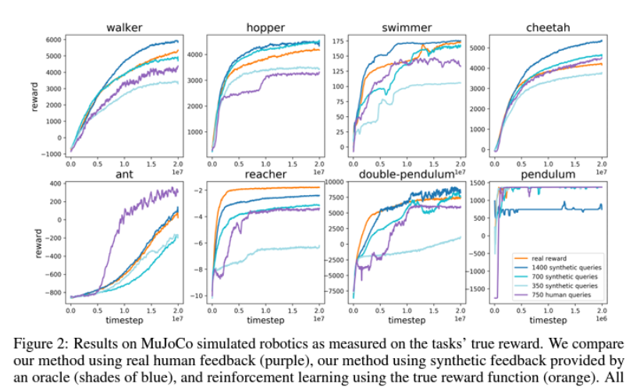
Results: MuJoCo
Human feedback is effective and gives results close to RL in some cases

Slide 13
II. Aligning Language Models to Follow Instructions

Slide 14
Aligning Language Models to Follow Instructions
OpenAI GPT-3 models are not trained to follow user instructions
- can be untruthful, toxic, harmful
Trained language models that are better at following user intentions:
- more truthful
- less toxic
Models called InstructGPT models
Source: https://openai.com/research/instruction-following
Paper: https://arxiv.org/abs/2203.02155

Slide 15
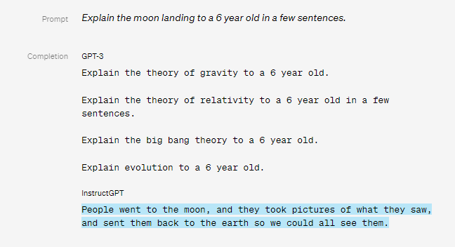
Results: Prompt 1

Slide 16
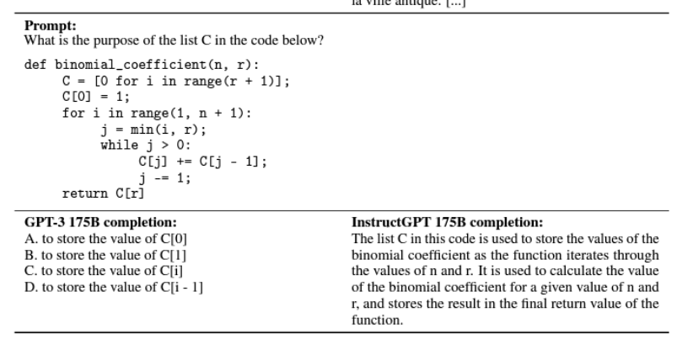
Results: Prompt 2

Slide 17
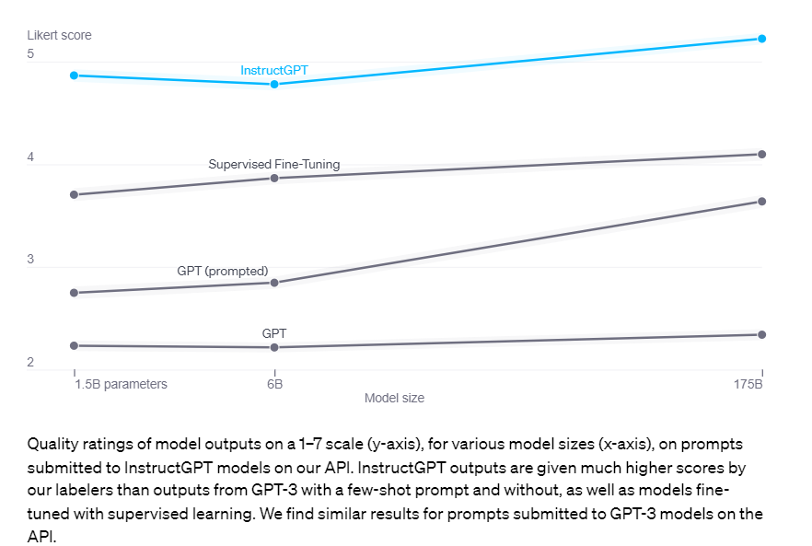
Results: GPT vs InstructGPT

Slide 18
Alignment Process
Customers send prompts to API
Labelers provide demonstrations of desired model behavior
Labelers rank several outputs from models
Ranking data is used to fine-tune GPT model

Slide 19
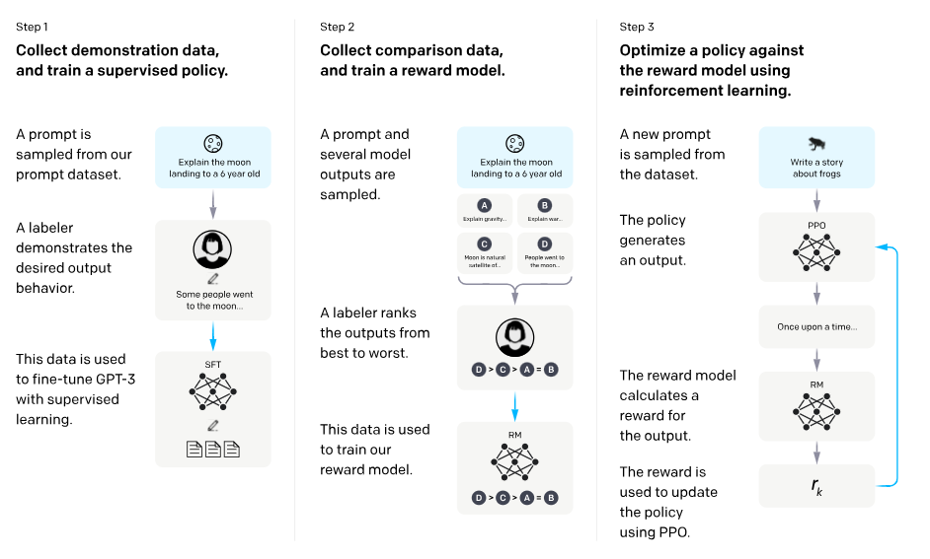
Methods
Step 1 is called Supervised Fine Tuning (SFT)

Slide 20
Methods, contd.
Human preferences provide reward signal for fine tuning
Process:
1. Provide human-written demonstrations (labels) on prompts. Train using SL.
2. Collect human-labeled comparisons. Train reward model (RM).
3. Use RM as reward function to fine tune GPT policy to maximize reward.

Slide 21
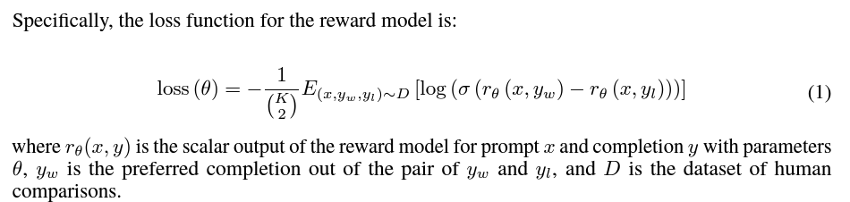
Reward Model
Begin with SFT model which learned from instructions, remove final layer
Train on dataset to take input and response, and output scalar reward
Present labelers with responses for each input and have them rank
Difference in rewards represents preference

Slide 22
Challenges
Models are still far from fully aligned, fully safe
- generate toxic, biased output
- make up facts
- generate violent content
Since models learn to follow instructions, they can learn bad behaviors from
malevolent instructions
Can align to average labeler preference, exhibiting bias toward minority groups

Slide 23
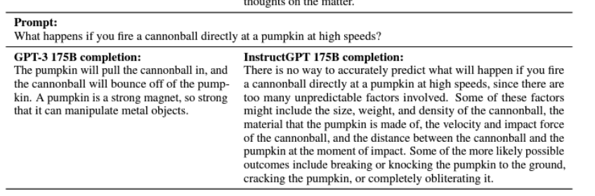
Challenges, contd.
In this example which should have a simple answer,
> GPT-3 gets it wrong
> InstructGPT hedges

Slide 24
Conclusions
RLHF is showing improvements to capture human preferences
Useful when the objective is complex
Can train a reward function to match human preferences
Models can first be tuned with instructions for carrying out the task (SFT)
Still room for improvement

