Slide 1
Reinforcement Learning with Human Feedback
Reinforcement Learning
School of Data Science
University of Virginia
Last updated: February 27, 2024

Slide 2
Background
A key ingredient for successful RL is the right reward function
As we’ve learned, it’s hard to get this right
In practice, the reward function can be quite complex
RLHF address this challenge

Slide 3
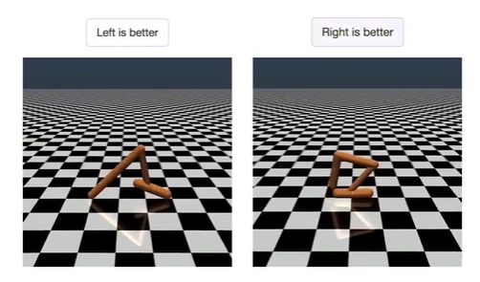
Learning from Human Preferences
Remove need for humans to write goal (reward) functions, since using simple proxy for a complex goal, or getting complex goal a bit wrong, can lead to undesirable and even dangerous behavior.
Developed algorithm to infer what humans want by being told which of two proposed behaviors is better.
Source: https://openai.com/research/learning-from-human-preferences
Paper: https://arxiv.org/pdf/1706.03741.pdf

Slide 4
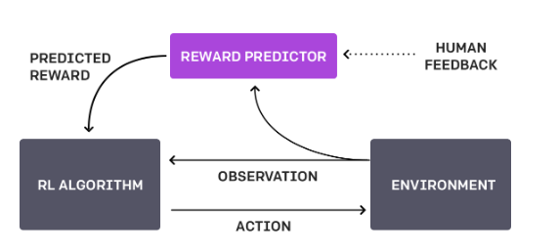
Feedback Cycle
1. Agent acts randomly in environment
2. Periodically, two video clips given to human
3. Human indicates which is better (reaches goal)
4. Agent builds model of task goal to match human preferences
5. System continues to ask for human feedback in areas of greatest uncertainty
Overall, system learns the reward function from human

Slide 5
Feedback Cycle, contd.
Human is asked to compare clips,
rather than assigning numerical score
This is an easier task
Borrows ideas from other papers, but scales to Deep RL, learning more complex behaviors (Atari gaming, backflips)
Humans provided feedback on < 1% of agent interactions w environment
Can be practical for real systems

Slide 6
Challenges
System requires a lot of human feedback; OpenAI working to reduce this need
Performance only as good as human evaluator’s intuition about what looks better

Slide 7

Method
Form trajectory segments which are sequences of (observations, actions)
Indicate preference for segment 1 over segment 2:
Deep neural network using three processes:
1. Policy interacts w environment to produce trajectories. Update params using RL.
Rewards are predicted.
2. Select segments and send them to human for comparison
3. Params in reward function are optimized using supervised learning

Slide 8
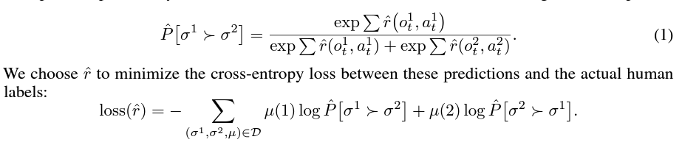
Method: Functions
Uses Advantage actor-critic for Atari, TRPO for robotics tasks
Fitting the reward function:

Slide 9
[Break down reward fcn]
Uses

Slide 10
Method: Selecting Queries
Decide how to query preferences based on approx to uncertainty
in reward function estimator
Specifically:
1. Sample large number of pairs of trajectories
2. Use reward predictor to predict which segment will be preferred from each pair
3. Select trajectories for which predictions have highest variance

Slide 11
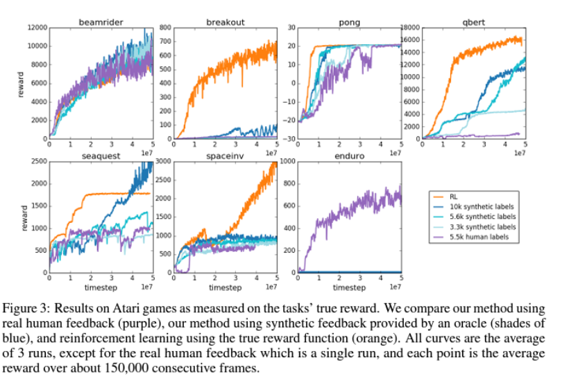
Results: Atari [conclusions]
:
[conclusions]

Slide 12
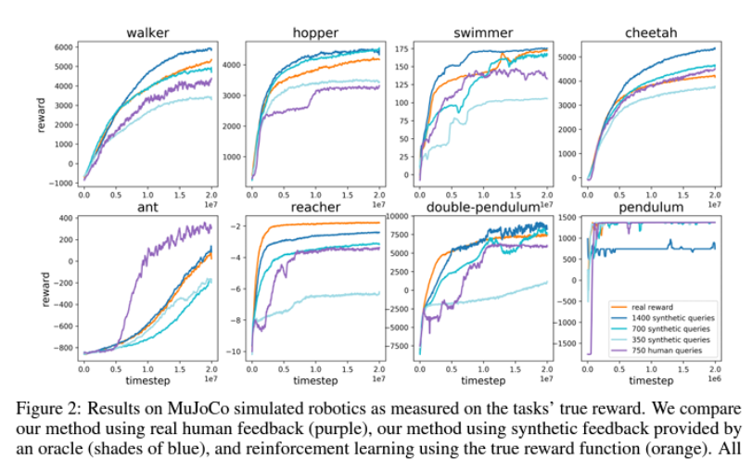
Results: MuJoCo [conclusions]
[conclusions]

Slide 13
Conclusions
[conclusions]

