Slide 1
Summary of Solution Concepts
Reinforcement Learning
School of Data Science
University of Virginia
Last updated: September 29, 2025

Slide 2
Agenda
> Backup Diagrams for Understanding MDP Solution Methods
> On-policy vs off-policy learning

Slide 3
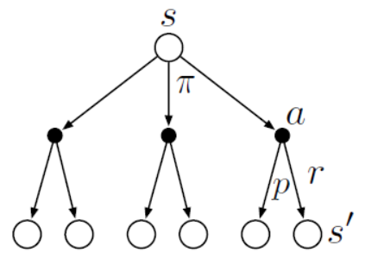
Overarching Goal for Solutions to MDP
The overarching goal is to estimate value functions
We study three solution methods:
1) Dynamic Programming
2) Monte Carlo Simulation
3) Temporal Difference
Backup diagrams (example on right)
can help understand how they work.
- Black circles are actions
- Hollow circles are states
- Time flows top down

Slide 4


Backup Diagrams
Dynamic Programming
Monte Carlo
Temporal Difference: TD(0)

Slide 5



Backup Diagrams with update equations
transition distribution
Dynamic Programming
- Update equation computes an expectation
- Need to know transition, reward distributions
Monte Carlo
- Update equation uses Gain
- Need to wait for episode to end
Temporal Difference: TD(0)
- Update equation uses single transition

Slide 6
On-Policy vs. Off-Policy Learning
We study algorithms that use on-policy learning and off-policy learning
It is important to realize that two things are happening:
1. An agent follows a policy to guide behavior
2. Based on historical actions, value estimates are calculated
We have a choice:
Option 1: We can use the same policy for both (on-policy learning)
Option 2: We can use different policies (off-policy learning)

Slide 7
On-Policy vs. Off-Policy Learning
On-policy algorithms learn and improve on the same policy that is being used to collect data in the environment:
1. The agent uses its policy to select actions
2. Data is generated in the form of transitions (s, a, r, s’)
3. This data is used to update the value estimates and the policy
Off-policy algorithms are more flexible and efficient as they separate behavior from estimates.
1. The agent uses behavior policy b to select actions
2. Data is generated in the form of transitions (s, a, r, s’)
3. This data is used to update the value estimates and the target policy

Slide 8
Example of Off-Policy Learning
In healthcare, it is not safe or possible to run experimental policies
We may have collected historical data. This can be regarded as behavior policy b.
Algorithm can be trained on this data for use (offline reinforcement learning)
These behaviors may have been conducted by current and past doctors
Going forward, doctors may make different choices.

