Slide 1
Deep Learning Background
Reinforcement Learning
School of Data Science
University of Virginia
Last updated: October 3, 2026

Slide 2
Purpose
Quick motivation and overview of deep learning (DL)
For details on DL, see Deep Learning by Goodfellow et. al.

Slide 3
Function Approximation and Deep Learning
As the state space grows, it can work better to use a function to
approximate the Q function, rather than learn a Q-table
Tables don’t scale: updates are slow, and storage is prohibitive
Many approaches have been used for the functional form
Modern techniques favor deep learning

Slide 4
What is Deep Learning?
Deep Learning (DL) is a subset of machine learning
Uses a neural network with multiple hidden layers
Unlike traditional ML where predictors are selected by a human,
in DL, predictors are learned as part of model training

Slide 5
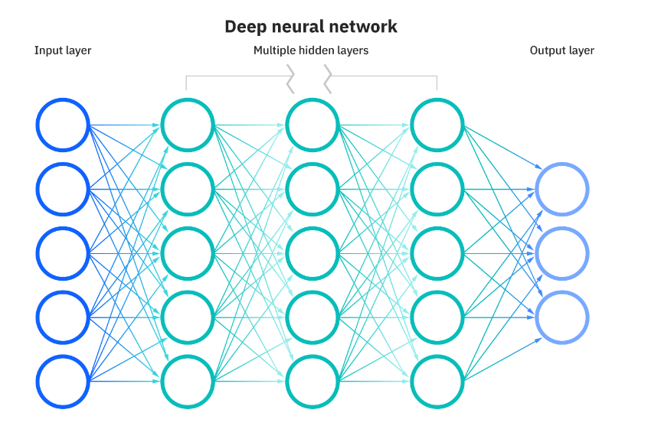
Deep Neural Network
Illustration of fully-connected multi-layer perceptron (MLP)

Slide 6
Deep Q-Network
Introduces non-linearities through non-linear activation functions

Slide 7
Deep Q-Network
Introduces non-linearities through non-linear activation functions
Mechanically, pass state vector as input
Output layer holds Q(s, a)
Q(s, a1)
Q(s, a2)
Q(s, a3)

Slide 8
Architectures
Some Deep RL approaches use conventional architectures like:
- MLP
- Recurrent neural network (LSTM, GRU)
There are also customized Deep RL architectures:
- Dueling Networks
Will study these later

Slide 9
References
Deep Learning. Goodfellow, I., Bengio, Y. , Courville, A.
What are neural networks?
https://www.ibm.com/topics/neural-networks

