Slide 1
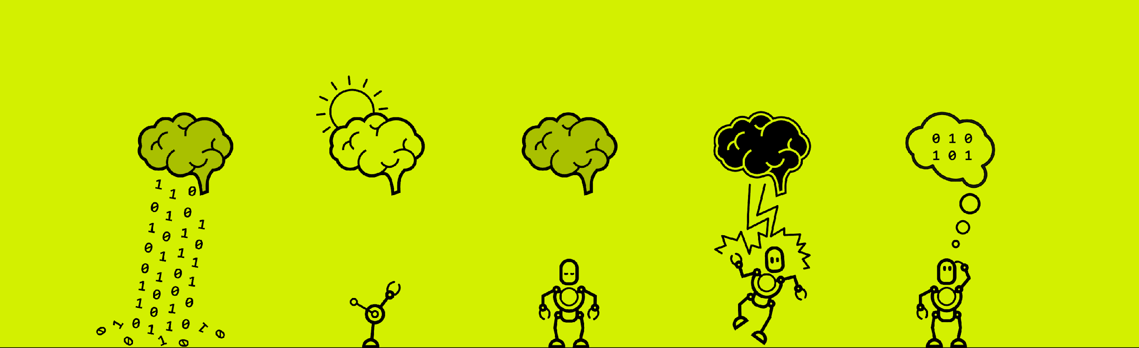
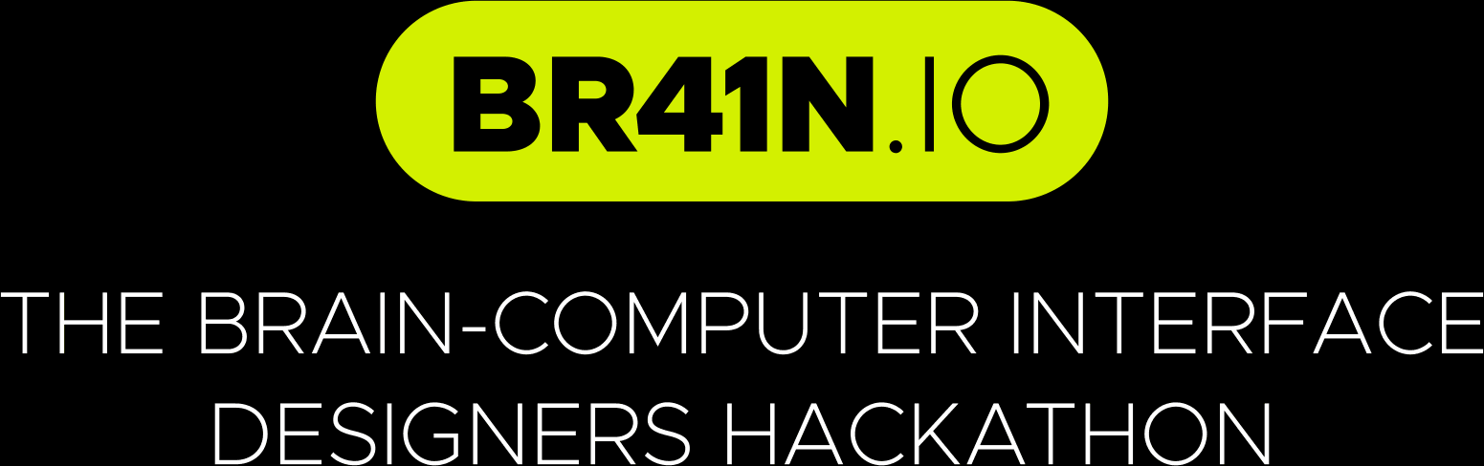

Slide 2

BrainWave Labyrinth
Țugui Radu, Adamescu Armand, Caraoncea Casian, Folțun Samuel, Popa Ciprian, Oparlescu Bogdan, Suciu Luca

Slide 3
Initial Situation & Introduction
Traditional BCI systems for game control often require extensive calibration and lack intuitive feedback.
Our goal is to create a seamless movement control in a Unity maze game using the Unicorn Hybrid Black EEG headset, reducing training time and improving user engagement.

Slide 4
Idea & Solution
We developed a Unity-based maze game where users focus on flashing directional arrows (forward, left, right) to move the player entity.
Initial training involves recognizing flashing object stimuli, followed by arrow-based movement control.

Slide 5
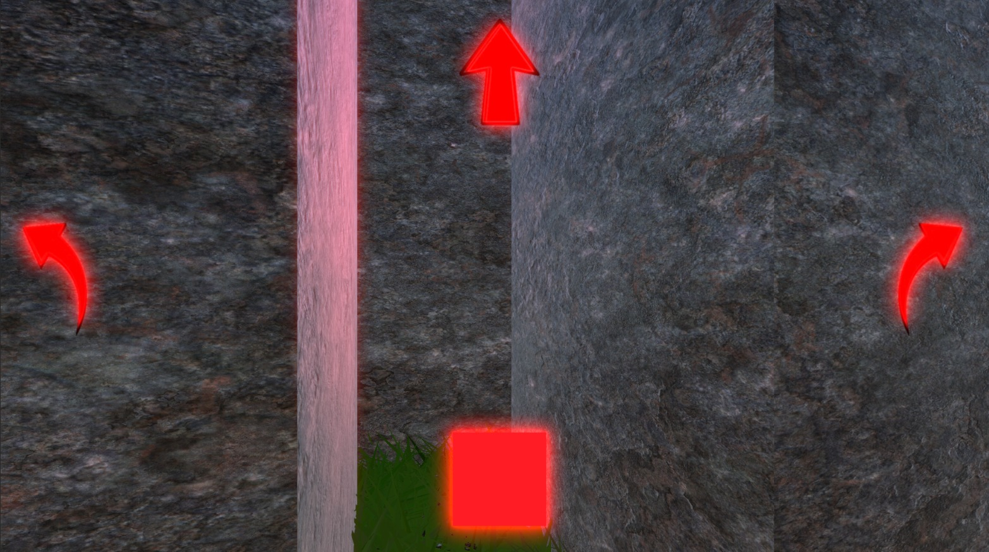
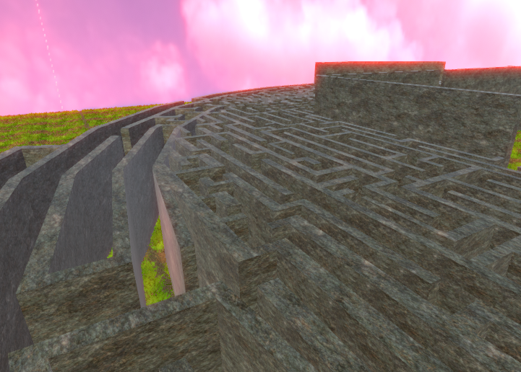
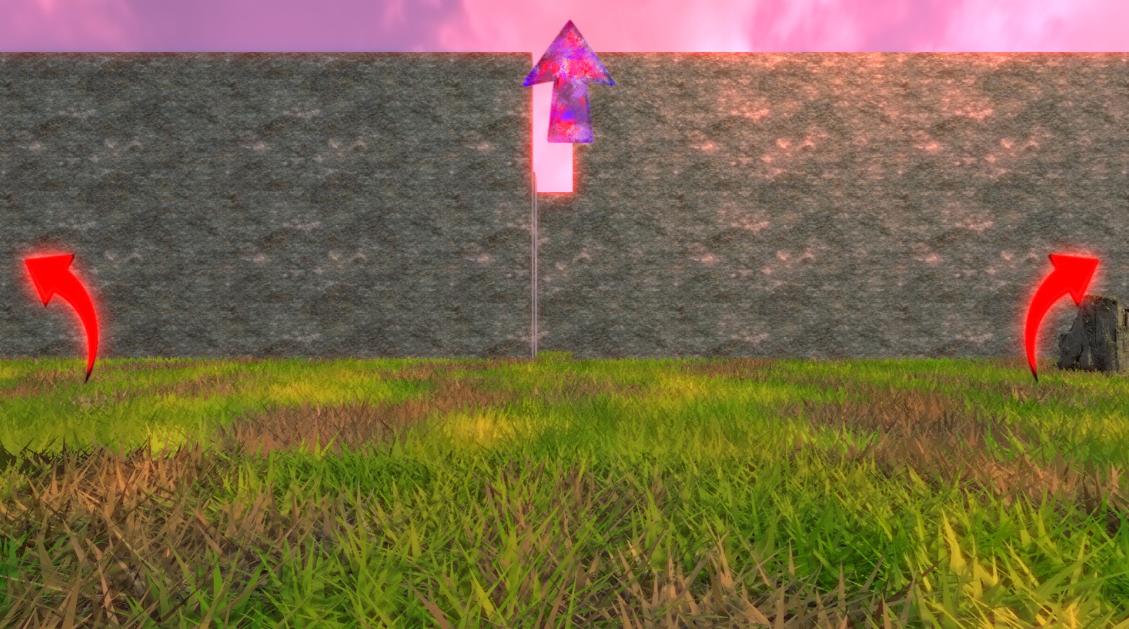
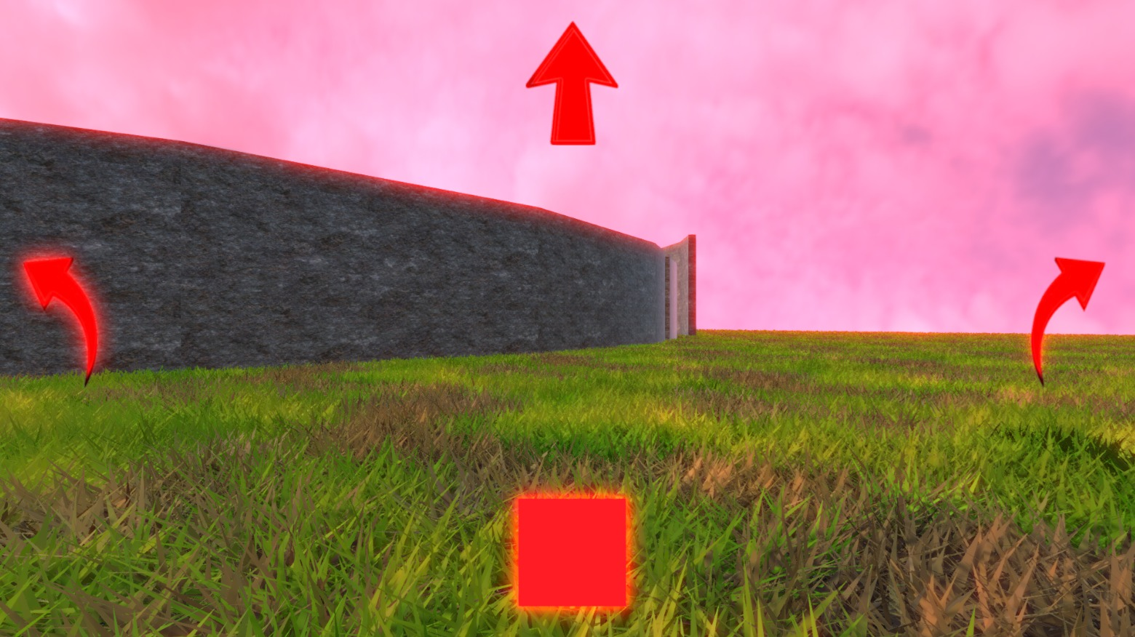

Slide 6
Implementation & Realization
Integrated Unicorn Hybrid Black SDK with Unity using the BCI Toolkit.
Implemented stimulus presentation: object flashes for training, arrows for control.
Signal processing pipeline extracts focus-related EEG features to trigger movement commands.
Unity C# scripts handle character movement in the maze environment using BCI.

Slide 7
Results & Outcome
Achieved 70-80% average accuracy in directional selection after a 30 second training session.
Users successfully navigated the maze using the directional arrows.
Positive user feedback on intuitiveness and reduced fatigue compared to manual controls.

Slide 8
Reflection
Real-time feedback is crucial for user confidence; we plan to add dynamic UI cues.
Future work: refine signal processing for lower latency and integrate more movement options.
Collaboration across EEG hardware and Unity development enhanced our skills and teamwork.

Slide 9
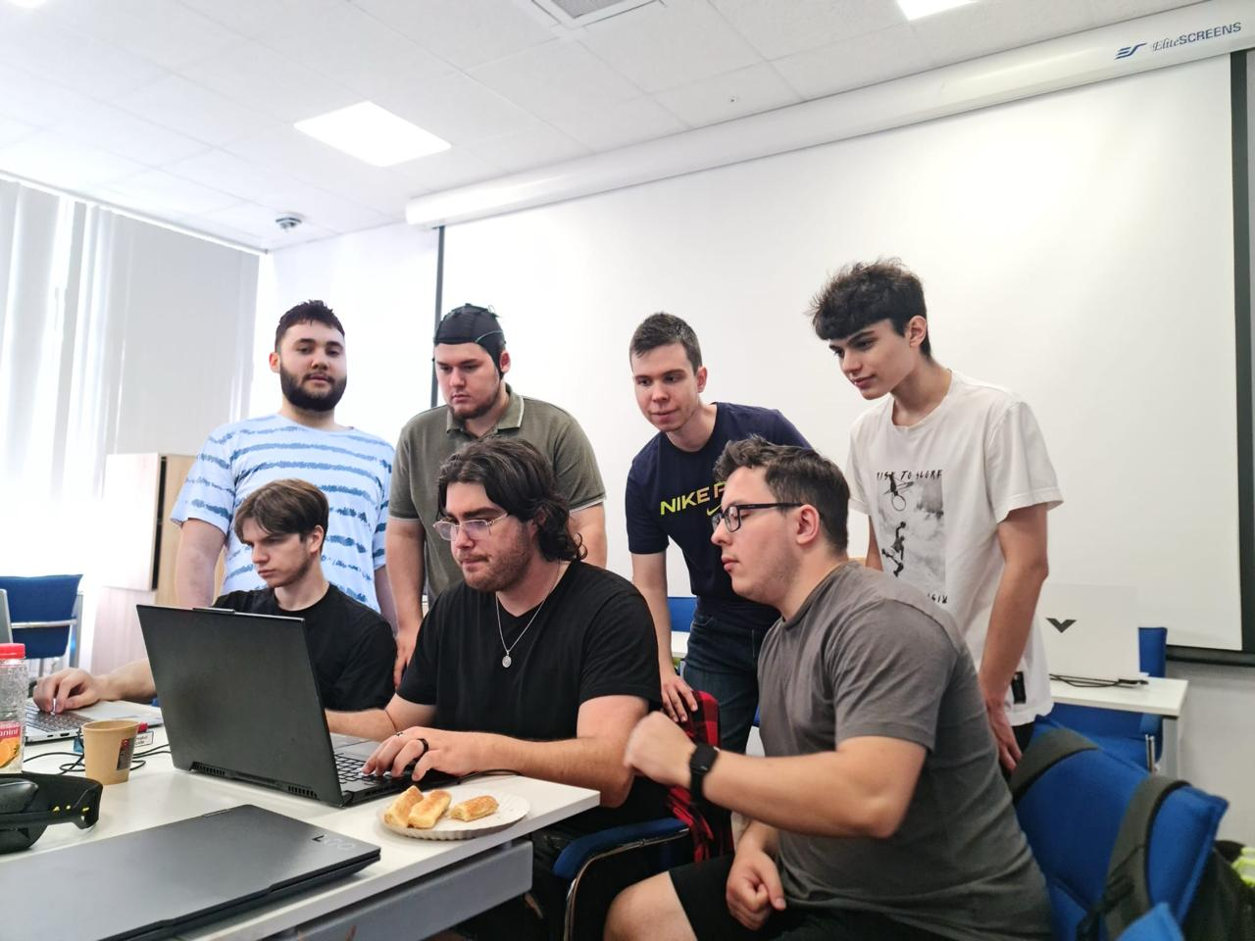
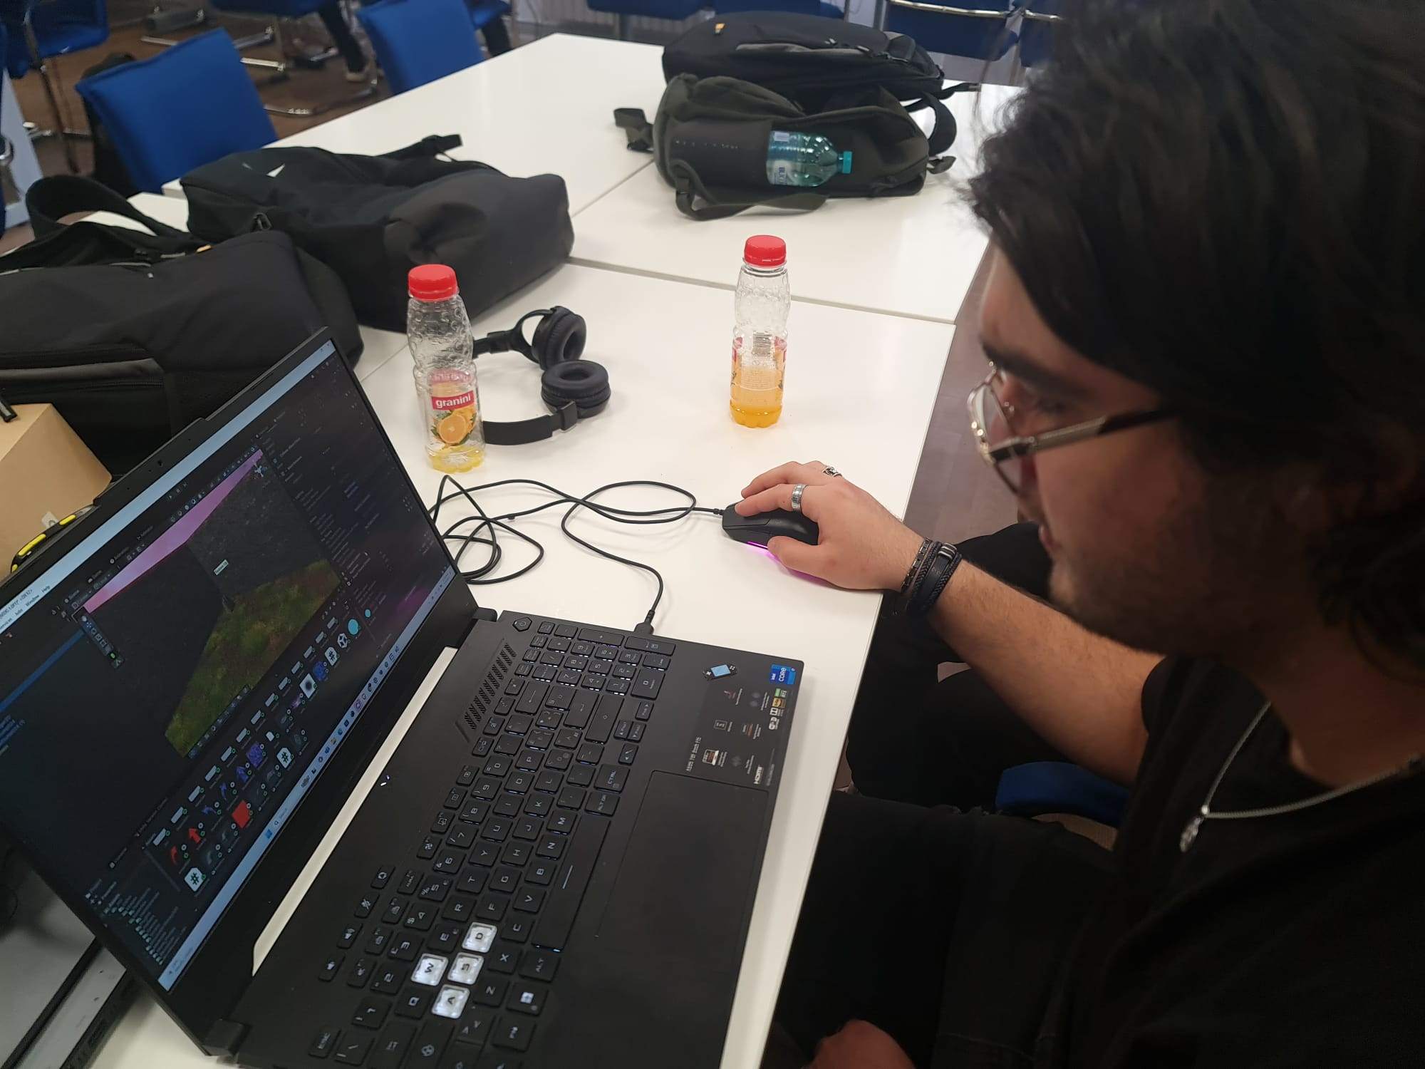
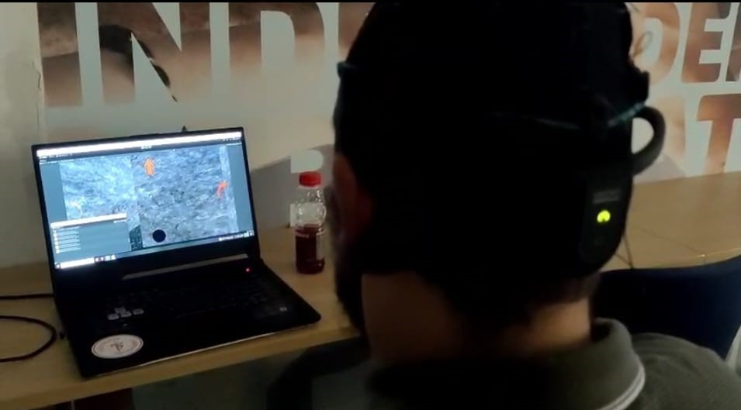
Group Picture & Development
Team members
Development Process

Slide 10
BrainWave Labyrinth
Țugui Radu, Adamescu Armand, Caraoncea Casian, Folțun Samuel, Popa Ciprian, Oparlescu Bogdan, Suciu Luca

