Slide 1

uvsim
Yicheng Ge
Shawn Dahl
Braxton Anderson
Jaxon Potter
2024-04-14

Slide 2


Introduction
Project Overview
GUI Design Documentation
file support
future development
catalogue

Slide 3

01
Introduction

Slide 4


Developing the UVSim simulation software
project objective
01
The simulation software named UVSim was developed.
main function
02
Simulating machine languages and computer architectures.
application area
03
Computer Science and Education

Slide 5
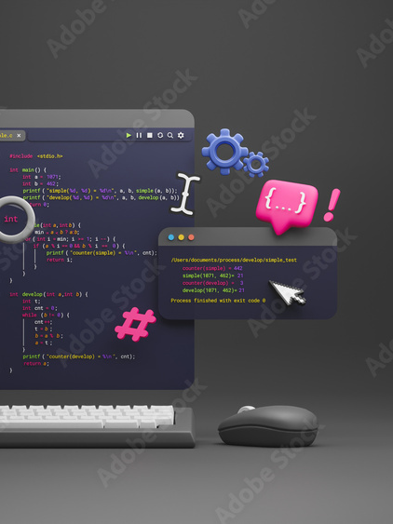
Introduce the project and its importance
The main purpose of the UVSim simulation software is to help students studying computer science to better understand machine languages and computer architectures. By simulating the real computer environment, students can better understand the working principle and internal mechanism of computers.
The importance of this software is that it can help students better grasp the basics of computer science and improve their professional skills. At the same time, it can also be used as a powerful tool for computer science and education to improve the quality and effect of teaching.

Slide 6
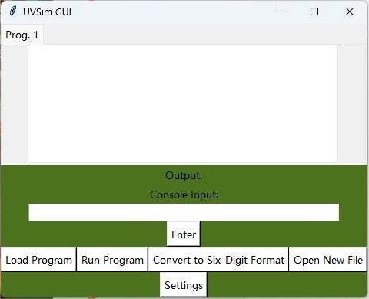
Introduce client requirements
Customer requirements are an important basis for software development. In this project, the client's main requirement was to develop a powerful and user-friendly simulation software to help students better understand machine language and computer architecture.
The client also wanted the software to be able to support import and export of multiple file formats to facilitate data exchange and archiving by users.

Slide 7
02
Project Overview

Slide 8
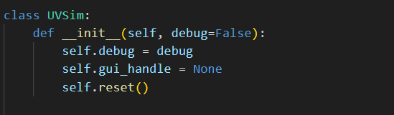
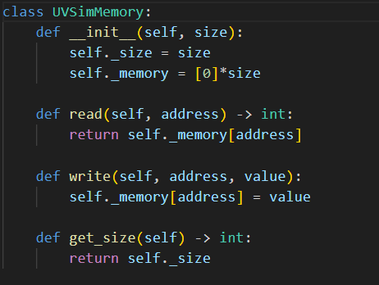
UVSim and its purpose in computer education
Definition of UVSim
UVSim is a machine language and computer architecture simulator. Its main purpose is to help computer students better understand and master the underlying computer architecture and machine language programming.
Features of UVSim
By simulating a real computer environment, UVSim allows students to study and practice machine languages and computer architectures without a real computer.
The application of UVSim in education
As an educational tool, UVSim plays an important role in computer education, helping students to understand the underlying principles of computers more deeply and improve their programming skills.

Slide 9

BasicML and its components
Definition of BasicML
BasicML, the core component of UVSim, is a set of instruction sets designed to simulate basic computer operations and machine language programming.
BasicML instruction types
Including data movement instruction, arithmetic operation instruction, logic operation instruction, etc., these instructions have the corresponding implementation in the real computer.
why learning BasicML
By learning and practicing BasicML, students can gain a deep understanding of machine language programming and the underlying architecture of computers.

Slide 10
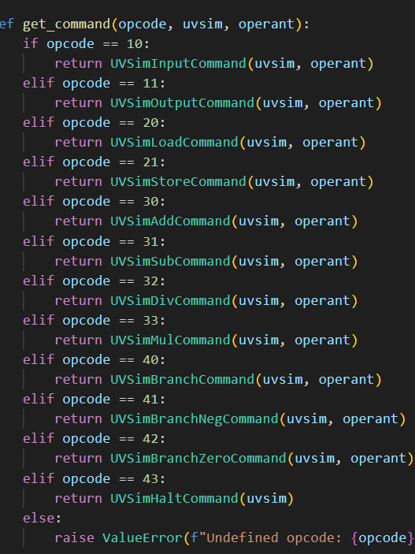
BasicML
01
I/O operation:
READ = 10 Read a word from the keyboard into a specific location in memory.
WRITE = 11 Write a word from a specific location in memory to screen.
02
Load/store operations:
LOAD = 20 Load a word from a specific location in memory into the accumulator.
STORE = 21 Store a word from the accumulator into a specific location in memory.
03
Arithmetic operation:
ADD = 30 Add a word from a specific location in memory to the word in the accumulator
SUBTRACT = 31 Subtract a word from a specific location in memory from the word in the accumulator
DIVIDE = 32 Divide the word in the accumulator by a word from a specific location in memory
MULTIPLY = 33 multiply a word from a specific location in memory to the word in the accumulator

Slide 11
BasicML
04
Control operation:
BRANCH = 40 Branch to a specific location in memory
BRANCHNEG = 41 Branch to a specific location in memory if the accumulator is negative.
BRANCHZERO = 42 Branch to a specific location in memory if the accumulator is zero.
HALT = 43 Pause the program
05
The last two digits of a BasicML instruction are the operand – the address of the memory location containing the word to which the operation applies.

Slide 12
03
GUI Design Documentation

Slide 13

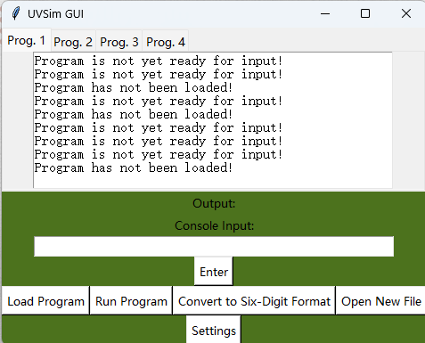
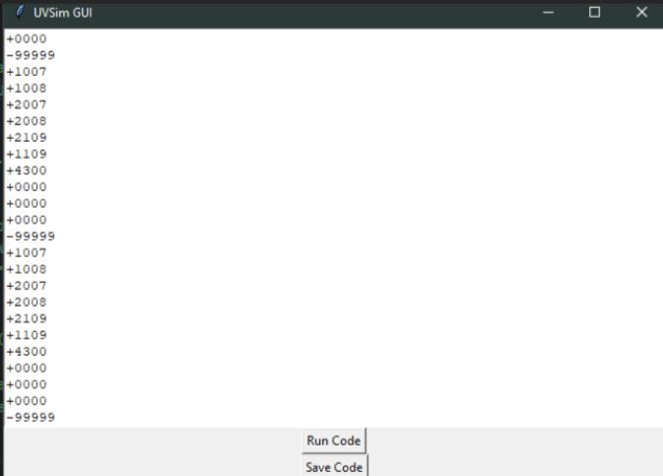
GUI
The main window will contain the primary components of the application, including the program tabs, output display, input entry, and control buttons
When users load a program, a separate window will appear where they can view and edit the program code before execution. This window will include options to run the code or save any changes made.
The GUI will feature tabs to manage multiple programs simultaneously. Each tab represents a separate program, allowing users to switch between programs easily. Tabs will be labeled as "Prog. 1", "Prog. 2", and so on.

Slide 14

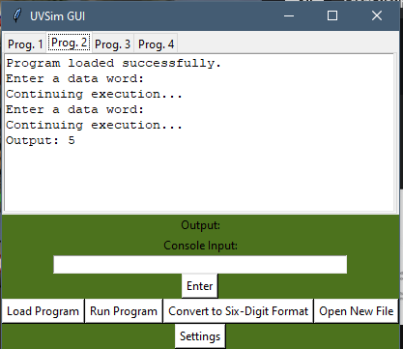
GUI
Control Buttons: Several control buttons will be provided to manage program execution and interaction. These buttons include:
Load Program: Allows users to load a program file from their system.
Run Program: Initiates the execution of the loaded program.
Enter: Commits user input entered in the input entry field.
Settings: Opens a settings window to configure color scheme preferences.
Convert to Six-Digit Format: Initiates the conversion process for loading programs in six-digit format.
Open New File: Opens a new program tab for creating or loading additional programs.

Slide 15
04
file support

Slide 16
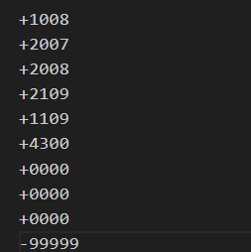
file support
Supporting Both Old and New Files:
When the user loads a file, the application checks the format of the file to determine whether it is an old format (four-digit word files) or a new format (six-digit word files).
If the file is in the old format, the application loads and executes it accordingly.
If the file is in the new format, the application processes it as usual.
This approach allows the application to handle both old and new files without requiring any conversion.

Slide 17
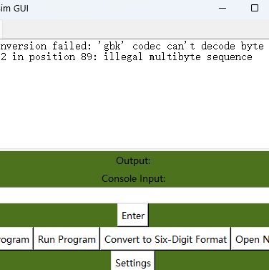
file support
Providing a Conversion Process:
If the user wants to convert an old format file to the new format, they can do so using the "Convert to Six-Digit Format" button in the GUI.
When the user clicks this button, they are prompted to select an old format file for conversion.
The application reads the contents of the selected file and converts each line from four digits to six digits by adding leading zeroes.
The converted file is then saved with a new name, indicating its format (e.g., "_six_digit_format.txt").
If the conversion is successful, the application displays a message indicating the success and the name of the new file. If an error occurs during conversion, an appropriate error message is displayed.

Slide 18
file support
1
Add a file selection button to the GUI
The user can select the file to enter with this button.
Write the code to handle file input and parsing
2
Write the code to handle file input and parsing
Ensure that the file input process is stable and reliable
3
Deal with various possible problems, such as file non-existence, file corruption, etc.

Slide 19
05
future development

Slide 20
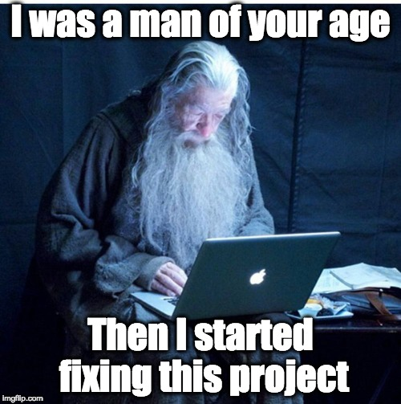
Allows saving and loading functionality
Add save and load buttons
Buttons are added to the GUI of UVSim so that users can easily save the current working state or the state saved before loading.
Write save and load code
Implements the ability to save the current state to a file and load the state from a file.
Ensure stability and error handling
Ensure the stability of the save and load process, and be able to properly handle possible problems, such as insufficient disk space, insufficient file permissions, etc.

Slide 21
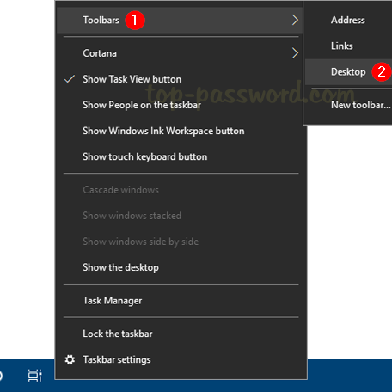
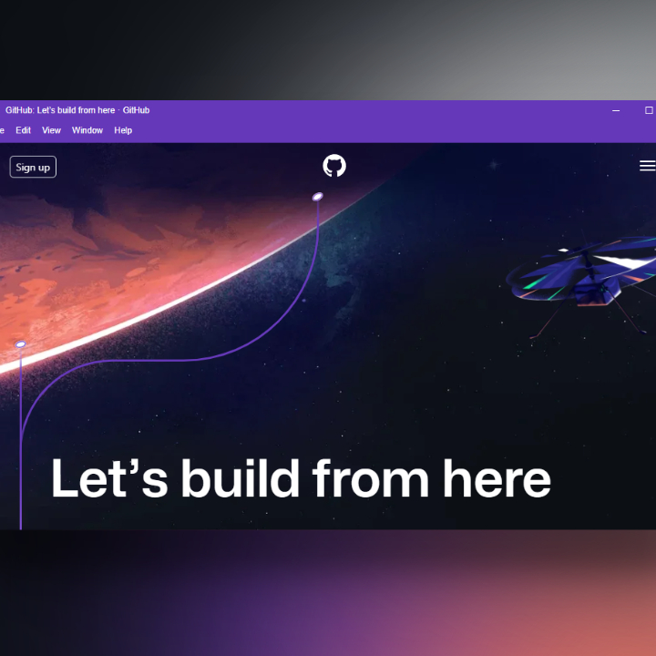
Interface configuration color scheme
title bar
The title bar will be at the top of the window and will contain the project name, logo, and menu options. We'll use a concise and attractive color scheme to highlight the project name and logo while providing easily recognizable menu options.
toolbar
The toolbar will contain a series of ICONS and buttons to perform common actions such as creating a new file, opening a file, saving a file, and so on. We'll use a scheme that coordinates with the title bar color so users can easily navigate between different sections.

Slide 22

Command optimization
Provides autocomplete functionality
UVSim should provide autocomplete, so that the user only needs to enter part of the command and UVSim can autocomplete the whole command.
Support for keyboard shortcuts
UVSim should support commonly used shortcuts such as Ctrl+C, Ctrl+V, Ctrl+Z, etc., to improve the operation efficiency of users.
Support undo and redo functions
UVSim should support undo and redo functions so that the user can undo the previous action or redo the previous action.

Slide 23

THANKS

