Slide 1

Data Security in an Insecure World
Development of the Women’s Initiative Client Scheduler
Image courtesy of www.telegraph.co.uk

Slide 2
The Women’s Initiative
Problem: Managing organizational data including client appointments, staff schedules, and meetings locations all managed by hand
Goal: Develop an online application that would allow TWI to:
Track and manage upcoming appointments
View reports of past appointments
Manage employee schedules and leave requests
Manage available meeting locations

Slide 3
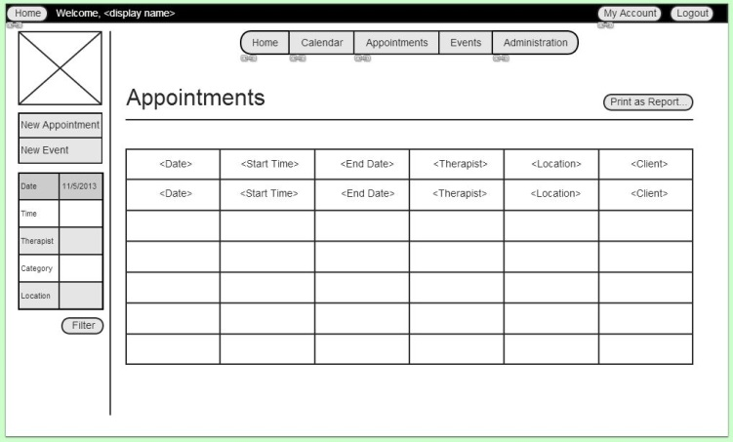
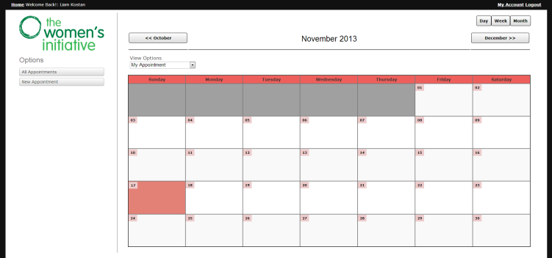
Mockups

Slide 4
System Goals
Secure data through password protected storage
Make data easy to navigate

Slide 5
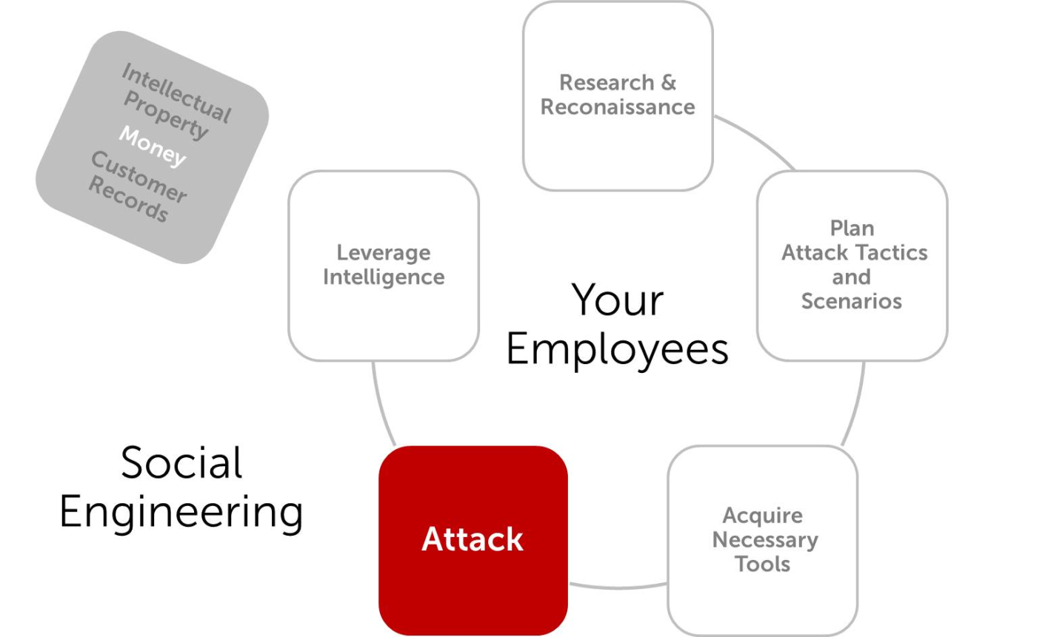
Social Engineering
Definition: The act of compromising security systems through the psychological manipulation of people.
Image courtesy of www.secureworks.com

Slide 6



Subtopics:
Psychological vulnerabilities
Vulnerabilities in organizational structure
Organizational Best Practices
Example: Hospital
Notes:
Psychological: Who is vulnerable and why? How are people manipulated?
Organizational: How does the work environment promote/discourage certain vulnerabilities? Who has information they shouldn’t?
Best practices: Minimal privileges.

Slide 7
Questions?

