Slide 1
WHY IPL DATASET?
Aimed to help:
TEAM OWNERS
COMMENTATORS
FANS
With the mega auctions that will be held in a few months time, it will be really helpful for the owners to know how the players have performed in the previous 2 editions of the ipl.
Usually play a massive role in selecting who wins the awards after the ipl final is won.
Help them understand the game.
Help them answer fan poll questions.
Help them make teams on gaming applications.

Slide 2
QUESTIONS THAT WOULD BE ANSWERED
Fan Poll Questions like:
1.For a bowler, which aspect of his game is more important:
2.A batsman is rated high on the basis of:
Queries related to the relationship between:
1.The number of runs scored and his strike rate.
2.The number of wickets taken and his average.
WICKETS
ABILITY TO SAVE RUNS
AVERAGE
STRIKE RATE

Slide 3
ABOUT OUR DATASET
Number of Rows:More than 1000 rows with each row identified by the player’s name.
Number of Columns:More than 15 columns or attributes which talk about player’s skill set ranging from number of runs scored to wickets taken.

Slide 4
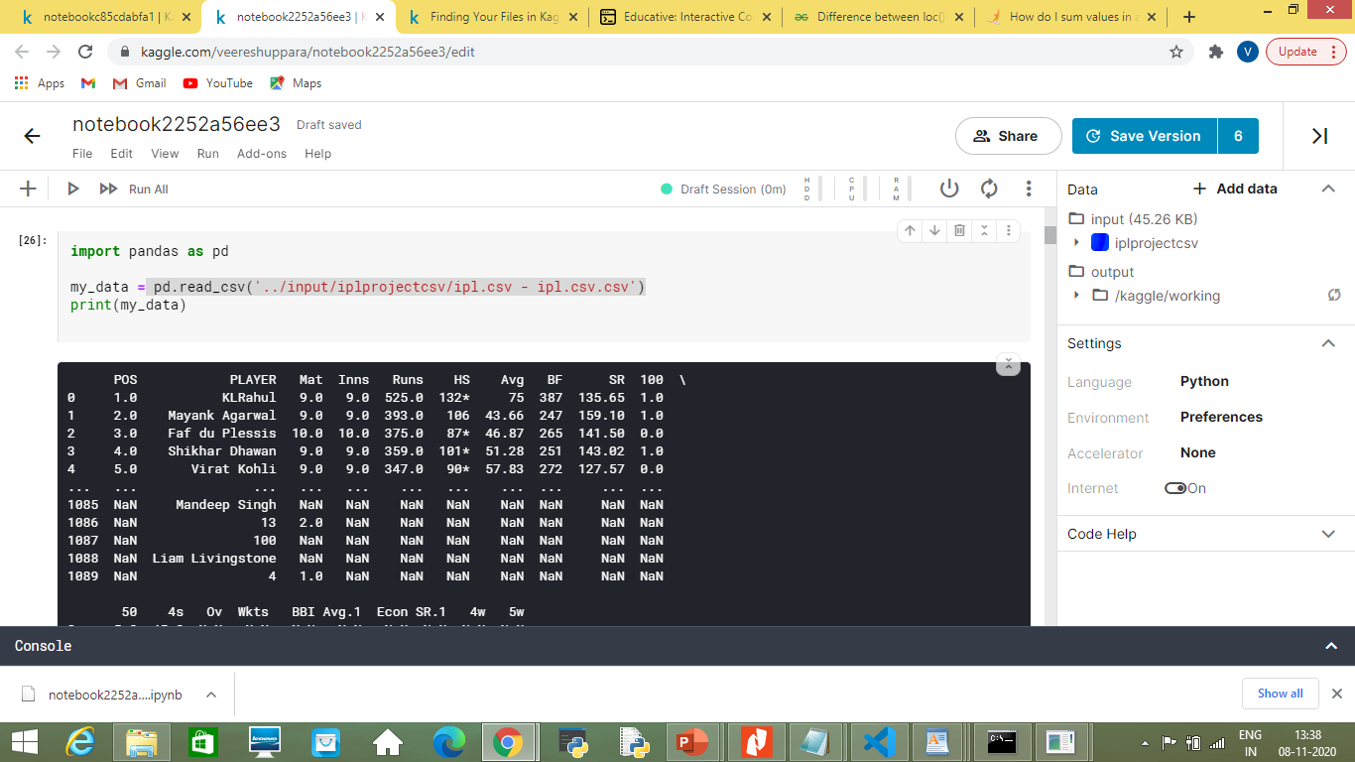

Slide 5
DATA CLEANING
We have dropped observations where in
Players name is empty or missing or has some other value which is not of string type.
The ‘Mat’ column has the value-’NaN’
We have used the ‘fillna()’ method to fill majority of the null values.
Other imputation method used:MEAN,QUANTILE,MEDIAN,MODE,loc() method available in the pandas module which helps us select specific rows from the data set.

Slide 6
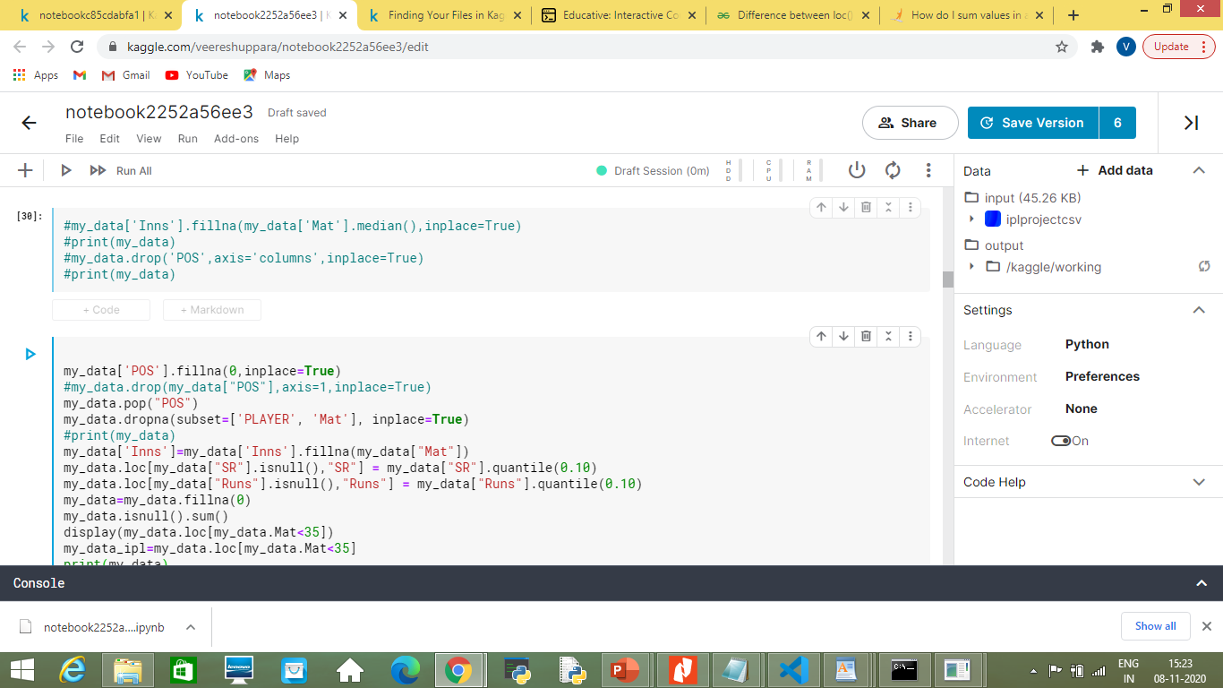

Slide 7
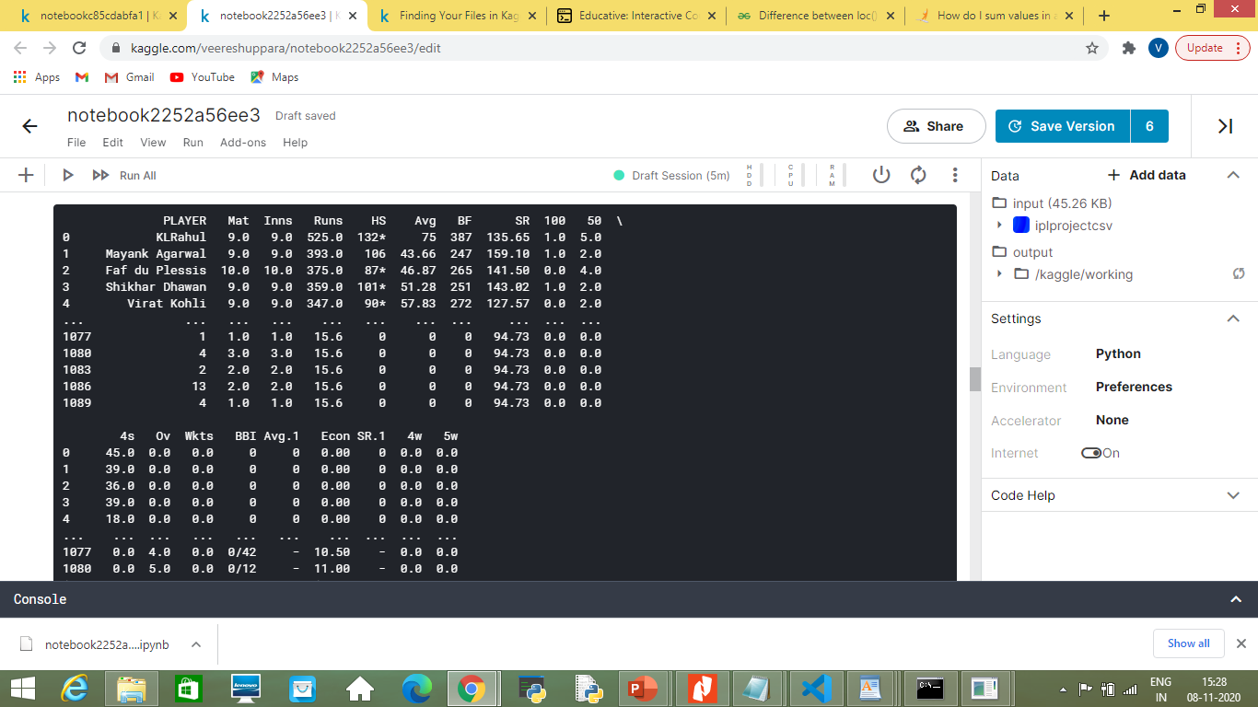
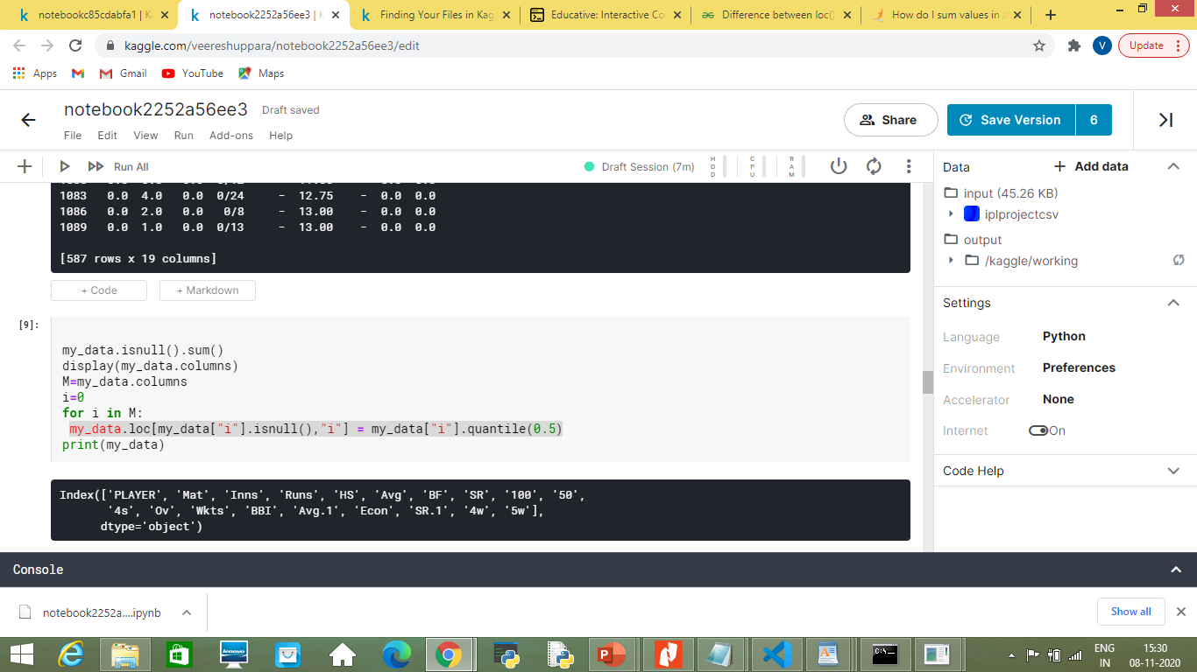

Slide 8
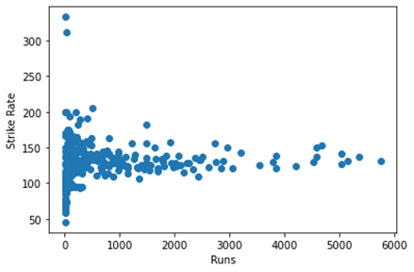
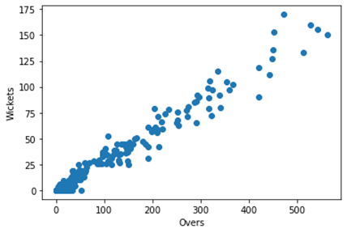
Various Ways To Visualize The Data
Scatter plot

Slide 9
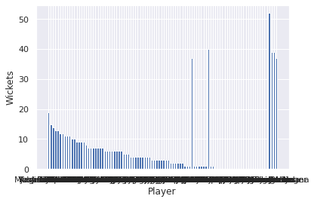
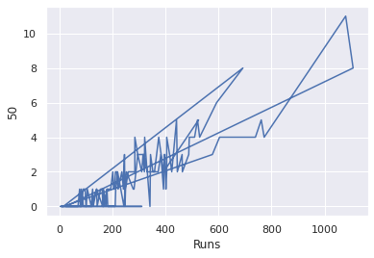
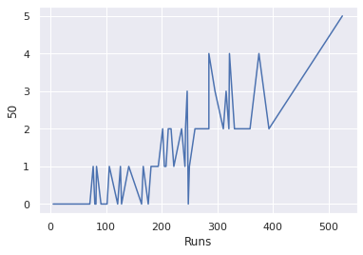
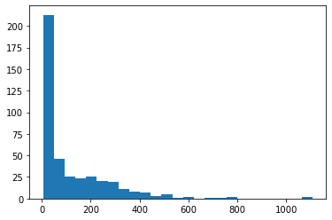

Slide 10
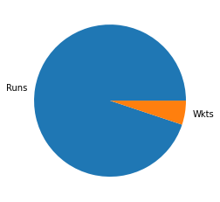
PIE CHART

Slide 11
Hypthesis Testing
Statement:A bowler who is capable of picking wickets can get a 5w(5-wicket haul).

Slide 12
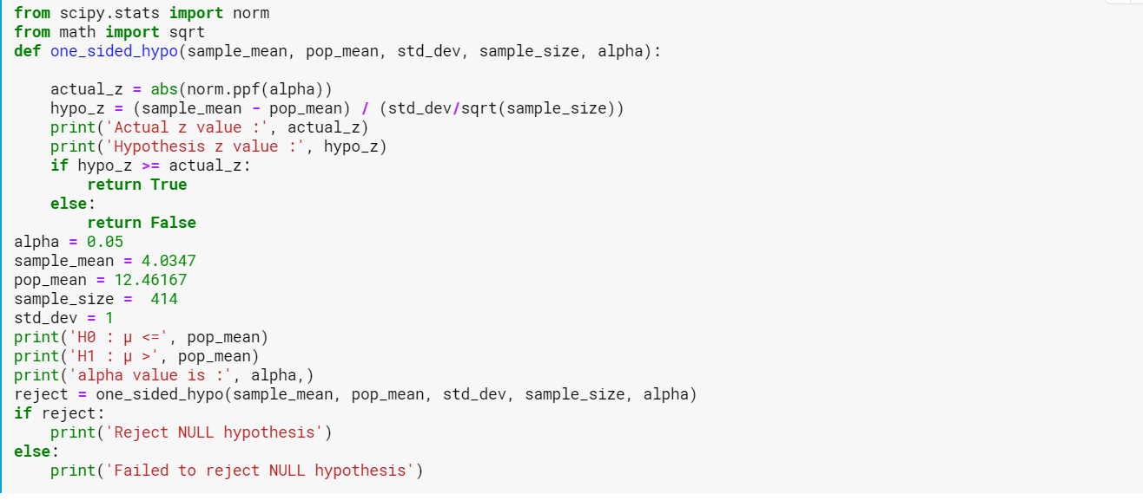
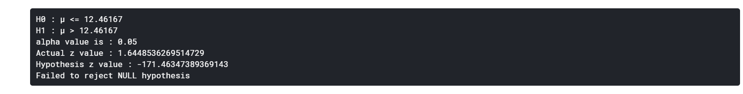

Slide 13
Correlation :
1} Correlation is relationship between columns or attributes.
2}We have used heat map to check for correlation.

Slide 14
