Slide 1
RESUME CLASSIFICATION
Team members:
Ms. Sheetal Kashyap
Mr. U.Vinod
Mentor Name: Mr. Rajasekhar

Slide 2
The document classification solution should significantly reduce the manual human effort in the HRM .It should achieve a higher level of accuracy and automation with minimal human intervention.
Business Objective

Slide 3
PROJECT ARCHITECTURE
Collection of Data
Business Understanding
Exploratory Data Analysis(EDA)
Deployment
Model Building

Slide 4
Data Set Details
After Extracting and Modifying the Dataset, given data contains a total of 5 features and 79 rows . By using features we will get the desired resume sample (person) for the software organization/Company.

Slide 5
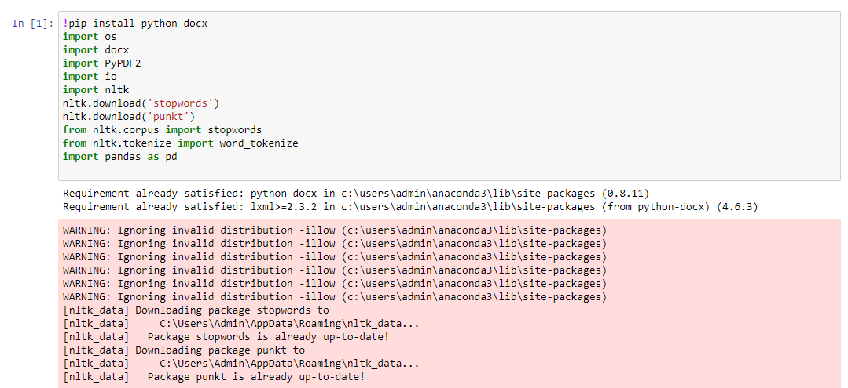
We have to import these libraries to work on the resume classification dataset.

Slide 6
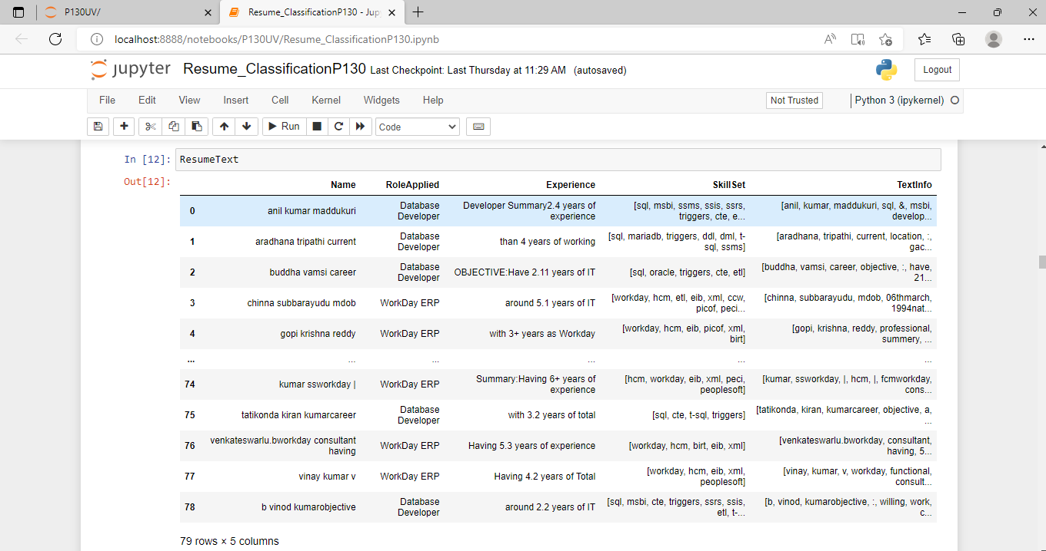
The Dataset contains 79 rows and 5 columns
Features are Name, Role Applied, Experience, SkillsSet and Textinfo .

Slide 7
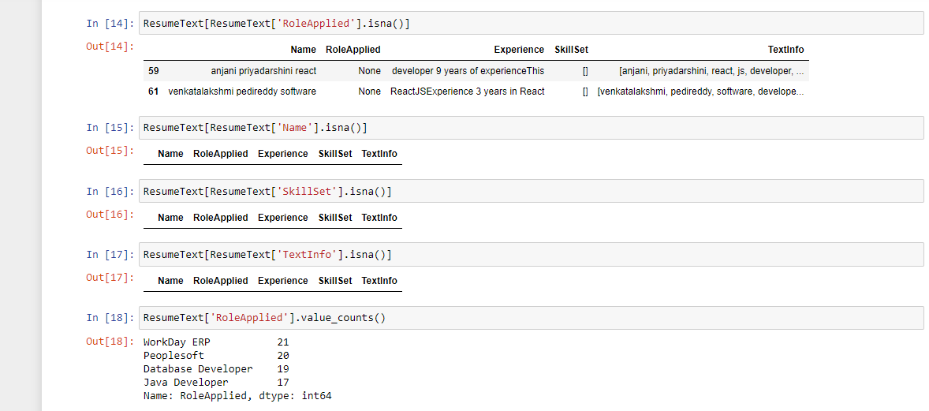
* In this ResumeText RoleApplied feature has two null values by using isnull we removed the null values in the dataset.

Slide 8
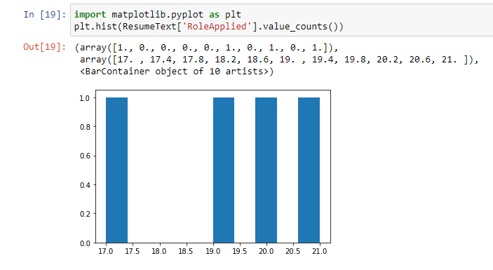
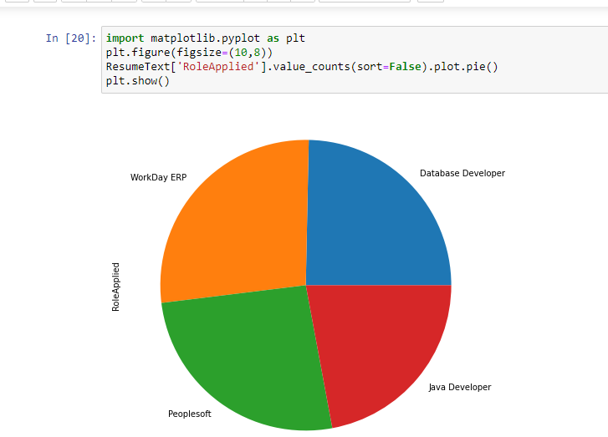
EDA Visualization
By using Histogram roleapplied feature is displayed to check the job types.
By using Pie chart roleapplied feature is displayed to visualize the job roles.

Slide 9
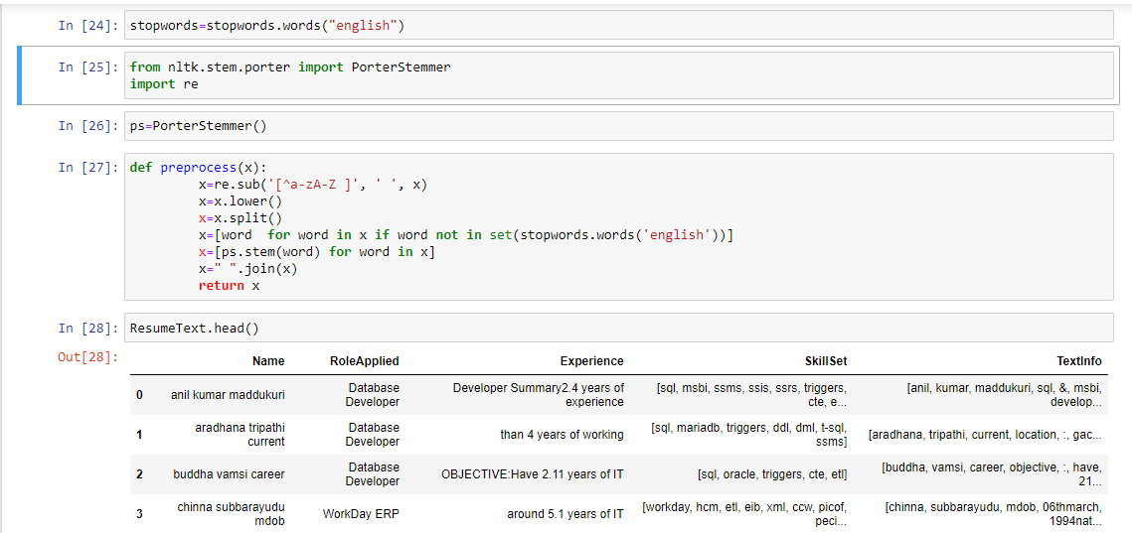
Using PorterStemmer algorithm
The Porter stemming algorithm (or 'Porter stemmer') is a process for removing the commoner morphological and inflexional endings from words in English.

Slide 10
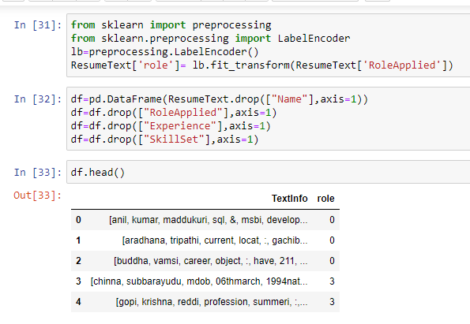
Important Data Preprocessing Techniques
Data Cleaning.
Dimensionality Reduction.
Feature Engineering.
Sampling Data.
Data Transformation.
Imbalanced Data.
In natural language processing, text preprocessing is the practice of cleaning and preparing text data. NLTK and re are common Python libraries used to handle many text preprocessing tasks.

Slide 11
Text preprocessing:
In NLP, text preprocessing is the first step in the process of building a model. The various text preprocessing steps are: Tokenization, Lower casting, Stop words removal, Stemming, Lemmatization.
LabelEncoder:
The LabelEncoder is class of sklearn library the class encoded variable digits.
The ML is between the labelEncoder and one of Hot Encoder.
The encoders are scikit library in python and used to convert the data and text data.

Slide 12
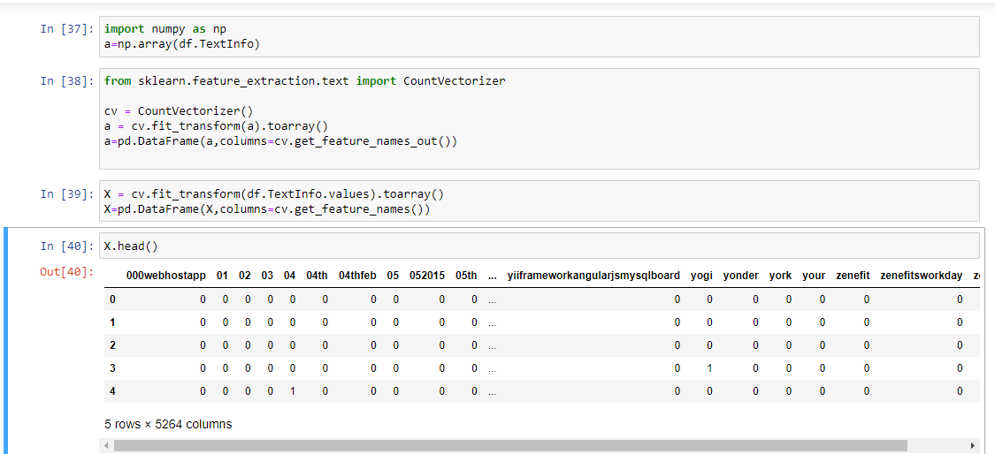
Model Building
CountVectorizer is a great tool provided by the scikit-learn library in Python. It is used to transform a given text into a vector on the basis of the frequency (count) of each word that occurs in the entire text.
Scikit-learn's CountVectorizer is used to convert a collection of text documents to a vector of term/token counts. It also enables the ​pre-processing of text data prior to generating the vector representation.

Slide 13
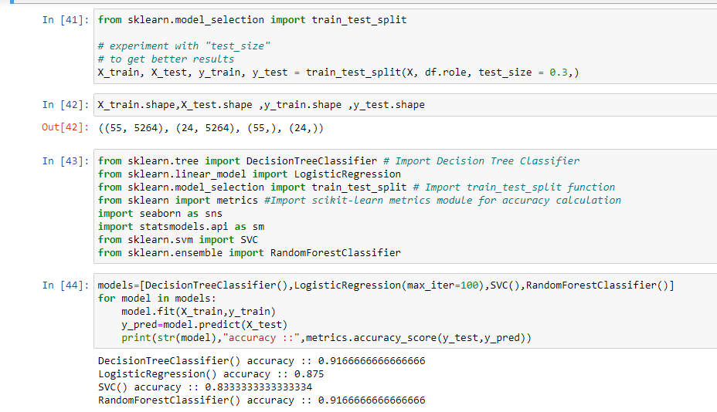
Here, we have taken Model building algorithms such as DecisionTreeClassifier, LogisticRegression, SVM, RandomForest.
Among these algorithms, we have taken RandomForest Classifier for ModelBuilding .
91% accuracy is achieved by using the model RandomForest Classifier.

Slide 14
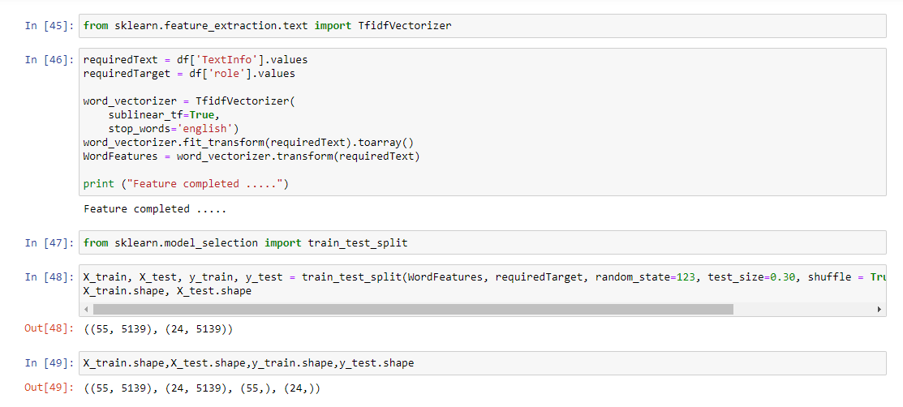
TF-IDF is better than Count Vectorizers because it not only focuses on the frequency of words present in the corpus but also provides the importance of the words.
We can then remove the words that are less important for analysis, hence making the model building less complex by reducing the input dimensions.

Slide 15
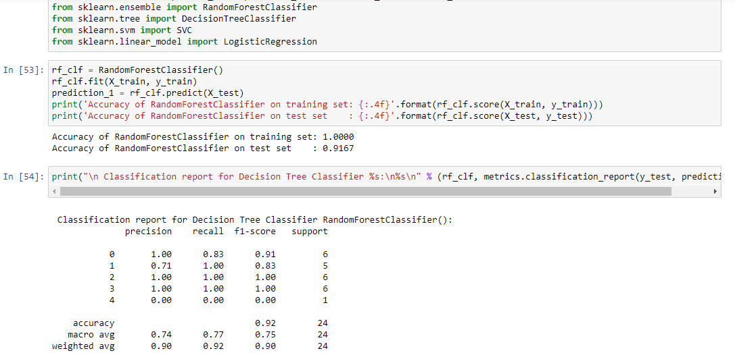
By using Tfidfvectorizer, which is better than countvectorizer, we have built a RandomForest Model.
Precision – 1.0
Recall -- 0.83
Accuracy – 0.92

Slide 16
Deployment
After the model building and Evaluation process , we have deployed the code using “Streamlit”.
We have selected the best model(RandomForest Classifier) and used in our deployment Phase.

Slide 17
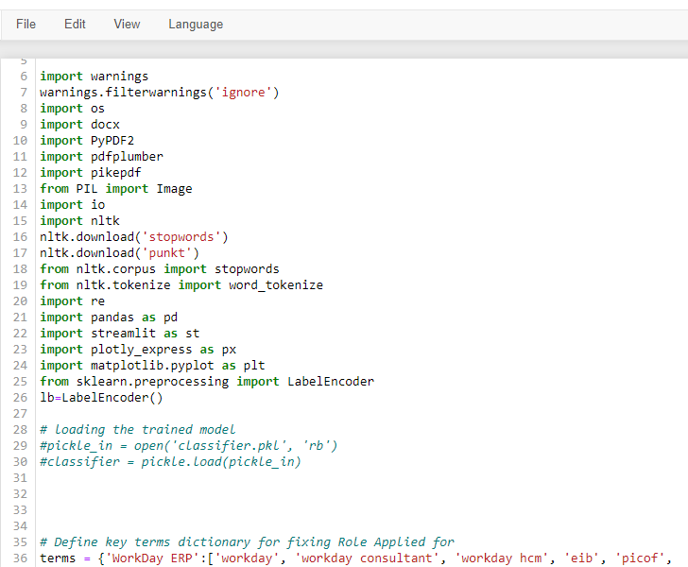
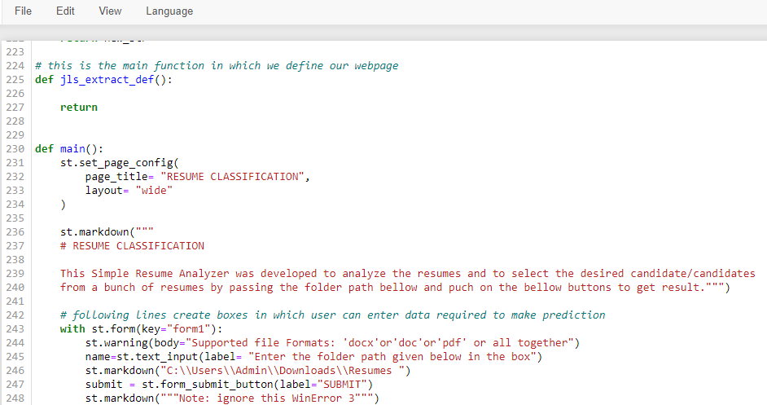

Slide 18
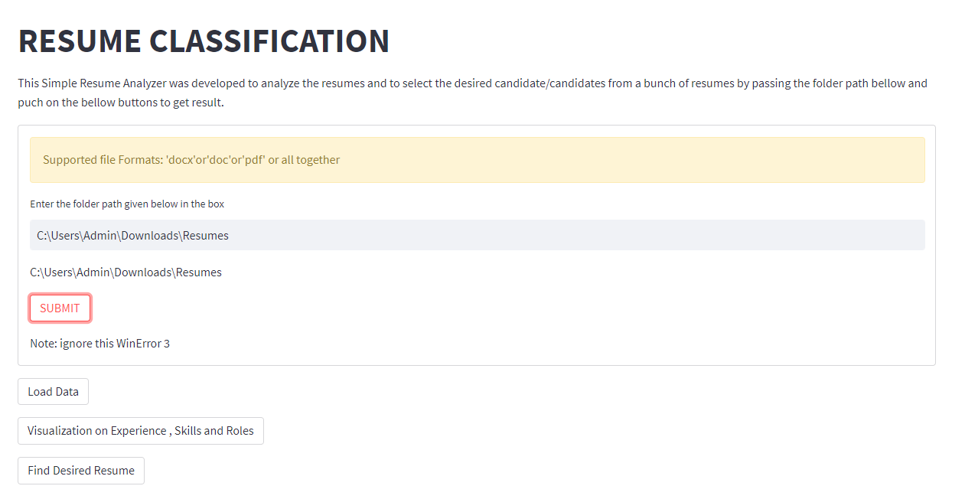

Slide 19
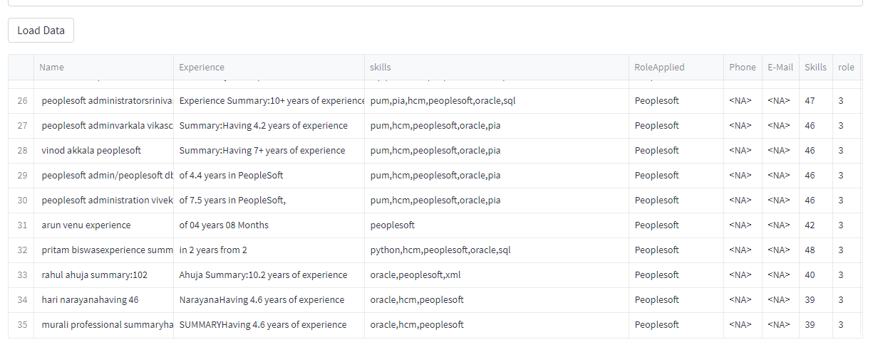
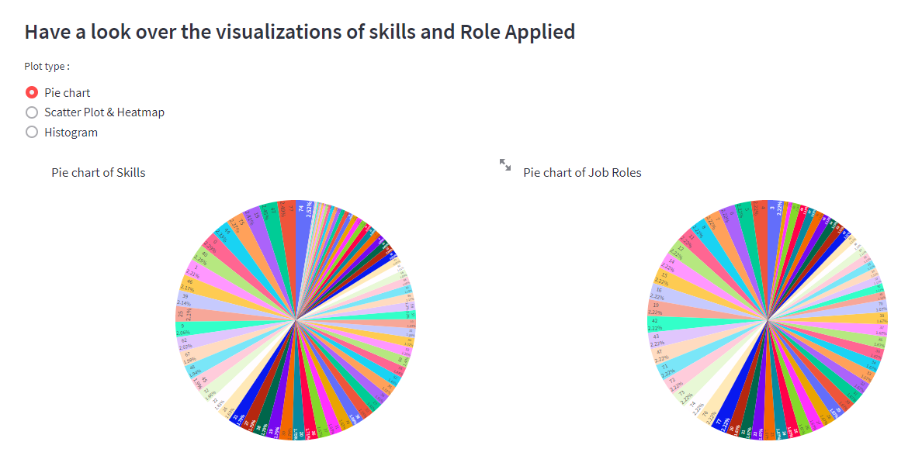

Slide 20
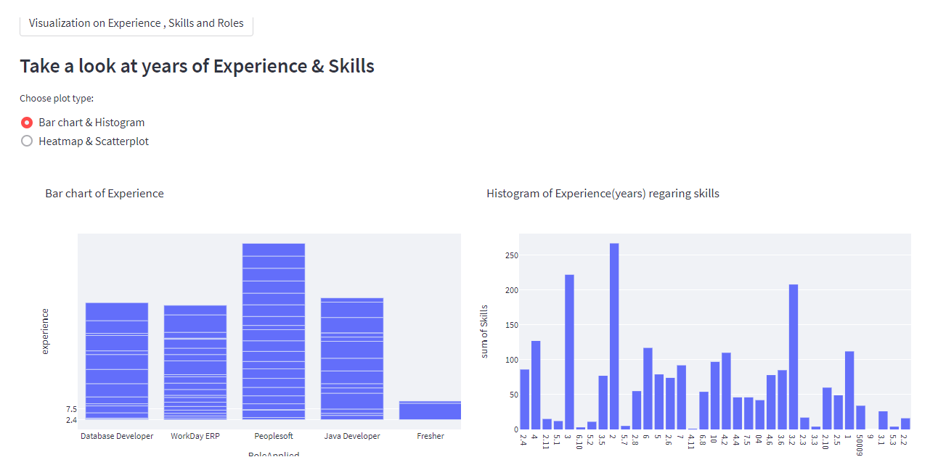
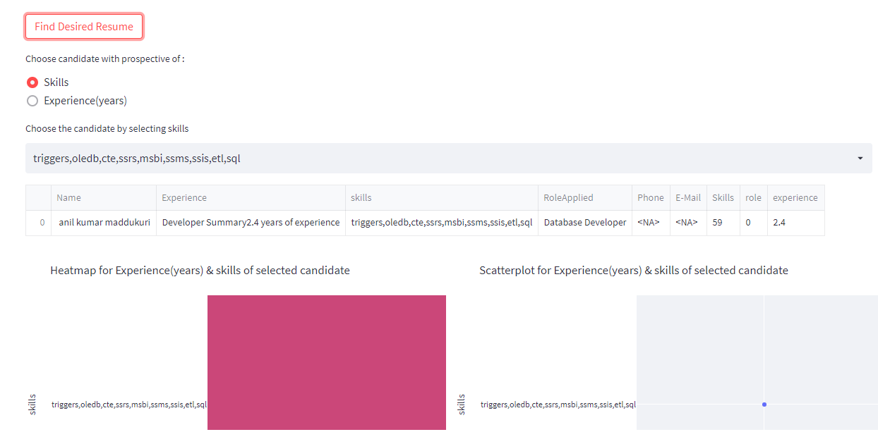
Click here

Slide 21
Thank You

