Slide 1

Lab 3: Decision Making
BME 121, Fall 2016
Rasoul Nasiri

Slide 2
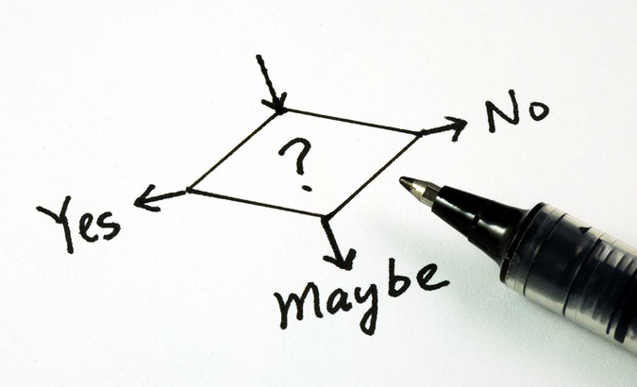
Topics
Logical variable and comparisons
More example with If-else
Logical operators
Switch-case statement
Random generator
Programming Assignment 2

Slide 3
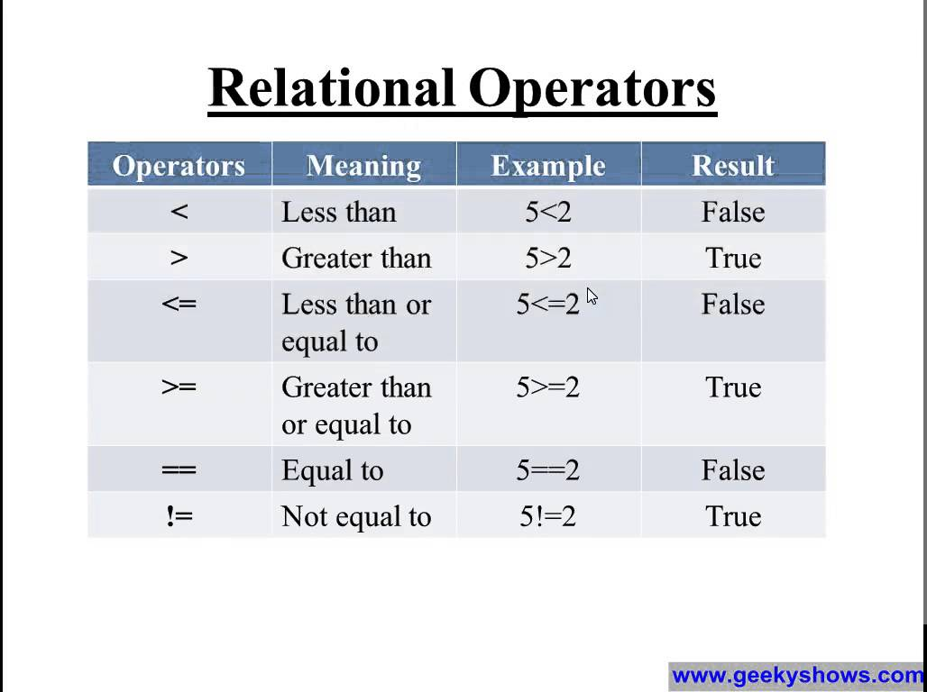
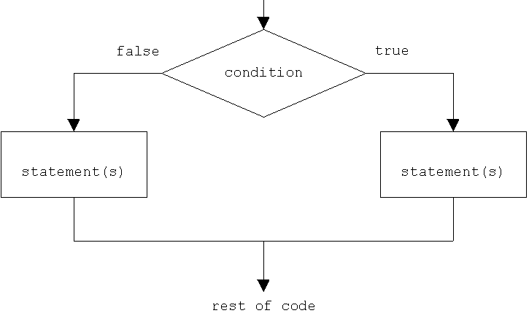
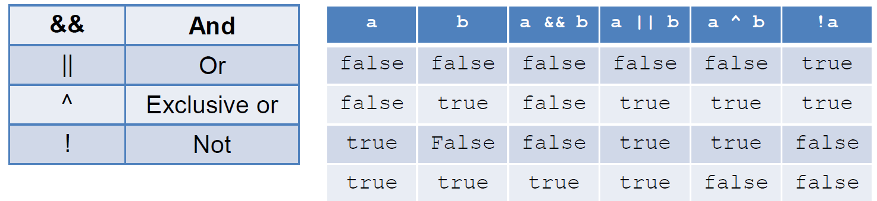
Review of Boolean variable

Slide 4


Practice:
Write a program to map a score to grade letter
Score is an integer between 0 to 100
Score intervals corresponding to grade letters:
A: [80-100],
B: [70,80),
C: [60, 70),
D: [50, 60),
F: [0,50).
Code: gradeLetter.cs

Slide 5
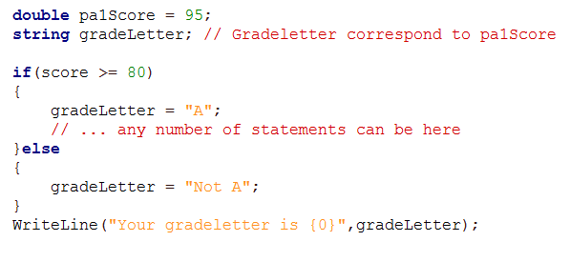
If, if-else, if-else-if: flow of the program execution
IF-else
95
1
2
3
4
5
6
7

Slide 6
If, if-else, if-else-if: flow of the program execution
IF-else
75
95
1
2
3
4
5
7
1
2
3
4
5
6
7

Slide 7
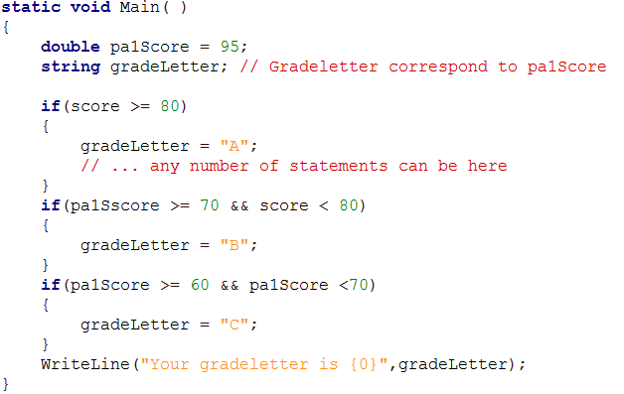
If, if/else, if-else-if: flow of the program execution
IF-IF-IF
95
1
2
3
4
5
6
7
8
All the conditions would be checked

Slide 8
If, if/else, if-else-if: flow of the program execution
IF-IF-IF: Program should check all the conditions
75
95
1
2
3
4
5
6
7
1
2
3
4
5
6
7
8

Slide 9
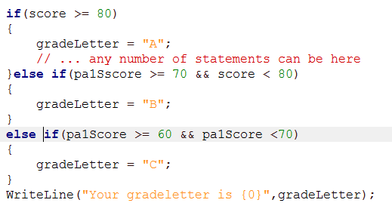
If, if/else, if-else-if: flow of the program execution
IF-Else-IF: Program should check all the conditions
75
95
1
2
3
4
5
6
1
2
3
4
5
6

Slide 10
Practice: Second Min
Write a C# program that finds the second minimum in a series of 10 numbers.
Ask the user to enter numbers one by one and at the end you have to display second smallest.
You don’t need to keep all the numbers, just keep 2 smallest ones.
Code: secondMin.cs

Slide 11
Practice
Write a program that find the area of a basic geometric shape
Possible shapes: Rectangle, Square, Circle
Area
Rectangle: w*l
Circle: π*r²
Square: x²
Design a method for calculating area of each shape
Use if statement in your Main method to call true method depend on the user request. You will ask user for the parameters you need in each function.
Code: area.cs

Slide 12
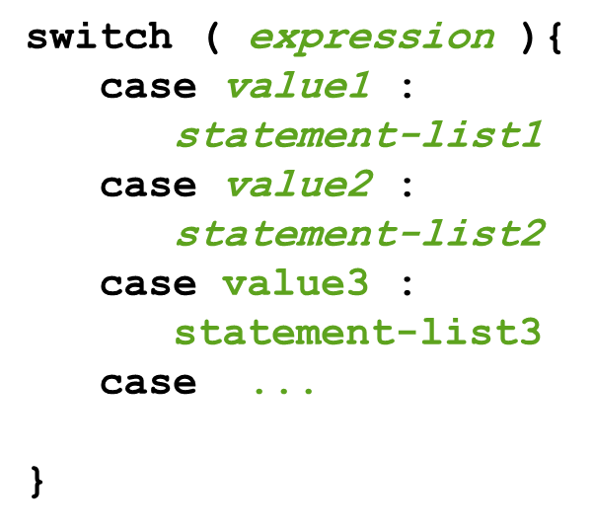
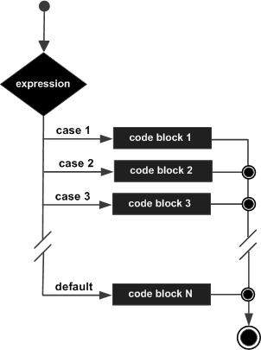
Switch statement
Another tool for making decision in C# is switch statement.
The general structure of switch statement is show in c# syntax
The expression in switch statement is evaluated.
There are different cases that would be compared with the expression value.
The code block for the case that exactly match with the expression value would be executed.
If there is no exact match, then the default code block would be selected

Slide 13
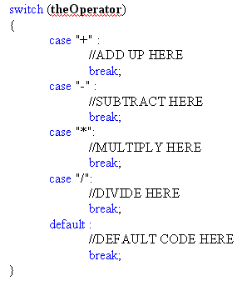
Switch statement
You could implement your calculator with switch-case statement as well similar to the bellow code snippet

Slide 14

Practice
Write a C# method that receive the name of month and return the number of days we have in that month.
Call this method from Main method to find the number of days for the month user defined.
Jan (31), Feb(28), Mar(31), Apr(30), May(31), Jun(30), Jul(31), Aug(31), Sept(30), Oct(31), Nov(30), Dec(31).
Code: month.cs
Notes:
Combine cases

Slide 15

Practice
Write a C# program that receive the name of the month and day of your birthday and return the number of days from the beginning of year to your birthday.
Using switch-case statement to switch to a specific month if you need any calculation or info for each month and put info/calc in corresponding code block.
Jan (31), Feb(28), Mar(31), Apr(30), May(31), Jun(30), Jul(31), Aug(31), Sept(30), Oct(31), Nov(30), Dec(31).
Code: birthday.cs

Slide 16
Switch-case or If-else statement?
Switch case is suitable for the case that we have countable and discrete possible cases.
If statement is more general for making any conditional statement with complex relational statements or any combination of relations.
Sample of cases that if statement is better or the only way:
If you are working with large number of numbers and you have class of them that can be detected by a conditional statement
e.g. you want to do an action for odd numbers and another action for even
If you faced with the intervals in most cases if-else should/is better to be used.
e.g. grade letter correspond to score code we had in this session

Slide 17

Break …

Slide 18
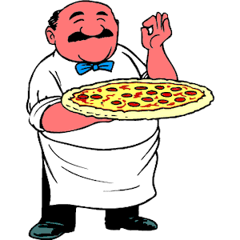
Practice: Ordering your pizza
Your friend is working in a fast food and he/she asked you to write a program for ordering pizza by customers.
Your program gives customer different option and return the final price that should be paid(price +HST).
You have different options for a pizza:
Type: Veggie(Basic(+$0)/Mediterian(+$1)), Pepperoni(Basic(+$0)/Special(+$2)), Italian(Basic(+$0)/Super(+$2))
Size: Small(+$0), Medium(+$2), Large(+$4), Family(+$5)
Cheese type: Mozzarella, Feta(+$2), Cheddar
Additional topping: GroundBeef(+$3), Hawaiian(+$2), BBQChicken(+$2), Corn(+$1), Spinach(+$1), Broce(+$1)
The basic price is $8 and all the above ones are additional
You may ask customer for optional TIP ☺
Code: pizza.cs

Slide 19
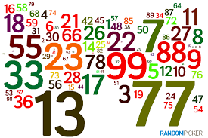
Practice: Guess the random number
Write a C# program that generate a random number between 1-100 and let the user should guess that one in 5 steps.
For random number generation search class Random in the Internet for MSDN documentation or other web pages you may find helpful (stackoverflow, …)
You will not show the random number.
Any time you ask user for the new guess,
If the guess is true you can show congratulation message. Otherwise you can hint user that the random number is greater/smaller than the guess.
If user couldn’t guess, you just show the number at the end.
Code: randomGuess.cs

Slide 20
Practice: Guess the random number
Add difficulty level to your random guess program.
In this case you can consider 4 different difficulty
Easy: interval [1,10] and 4 steps,
Moderate: interval [1, 100] and 6 steps,
Hard: Interval [1 100] and 4 steps.
How many guess we need to find exactly such random numbers???
Code: randomGuess.cs

Slide 21
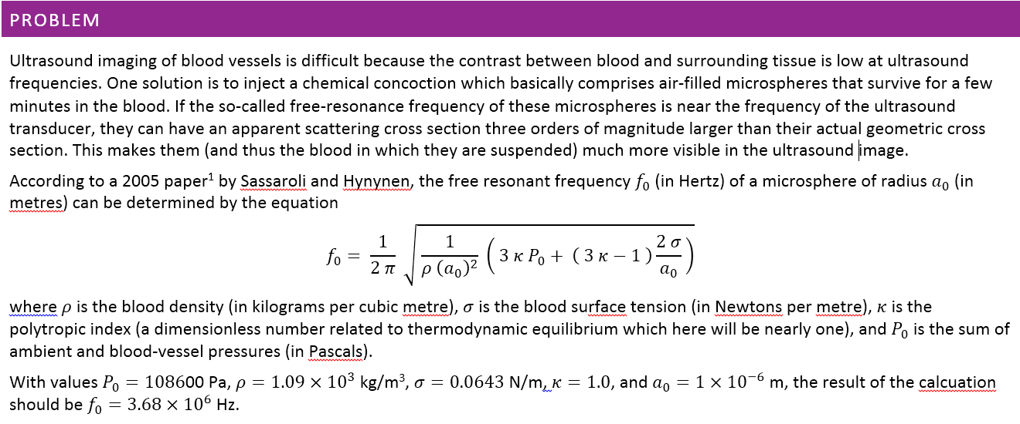
PA 1

Slide 22

The end …

